Slide 1


Head Start A to Z, 2.0:
Training & Professional Development
Notes:
Slide 1
Facilitator Notes:
Welcome participants to the session and introduce yourself. If you have co-facilitators, invite them to introduce themselves, too. Begin the session with an introductory activity to create a positive group climate and begin the engagement process.
Say to Participants: "The Head Start A to Z materials for leaders have been updated to align with the revised Head Start Program Performance Standards, or HSPPS, that became effective Nov. 7, 2016.
"Head Start A to Z, 2.0, emulates the concept of the 'learning organization.' We recognize its key characteristics, including a supportive learning environment, openness to new ideas, and time dedicated for reflection. Each participant has an important role to play in the success of this session. Those with experience remind us where we've come from and what we must do to maintain our identity and uniqueness. New members bring a fresh perspective and remind us what we must do to prepare for the future. All roles are essential for Head Start to be a learning organization that continues to grow and flourish.
"These modules are most successful when they help us share the best of what we have to offer with a strength-based focus. As you engage in this session, we hope you will support one another in the learning process by generously sharing your knowledge, experience, and perspectives."

Slide 2
Learning Objectives
As a result of this session, participants will:
    Examine Head Start requirements and standards for training and professional development systems
    Identify strategies for developing a meaningful and responsive system of professional development
    Develop a working understanding of the relationship between professional development and continuous improvement
Notes:
Slide 2
Facilitator Notes:
Distribute the Reflective Practice Tool handout. Review the following learning objectives with participants, reading from the slide or from the bulleted list below.
Say to Participants: "We want to focus for a moment on the learning objectives for this module. As a result of this training, you should be able to:
Examine the Head Start standards and requirements for training and professional development systems
Identify strategies for developing a meaningful and responsive system of professional development
Develop a working understanding of the relationship between professional development and continuous improvement."
Ask if participants have any expectations for learning they would like to add. Write their responses on a flipchart.
Say to Participants: "For the purpose of this session, we are addressing the professional development of staff. However, it is important to remember that regulations do require training and technical assistance, or T/TA, plans to include training for Policy Councils and governing bodies or Tribal Councils."
Direct participants' attention to the Reflective Practice Tool handout.
Say to Participants: "At the end of our session, you will be asked to use this Reflective Practice Tool to write down some key thoughts from your learnings. We encourage you to jot down preliminary ideas as we move through the session."

Slide 3
Six Guiding Principles for A to Z Trainings
1
3
4
Successful programs
are learning organizations.
Sound decision-making is informed by quality data.
Relationship-building is at the heart of transformational leadership.
2
The effective delivery of services grows out of strong systems.
5
6
School readiness
for all is our driving goal.
Culturally and linguistically diverse organizations rely on intentional, specific, and coordinated approaches.
Notes:
Slide 3
Facilitator Notes:
Distribute the Head Start A to Z, 2.0, Guiding Principles handout.
Say to Participants: "Head Start A to Z, 2.0, is based on six guiding principles. The guiding principles have been aligned with the HSPPS.
"Head Start and Early Head Start directors, managers, and T/TA staff come from all walks of life and employment experiences. Yet, we all share an enduring commitment to providing comprehensive, high-quality early childhood experiences. We also recognize that to promote school readiness and be responsive to the needs of our communities, we must engage in ongoing professional development. Head Start A to Z, 2.0, is designed to provide that support. It offers insight and strategies into the systems that characterize effective Head Start programs. These units of study are built on the following guiding principles."
Review the six guiding principles of Head Start. Each one is described below.
Successful programs are learning organizations. Head Start is a dynamic organization with high expectations, values, and traditions. In addition, programs are constantly responding to changing community needs and evolving best practices. To cultivate a learning organization that thrives in this environment, program leaders must support all staff in becoming lifelong learners who embrace challenges as opportunities for collective problem-solving and innovation.
The effective delivery of services grows out of strong systems. Program leaders must regularly refine their program's management and fiscal systems. To target community needs and deliver comprehensive services, leaders need to understand systems thinking and view their program through a systems lens. They also need to recognize the relationship between systems, services, and child and family outcomes.
Sound decision-making is informed by quality data. Used in planning, evaluating, and communicating information, quality data is integral to cultivating a culture of continuous quality improvement. To this end, it is critical for leaders to establish efficient processes for collecting, aggregating, analyzing, and synthesizing data. This will involve training teachers, home visitors, family advocates, health services workers, and other staff on how to integrate data management into their day-to-day work.
Relationship-building is at the heart of transformational leadership. Robust Head Start communities build on authentic relationships among all of their stakeholders, from children, families, staff, and managers to governing bodies, Tribal Councils, and Policy Councils. To cultivate these communities, leaders need to communicate effectively, empower others, foster team-building, and nurture collaboration.
School readiness for all is our driving goal. Head Start leaders play an integral role in conceiving and promoting an inclusive vision of school readiness. To support children with diverse abilities and backgrounds to develop the skills, knowledge, and attitudes needed to be successful in school, effective leaders must stay informed on developments in early childhood education. They also must actively collaborate with parents, staff, governing bodies, local education agencies, and community partners in embedding these best practices into services and programming.
Culturally and linguistically diverse organizations rely on intentional, specific, and coordinated approaches. To ensure the full and effective participation of dual language learners and their families, Head Start leaders must coordinate program-wide plans that involve all service areas and multiple staff. This includes staying connected to the communities served, implementing targeted strategies, and articulating how programs and services address specific linguistic and cultural needs.
Say to Participants: "In addition to anchoring the content in Head Start A to Z, 2.0, you will revisit these guiding principles in all of the trainings offered by the Office of Head Start's National Center on Program Management and Fiscal Operations."

Slide 4
Icebreaker: Personal Experience
Share one personal past professional development opportunity and how
it strengthened your role in your organization.
Notes:
Slide 4
Facilitator Notes:
Have flipchart paper ready. Direct participants' attention to the icebreaker slide.
Say to Participants: "Take three minutes to think about a professional development opportunity you have participated in and how it strengthened your role in your organization.”
After three minutes, ask participants to share their experiences with their tablemates. Ask for volunteers from each table to report to the whole group.
Listen for the following types of responses:
The professional development opportunity challenged me to expand my knowledge of a particular subject.
It increased my skill set.
It prepared me for future positions.
Write down the responses on a flipchart.
Say to Participants: "As you reflect on the experiences we've just heard about, think about how they can help you design or improve your program's professional development system."

Slide 5
Key Definitions
Notes:
Slide 5
Facilitator Notes:
Distribute the What's the Difference? handout and keep the answer key for yourself.
Say to Participants: "Professional development is the continuous process of acquiring new knowledge, skills, and abilities, along with experience and competencies, that relate to one's career, job responsibilities, or work environment.
"As you can see in the image on the slide, professional development covers a broad spectrum of activities and resources. Professional development opportunities can range from formal college coursework to workshops and conferences. They can also include a variety of learning opportunities that occur on the job.”
Ask participants to take a few minutes to complete the What's the Difference? handout. When everyone has finished, review the correct answers using the answer key.

Slide 6
Training is…
"A learning experience, or series of experiences, specific to an area of inquiry and related set of
skills or dispositions, delivered by a professional with subject matter and adult learning knowledge and skills."
Source: ECE Professional Development: Training and Technical Assistance Glossary, NAEYC, NACCRRA
Notes:
Slide 6
Facilitator Notes:
Read the slide to participants, noting that the definition comes from the National Association for the Education of Young Children (NAEYC) and the National Association of Child Care Resource and Referral Agencies (NACCRRA).
Say to Participants: "In other words, as noted on the handout you just completed, training involves an expert working with individuals to transfer certain types of learning so the trainees grow and refine their skill sets. Next let's look at the definition of TA."

Slide 7
Technical Assistance (TA) is…
"The provision of targeted
and customized supports
by a professional with
subject matter and adult
learning knowledge and
skills with the goal of
developing or strengthening processes, knowledge application, or implementation of services by recipients."
Source: ECE Professional Development: Training and Technical Assistance Glossary, NAEYC, NACCRRA
Notes:
Slide 7
Facilitator Notes:
Read the slide to participants, noting again that the definition comes from NAEYC and NACCRRA.
Say to Participants: "In addition to the definition from the slide, we need to also note that TA helps professionals translate theories and information into practice.
"Mentoring, coaching, consultation, advising, and peer-to-peer strategies are types of professional development that can be discrete processes or used as part of education or training programs.
"To be effective, TA should be embedded in the recipient's broader professional development plan. It should also be relationship-based. TA should benefit everyone involved by building positive and respectful relationships.
"Be aware that TA:
Will vary greatly in intensity and duration depending on needs, responses, and resources
May be delivered:
Face-to-face
Remotely
In hybrid approaches that utilize both face-to-face and technology-based interactions."
For these super-indented bullet points are usually hollow round circles, right?

Slide 8
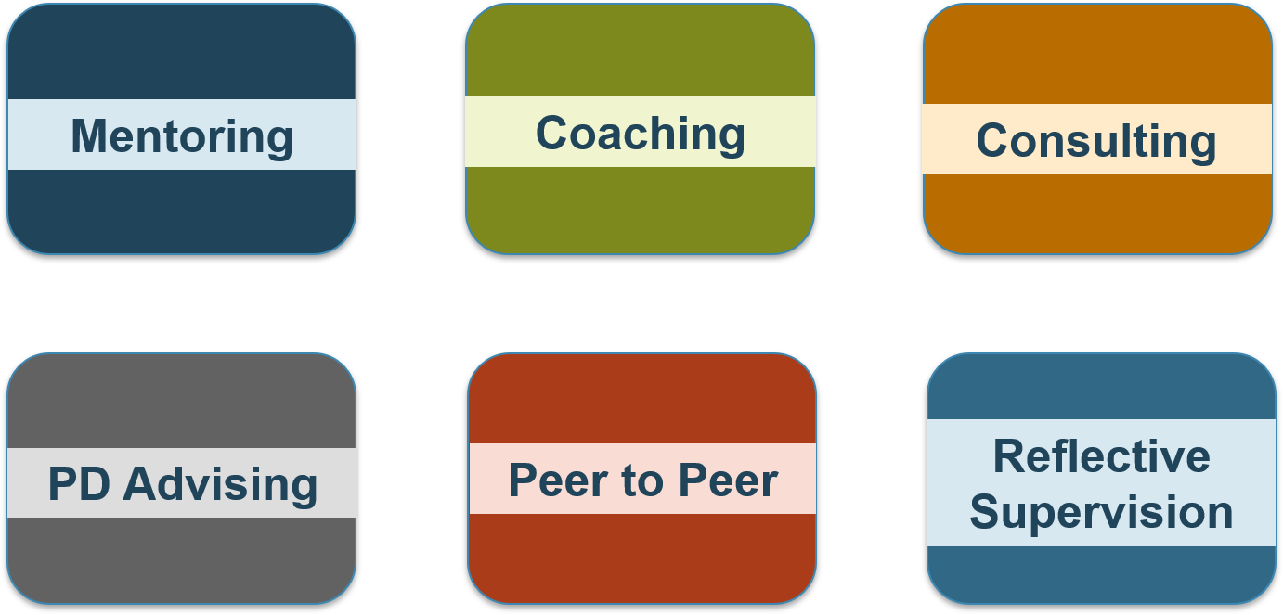
Technical Assistance Approaches
Source: ECE Professional Development: Training and Technical Assistance Glossary, NAEYC, NACCRRA
Notes:
Slide 8
Facilitator Notes:
Distribute the Professional Development Approach Scenario handout.
Say to participants: "Designing a professional development system is a complex and challenging process.
"Programs provide many different supports to meet individual professional development needs. Note the various approaches to TA displayed on the slide. Let's go through them one by one.
Mentoring is a relationship-based process between colleagues in similar professional roles, with a more experienced individual who has adult learning knowledge and skills—the mentor—providing guidance to a less experienced protégé, or mentee. Mentoring is intended to increase an individual's personal or professional capacity, resulting in greater professional effectiveness.
Coaching is a relationship-based process led by an expert with specialized and adult learning knowledge and skills, who often serves in a different professional role from the recipient. Coaching is designed to build capacity for specific professional dispositions, skills, and behaviors. It's focused on goal-setting and achievement for an individual or group.
Consultation is a collaborative problem-solving process between an external consultant and an individual or group. The consultant will have specific content expertise and experience in teaching adults. Consultation might address a particular topic or help assess and resolve an issue related to the organization as a whole, a program, the staff, or a family or child.
Professional development advising is sometimes referred to as career or professional development counseling. It's a one-on-one process through which an advisor offers information, guidance, and advice to an individual about professional growth, career options, and pathways to obtain or meet required qualifications.
Peer-to-peer technical assistance fosters the development of relationship-based learning and support communities among colleagues who are in similar roles. It is based on the premise that a significant expert knowledge base exists in the field and peers who have solved challenges on the ground have developed tools and strategies that can be shared with their colleagues. Regular and structured group peer-to-peer TA may be called 'communities of practice' or 'professional learning communities.’
Reflective supervision is the practice of meeting regularly with staff members to discuss their experiences, thoughts, and feelings about their work.”
Introduce the next activity by telling participants to take about 10 minutes to review the Professional Development Approach Scenario handout. Then, ask groups to discuss how each of the TA approaches described in the handout has worked to support staff and strengthen their program. Encourage participants to share TA approaches they have used in their own programs. After another 10 minutes, ask each table to share an interesting insight from their discussion.
If you prefer a more interactive activity, post six flipchart sheets around the room, each labeled with the name of one of the TA approaches from the handout. After participants have reviewed the handout, ask each person to walk to the TA approach they use most often. Ask the groups congregating at each flipchart sheet to share how they've used that approach, what about it tends to work well, and what does not work well. Next, ask participants to move to the approach they have used least often and have a similar discussion.

Slide 9
Implementation Considerations
Reflects evidence-based
best practices
Considers principles of
adult learning
Promotes linkages between research, theory, and practice
Responsive to each learner's background, experiences,
and professional goals
Includes resources to ensure access for all
Source: ECE Professional Development: Training and Technical Assistance Glossary, NAEYC, NACCRRA
Notes:
Slide 9
Facilitator Notes:
Direct participants' attention to the slide.
Say to Participants: "All professional development, whether it involves formal education, training, or TA, should:
Be designed using evidence-based best practices
Be consistent with the principles of adult learning
Be structured to promote linkages between research, theory, and practice
Address the continuum of young children's abilities and needs
Respond to each learner's background, including their cultural and linguistic background and ability and the current context of the individual's role and professional goals
Include resources to ensure access for all
"Professional development is an opportunity for programs to flex their creativity.
Of course, ensuring access and implementation across your programs can be challenging. Demographics, changing communities, and multiple languages can create barriers, but they can also create new and exciting opportunities.”
Ask participants to share innovative ways their organization ensures access to professional development across its programs. Listen for the following:
Technology, such as webinars, Skype, or MyPeers
Communities of practice
Early Childhood Learning and Knowledge Center (ECLKC) website resources
Training materials translated from English to other languages
Ask participants how they make sure these training mechanisms are being accessed and are working well for staff.
For instance, participants may say they:
Follow up with a staff supervisor
Have created a feedback loop for staff to report back to leadership
Have made questions about individual professional development a standard part of reflective supervision
Remind participants that, regardless of their type, all professional development activities should be culturally and linguistically responsive to participants and address generational differences and preferences.

Slide 10
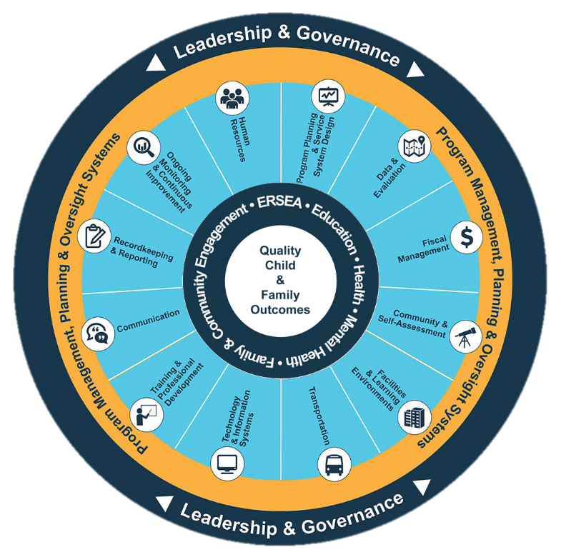
Head Start Management Systems Wheel
Notes:
Slide 10
Facilitator Notes:
Direct participants' attention to the slide. Introduce the Head Start Management Systems Wheel and briefly call out each of the management systems, seen in the aqua blue areas of the slide.
Say to Participants: "In Head Start, all of these systems work together to inform and influence the program's service delivery, which you see in the dark blue inner circle. When innovative leadership, strong management systems, and well-designed services are working together, we produce quality child and family outcomes."

Slide 11
Training & Professional Development
Emphasizes the importance of training and technical assistance (T/TA) for every grantee
Offers a range of instructional resources, including federal and regional T/TA staff
and key resources on the ECLKC website
Source: 45 CFR §1302.92(b)
Notes:
Slide 11
Facilitator Notes:
Direct participants' attention to the slide.
Say to Participants: "As you see on the slide, training and professional development is one of the 12 management systems. It prioritizes T/TA for all grantees and offers a robust array of resources to help provide that."

Slide 12
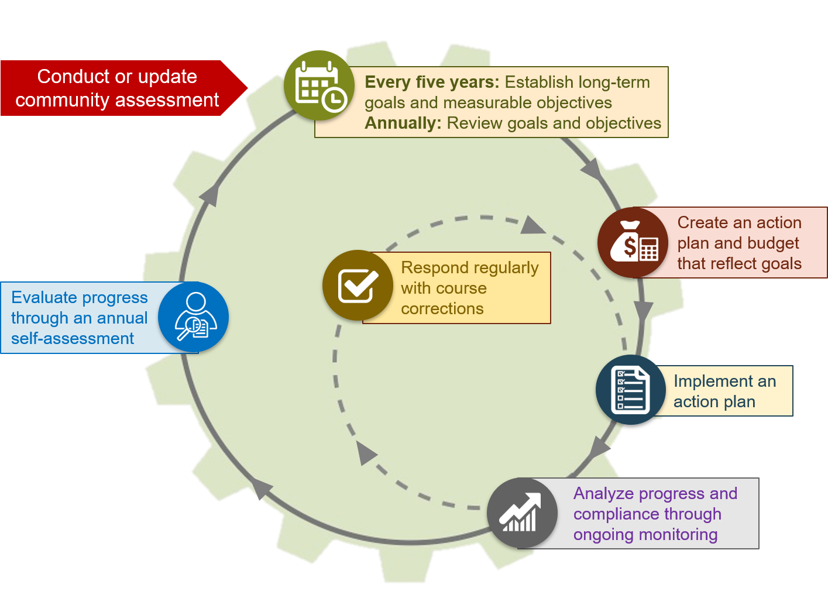
Program Planning for Continuous Improvement
Notes:
Slide 12
Facilitator Notes:
Direct participants' attention to the slide.
Say to Participants: "Let's spend a moment looking a little more deeply at how training and professional development fits into the program planning cycle, feeding continuous quality improvement. Take a close look at the slide, noting how the various activities work together."
Pause a moment.
Say to Participants: "As you reflect on your program's training and professional development system, ask yourself this overarching question: Are our training and professional development activities helping us move our Head Start program from compliance to excellence?"

Slide 13

Requirements
Notes:
Slide 13
Facilitator Notes:
Distribute the Training and Professional Development Regulations, 45 CFR §1302.92 and Training and Professional Development: Understanding the Requirements handouts. Keep the answer key for yourself. Deliver the following material in the form of a mini-lecture.
Say to Participants: "Obviously, our professional development programs need to be aligned with state and federal requirements, including the HSPPS. Throughout this presentation, we're going to be looking at what the Performance Standards require.
"HSPPS 45 CFR §1302.92 states that a program must establish and implement a systematic approach to staff training and professional development. The purpose is to assist staff in acquiring or increasing the knowledge and skills they need. Programs must also provide appropriate T/TA to the members of the Policy Council and governing body or Tribal Council. The purpose in this case is to ensure that these members are able to understand the information they receive so they can effectively oversee Head Start programs.”
Ask participants to take five minutes to scan the regulations handout and to fill in the blanks on Understanding the Requirements. After five minutes, read the statements from the handout one at a time and ask participants to share their answers with the group. Use the answer key to provide and reinforce correct answers.

Slide 14
Paint a Data Picture
How do you use data to inform
your program-wide coordinated approach to training and professional development?
Notes:
Slide 14
Facilitator Notes:
Make sets of three index cards for each table using the questions in the script below. Write question number 1 on
the first card, question number 2 on the second card, and question number 3 on the third card. Distribute a set to each table so every table has all three questions.
Say to Participants: "The training and professional development system must also be coordinated.
"What does 'coordinated' mean in practice? Let's take a few minutes to imagine what a program-wide coordinated approach to training and professional development would look like in your program."
Introduce the activity by asking participants to work with their tablemates as a team. Each participant should formulate an answer to the question posed on the slide, and then share their response with their team. Then ask each table to work as a team to answer the three questions on their cards:
What data does your team identify that will be used to inform a program-wide approach to professional development?
Who was involved in designing a program-wide coordinated approach to professional development?
How does your program conduct internal monitoring of professional development across your program and who is involved?
Ask each team to report its answers to the group. Track the responses on a flipchart.

Slide 15
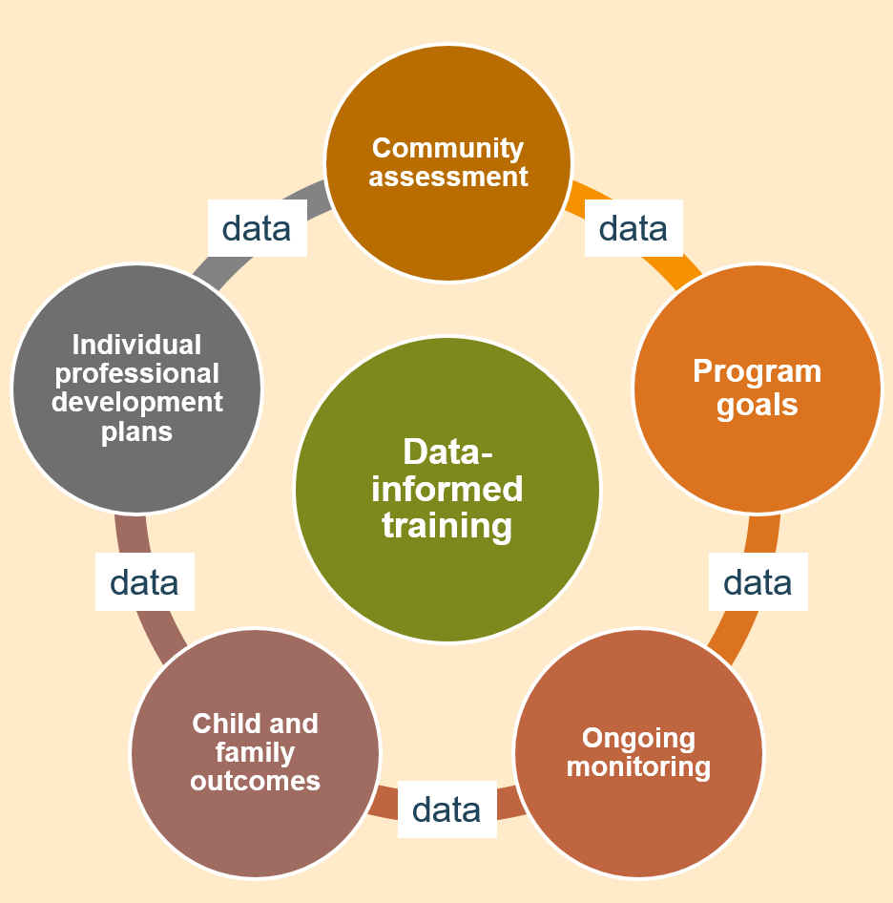
Data-informed Training
Community assessment
Annual
self-assessment
Program goals
Ongoing monitoring
Child and family outcomes
Individual PD plans
Notes:
Slide 15
Facilitator Notes:
Deliver the material on this slide in the form of a mini-lecture.
Say to Participants: "As we just noted, to create a truly effective and coordinated training and professional development program, you need to base it on data. Where does that data come from? The major sources are listed on this slide. They are:
The community assessment and annual update
The annual self-assessment
Your program goals
Ongoing monitoring data
Child and family outcomes data
Individual professional developments plans.”
Ask participants if you missed any data sources based on the activity completed in the previous slide. If so, chart additional responses.

Slide 16
Understanding Expectations
Staff qualification and competency requirements, 45 CFR §1302.91
Knowledge, training, experience, and competencies
Ongoing training and professional development
Notes:
Slide 16
Facilitators Notes:
Distribute the Head Start Act Training and Professional Development Requirements: Staff Qualifications handout.
Say to Participants: "In order to design your plan for professional development, you'll need to know what the Performance Standards and other regulations require in terms of staff qualifications and competencies.
As you can see from the slide, according to the HSPPS, programs must ensure that all staff, consultants, and contractors who are engaged in the delivery of program services have sufficient knowledge, training, experience, and competencies to do their jobs. That means programs must provide ongoing training and professional development for staff. It also means that programs need to continually assess the professional needs of staff so they can respond to them.”
Let participants know that the ECLKC can offer support on staff qualification descriptions.

Slide 17
Assessing Staff and Building Capacity
How do we assess the strengths and needs of our staff?
Do our approaches to training meet the needs of our staff?
How do we support our staff in providing responsive services?
Notes:
Slide 17
Facilitator Notes:
Direct participants' attention to the slide.
Say to Participants: "When you think about building
the capacity of your staff, start by asking yourself these questions:
Does our staff reflect the communities we serve?
How do we assess the strengths and needs of our staff?
Do our approaches to training meet the needs of our staff?
How do we support our staff in providing responsive services to our children,
families, and communities?”
Ask participants to take five minutes to discuss the questions on the slide with their tablemates. Ask for volunteers to report what they discussed and learned.

Slide 18
Individual Professional Development Plans
Individual professional development plans are:
Developed in consultation with each employee
Required for all staff
who have direct
contact with children
Implemented to the
extent feasible and practical
Notes:
Slide 18
Facilitator Notes:
Deliver the content on this slide in the form of a mini-lecture.
Say to Participants: "We know one size doesn't fit all. That is why the Head Start Act requires programs to create an individual professional development plan for every full-time Head Start employee who provides direct services to children. Each plan needs to be created in consultation with the employee, and plans must be regularly evaluated to see how well they're working to improve or maintain staff job performance.
"Note that these plans can include both internal and external learning activities, such as outside training and coursework along with various kinds of individual TA, like coaching or mentoring.
"Finally, while the Head Start Act only addresses individual professional development plans for staff who provide direct services to children, many programs see the value of writing plans for all their staff. Working with every staff person on individual professional development
helps create the truly coordinated training and professional development approach
you're aiming for.”
Ask participants to review the Head Start Act Training and Professional Development Requirements: Staff Qualifications handout and consider the following questions:
Does your program complete individual professional development plans for all staff?
What data do you use to support the development of individual plans?
How do you see staff individual professional development plans supporting
continuous improvement?

Slide 19
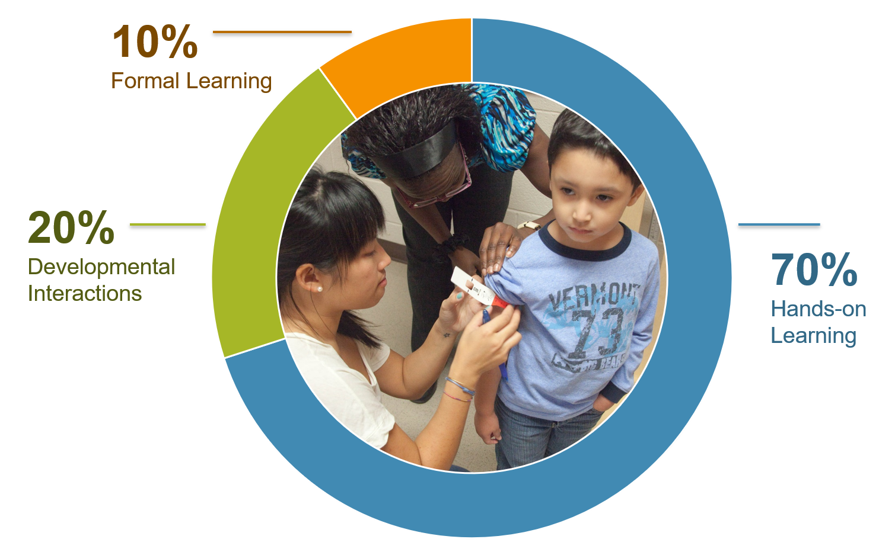
Where Staff Learn
Notes:
Slide 19
Facilitator Notes:
Distribute the 70-20-10 Checklist handout. Write the scenarios below on index cards, one scenario per card, and place one card on each table.
Say to Participants: "In the 1980s, the Center for Creative Leadership in North Carolina conducted workplace research. Out of that research, they developed a framework called the 70-20-10 Model. This model says that 70 percent of learning comes from hands-on experience; 20 percent from developmental interactions; and 10 percent from formal learning. This framework is now used widely throughout the business world. Its implications are profound because, according to the 70-20-10 Model, a full 90 percent of learning occurs outside formal training settings."
Introduce the next activity by guiding participants to the 70-20-10 Checklist handout. Ask them to read the scenario on their table and team up with tablemates to complete the handout. Give them 15 minutes to finish the exercise, and then ask each table to describe some of the learning exercises they designed.
Scenarios:
As your program's education manager, you were sent to a coaching training and now need to transfer your new knowledge to your team.
You're a family services manager and need to train your staff in the Nurturing Parent Program, a new parent education curriculum.
You have just finalized a partnership with a local child care agency, and your two organizations need to learn about each other's systems and daily work.

Slide 20
Maximize the 90 Percent
Inspire employees
to learn with meaningful and challenging tasks
Provide opportunities for feedback and reflection
Provide fresh and relevant content
Source: Beich, E. "The 90 Percent Solution" Talent Development, (December 2016).
Notes:
Slide 20
Facilitator Notes:
Direct participants' attention to the slide.
Say to Participants: "If staff do 90 percent of their learning outside of formal training, how do we make sure they encounter quality learning opportunities in their day-to-day work?
"On the slide, you see some basic principles. When designing and planning training, programs need to:
Inspire employees to learn by giving them meaningful and challenging tasks
Provide opportunities for feedback and reflection
Provide fresh and relevant content"

Slide 21
Adult Learning Theory
Direct their own learning as they mature
Draw on their life experiences to help them learn
Are ready to learn when they assume new life/social roles
Are problem-centered and want to apply new
learning right away
Are motivated by internal factors rather than external ones
Notes:
Slide 21
Facilitator Notes:
Direct participants' attention to the slide.
Say to Participants: "The late Malcolm Knowles, a well-known educator in the 1980s, made some key assumptions about the characteristics of adult learners.¹
"He wrote that adults:
Begin directing their own learning as they mature
Draw on their life experiences to help them learn
Are particularly ready to learn when they assume new life and social roles
Are problem-centered and want to apply new learning right away
Are motivated by internal factors rather than external ones
"We can see that assumptions about how adults learn are quite a bit different from our assumptions about how children learn.”
Ask participants to take 10 minutes to have a discussion with their tablemates about the adult learning assumptions on the slide. Suggest that they focus on how these factors have come into play in their own personal learning. After 10 minutes, ask for volunteers to share.
¹Teaching Excellence in Adult Literacy (TEAL),TEAL Center Fact Sheet No. 11: Adult Learning Theories, https://lincs.ed.gov/state-resources/federal-initiatives/teal/guide/adultlearning (2011).

Slide 22

Fiscal Implications of Professional Development
Effective communication
is necessary for strong financial planning and budgeting
Decisions about the resources needed to accomplish program
goals and objectives
must be based on data
Notes:
Slide 22
Facilitator Notes:
Deliver the material on this slide in the form of a mini-lecture.
Say to Participants: "Of course, programs need to think carefully about the fiscal implications of providing necessary learning opportunities to their staff.
"All programs should have a strong financial management system. In order to build a strong fiscal system, you need to establish:
Effective communication. Communication goes hand in hand with establishing relationships. You need both if you're going to have effective financial planning and budgeting.
A strong emphasis on using data to make decisions. When you base your decisions on solid data, you will have a clear picture of precisely what resources you'll need to accomplish your program goals and objectives."

Slide 23
T/TA Funds
Funds can be used for teachers, managers, fiscal staff, and Policy Council members, just to name a few
T/TA funds are specially earmarked on the Notice of Award (NOA)
Funds should be budgeted and submitted in the grant application process yearly
Notes:
Slide 23
Facilitator Notes:
Distribute the T/TA Funds handout.
Say to Participants: "The Head Start Act makes training funds available to each grantee.
"These funds, called PA 20 funds, are used for T/TA in Head Start programs. While regular program funds also can be used to pay for T/TA, PA 20 funds are specially earmarked for this purpose.
"PA 20 funds can be used for a variety of types of T/TA by staff and others throughout the organization. For instance, funds can be used to increase the capacity of the program's fiscal staff, to train the Policy Council, or for annual staff trainings.
"When a program is preparing its grant application, it decides how these PA 20 funds will be used and incorporates those funding allocations into its budget proposal. These allocations must be approved by the Policy Council and governing body or Tribal Council, along with the rest of the grant application."
Ask participants to take a few minutes to review the T/TA Funds handout with their tablemates. Ask them to identify how PA 20 funds can be used.

Slide 24
Sec. 642(h) T/TA Plan
Receipt of funds is dependent upon annual T/TA plan
T/TA plan must be based on the agency's self-assessment, community assessment, needs of parents and
children to be served,
and the results of
federal reviews
Notes:
Slide 24
Facilitator Notes:
Deliver the material on the slide in the form of a mini-lecture.
Say to Participants: "How do you actually begin writing your T/TA plan? As the slide indicates, the Head Start Act says that:
Receipt of program funds is dependent upon having an annual T/TA plan
The T/TA plan must be based on the agency's annual self-assessment, community assessment, the needs of parents and children to be served, and the results of federal reviews."

Slide 25
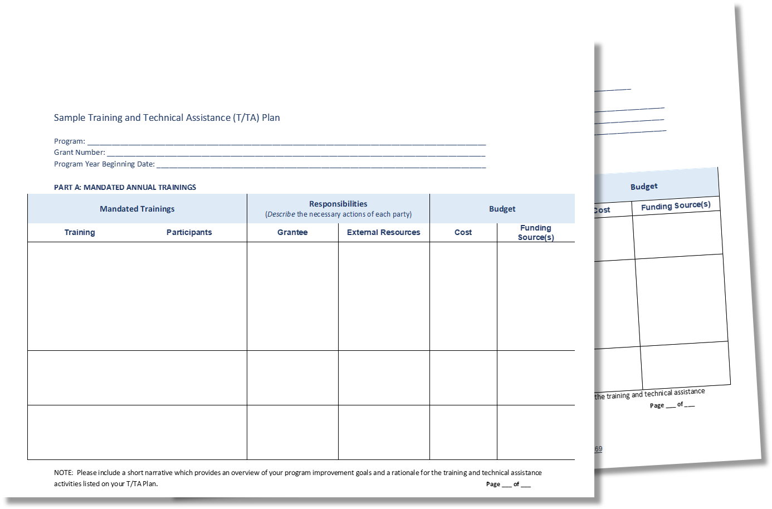
Writing a T/TA Plan
Notes:
Slide 25
Facilitator Notes:
Distribute the Sample T/TA Plan handout.
Say to Participants: "Let's look at a sample T/TA plan.
To recap, these plans are used by programs to support activities that ensure you have qualified staff.
"On the handout, you'll see that the sample T/TA plan:
Includes professional development of staff, volunteers, Policy Council members, and members of the governing body or Tribal Council
Addresses mandatory training, priorities identified from the program's ongoing monitoring and annual self-assessment, and specific training areas required by the Performance Standards."
Suggest that participants refer back to the Training and Professional Development Requirements: Staff Qualifications handout as they review the Sample T/TA Plan.

Slide 26
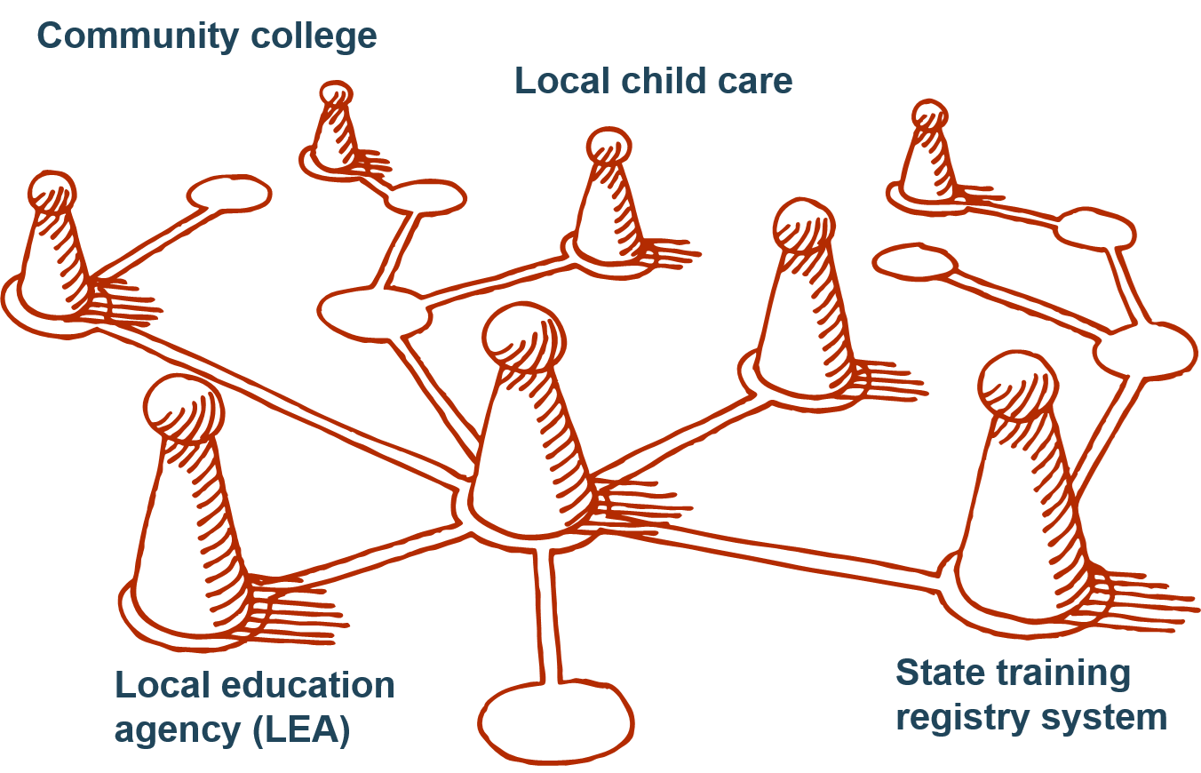
Partnerships and Collaboration
Notes:
Slide 26
Facilitator Notes:
Tape a flipchart sheet to the wall and distribute sticky notes to each table.
Say to Participants: "As you're developing your T/TA plan, you need to think carefully about partnerships. Partnerships are critical in meeting your professional development goals.
"Program leaders should be aware of the many professional development systems that address national, state, and local standards. There are registries, alliances, and credentialing and licensing organizations, some at the state level and others at the national level. Of course, state-level requirements vary depending on where your program is located, and they will have a major impact on the nature and scope of your professional development program.
"Providing quality training and professional development opportunities for staff has clear fiscal implications for your program. So, it's important that programs seek partnerships with local, state, and regional entities interested in joint-training opportunities. These partnerships can substantially reduce your costs. Programs should reach out to local colleges and connect training to college credit for their staff whenever possible.
"Note that when you build partnerships, you always need to consider the following questions:
How is the partnership reciprocal for both entities involved?
How does the partnership benefit our program?
Can the partnership be sustained over time?”
Ask table teams to take a few minutes to brainstorm innovative ways they have partnered across their communities to provide professional development activities for their staff. Ask them to write down these approaches on sticky notes and put them on the flipchart sheet you taped to the wall. Each table should report about the ideas they posted.

Slide 27

Assessing Professional Development
Data Points:
Continuous quality improvement progress data on goals, objectives,
and outcomes
Program Information Report (PIR) data
Personnel and staff training files
Classroom Assessment Scoring System (CLASS®) scores
Direct feedback from staff, parents,
and community stakeholders
Training evaluations
Self-assessment data
Ongoing monitoring data
Notes:
Slide 27
Facilitator Notes:
Direct participants' attention to the slide.
Say to Participants: "Now, we're going to talk about how to assess the impact of your professional development program. Remember that you need to be assessing your plan in a systematic and ongoing way, both throughout the year and during your annual self-assessment.
"How do you really know if new learning from your professional development program is being put into practice? You have to look at the data, some of which you're already collecting for other purposes and some of which you'll collect just to evaluate these learning opportunities you have created."
Ask participants to review the types of data listed on the slide and name those they have considered most valuable in assessing their professional development opportunities. Ask for specifics about how they have used the data to make changes. If certain sources of data were not selected, briefly discuss them and how they, too, can provide valuable insights.

Slide 28
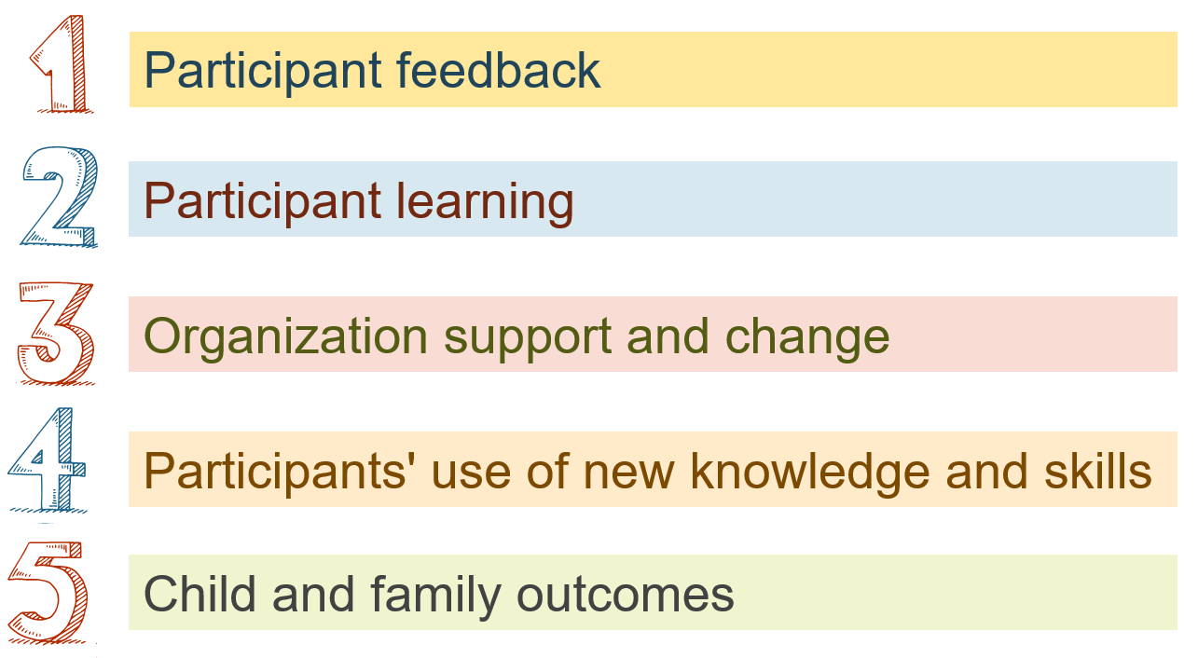
Levels of Professional Development
Five Levels of Professional Development Evaluation
Source: “Does it Make a Difference? Evaluating Professional Development,” Thomas Guskey (2002).
Notes:
Slide 28
Facilitator Notes:
Distribute the Does It Make a Difference? Evaluating Professional Development handout.
Say to Participants: "As we've said, to find out if your professional development program has actually supported continuous improvement and improved child and family outcomes, you need to evaluate it.
"In his article, "Does it Make a Difference? Evaluating Professional Development," Thomas Guskey outlines five levels of evaluation and strategies for measurement and assessment at each level. He also suggests ways to use this information to inform change efforts. ²
"As you can see on the slide, the five levels are:
Participant feedback, such as whether staff liked a training and found it useful
Participant learning, which looks at whether staff acquired new knowledge or skills
Organizational support and change, which is about whether the organization supported participants to put their new knowledge or skills into practice
Participants' use of new knowledge and skills, or whether staff really did implement the new learning
Child and family outcomes, which looks at how the new learning impacted children and their families
"Guskey points out that while we usually evaluate learning activities such as workshops and seminars, we should also evaluate other types of professional development activities. This includes those embedded in day-to-day work, like coaching, mentoring, reflective supervision, professional development advising, and peer-to-peer TA.”
Ask participants if they can think of ways to evaluate the kinds of learning activities that are embedded in day-to-day practice, and ask volunteers to share their ideas.
Then, ask participants to break into teams of three to four to review Does it Make a Difference? Evaluating Professional Development. Ask them to discuss how the types of evaluation Guskey proposes could be used in their programs. Tell them they will have 15 minutes to complete this exercise.
After 15 minutes, solicit volunteers to report to the wider group.
²Guskey, T. Does It Make a Difference? Evaluating Professional Development, (2002).

Slide 29
T/TA System
The T/TA system is free to grantees
There are currently four types of
T/TA specialists
Requests for services go through the Regional Office or the T/TA coordinator
Notes:
Slide 29
Facilitator Notes:
Deliver the following information in the form of a mini-lecture.
Say to Participants: "We said earlier that we would dive a little deeper into OHS' T/TA System.
"The first thing to note is that this assistance is available to grantees free of charge.
"There are currently four types of regional T/TA specialists: grantee specialists, early childhood specialists, health specialists, and systems specialists.
"Requests for services go through your Regional Office or your regional T/TA coordinator."

Slide 30
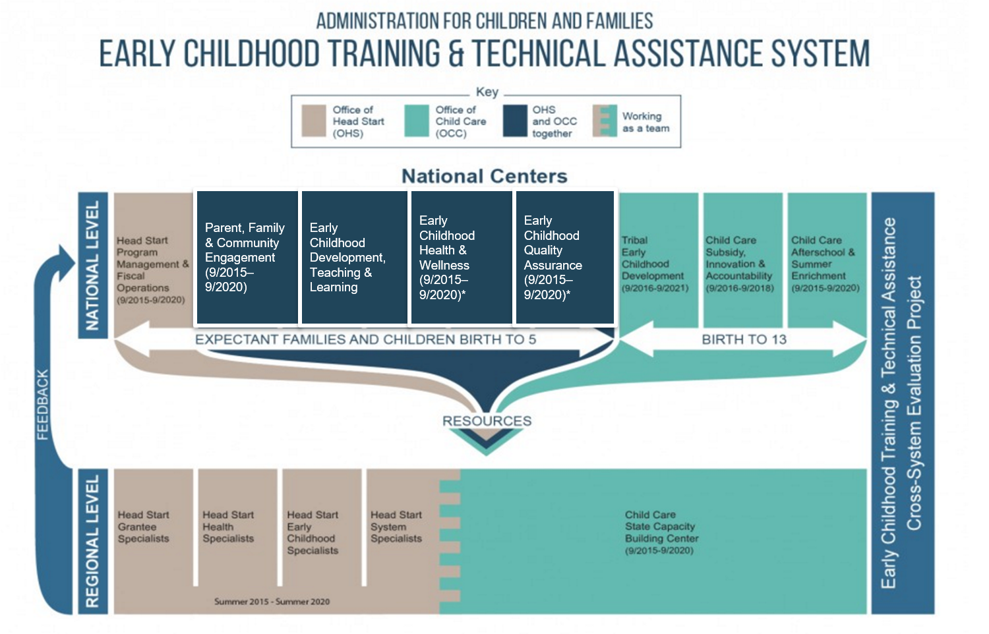
Office of Head Start T/TA System
Notes:
Slide 30
Facilitator Notes:
Guide participants' attention to the slide.
Say to Participants: "Let's look a little more at how the OHS T/TA system is structured. You can see on the slide that the system consists of three levels: national, regional, and grantee. You'll find the PMFO Center at the national level.
"Each level has distinct and unique functions, but they're designed to complement each other. As a whole, the goal of the T/TA system is to strengthen the quality of grantee services and improve child and family outcomes.
"Now I'd like to hear from you. How have you used the T/TA system?”
Note responses on the flipchart and point out any emerging themes.

Slide 31
Key Messages
A data-informed training and professional development system supports ongoing continuous improvement.
Training and professional development supports quality programming and improved child and family outcomes.
Programs must use a systematic, multi-faceted approach in designing and implementing training and professional development.
Notes:
Slide 31
Facilitator Notes:
Deliver this wrap-up material in the form of a mini-lecture.
Say to Participants: "To wrap up, let's review key takeaways.
"In this session, we learned that programs' training and professional development efforts must be:
Data-informed
Systematic and multi-faceted
Effective in supporting quality programming and improved child and family outcomes."

Slide 32
Related ECLKC Resources
Foundations for Excellence: A Guide
for Five-Year Planning and Continuous Improvement, 2nd Edition
https://eclkc.ohs.acf.hhs.gov/program-planning/article/foundations-excellence-guide-
five-year-planning-continuous-improvement-2nd
Professional Development-to-Go https://eclkc.ohs.acf.hhs.gov/professional-development/article/professional-development-go
Head Start Policy and Regulations
https://eclkc.ohs.acf.hhs.gov/policy
Notes:
Slide 32
Facilitator Notes:
Distribute the Early Childhood Education Professional Development: Training and Technical Assistance Glossary handout, or save paper and share the online version.
Say to Participants: "Take note of the foundational resources listed on the slide. Foundations for Excellence is a comprehensive resource for Head Start planning and continuous improvement. The Head Start Policies and Regulations section of the ECLKC includes the HSPPS and the requirements set forth in the Head Start Act of 2007. It also contains Program Instructions (PIs) and Information Memoranda (IMs), through which OHS offers program direction and implementation help. More guidance is available to programs through their federal program specialist."

Slide 33
Closing Reflections
What did
I learn?
What excites or concerns me about what I've learned?
How will this new learning inform how I work?
*Adapted from: Professional Development Guides for Implementing PFCE
Notes:
Slide 33
Facilitator Notes:
Guide participants to the Reflective Practice Tool handout.
Say to Participants: "Now it's time to turn inward to reflect on what we have learned and what we will do with this information.
"Using the handout, take a few minutes to reflect and write down your thoughts about:
What you have learned
What excites or concerns you about what you have learned
What you plan to do with what you've learned."
Ask for volunteers to share their responses aloud, and process the activity using the following questions:
What themes did you hear?
What insights do you need to remember?
How can you use these insights?

Slide 34



Contact PMFO
pmfo@ecetta.info
https://eclkc.ohs.acf.hhs.gov/ncpmfo
888-874-5469
Notes:
Facilitator Notes:
Review PMFO contact information.

