Slide 1
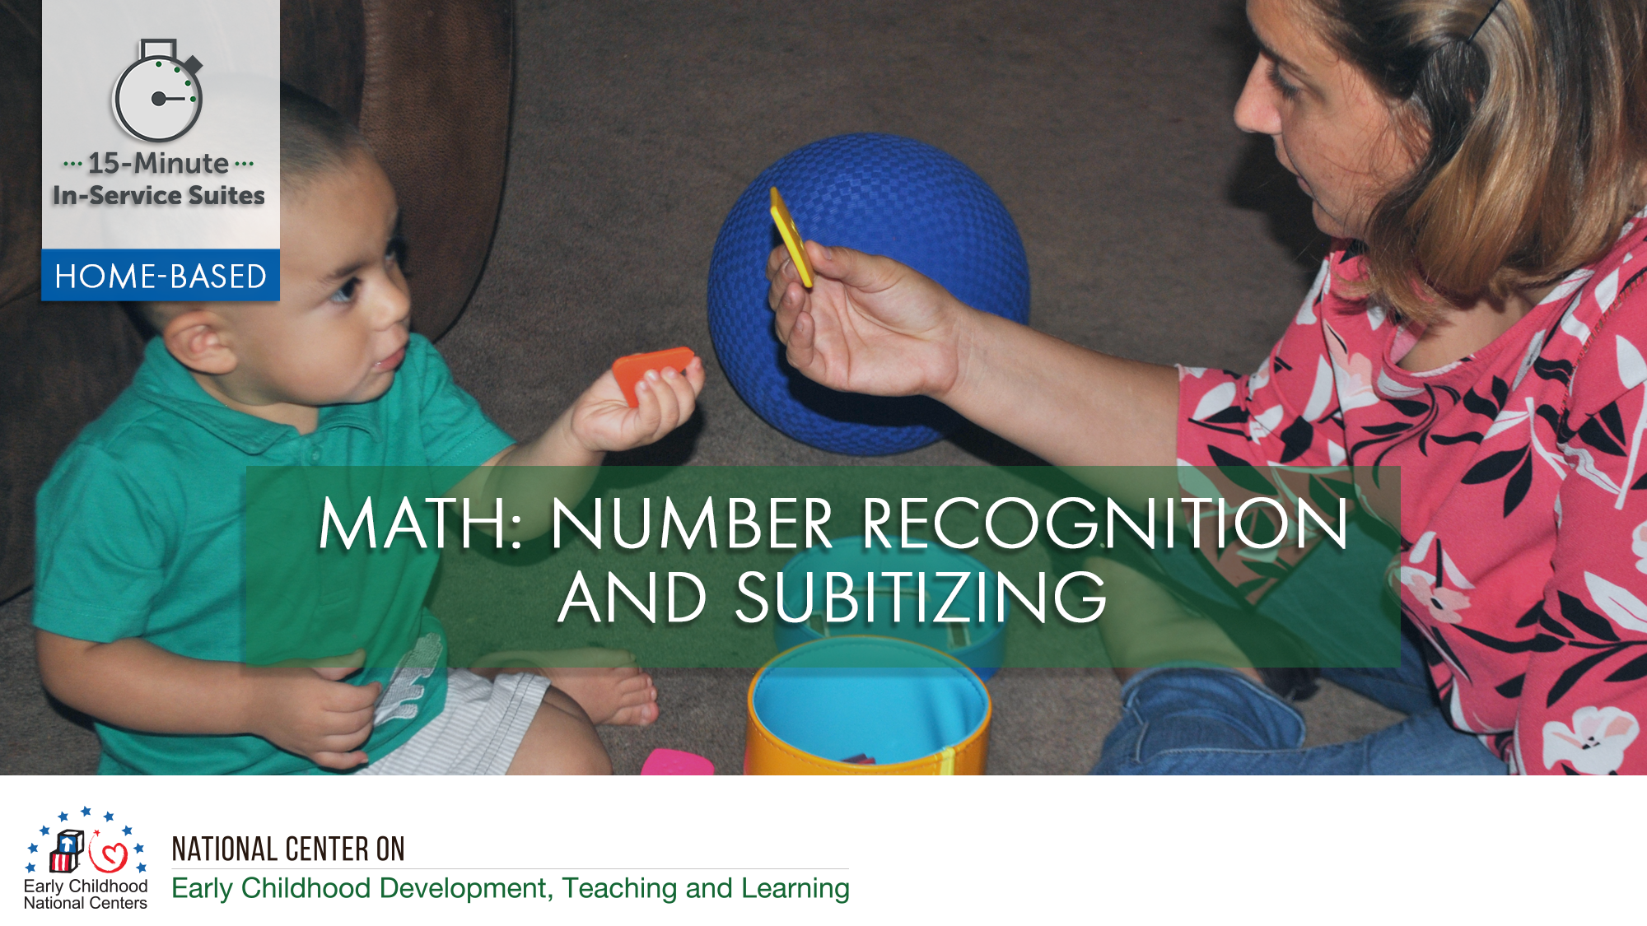

Slide 2
HSPPS Support Math
Subpart C - Education and Child Development Program Services
1302.30 Purpose
All programs must provide high-quality early education and child development services, including for children with disabilities, that promote children’s cognitive, social, and emotional growth for later success in school….

Slide 3
HSPPS Support Math
Subpart C - Education and Child Development Program Services
    1302.35 Education in Home-Based Programs
    A home-based program must provide home visits and group socialization activities that promote secure parent-child relationships and help parents provide high-quality early learning experiences in language, literacy, mathematics, social and emotional functioning, approaches to learning, science, physical skills, and creative arts. A program must implement a research-based curriculum…

Slide 4
Center-Based and Family Child Care Practices
Effective Teaching
Child Development

Slide 5
Home Visiting Practices
Effective Home Visiting and Socialization
Positive Parenting
Child Development

Slide 6
What’s Different for a Home Visitor?
Effective Home Visiting
Positive Parenting
Child Development

Slide 7
Theory of Change for Home-Based
THEORY OF CHANGE FOR INFANT-TODDLER PROGRAMS
HOME-BASED AND CLASSROOM
Source: Roggman et al, 2016

Slide 8
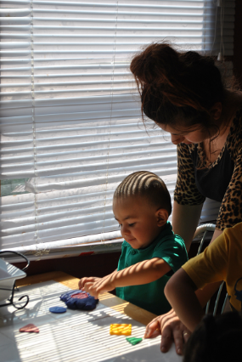
Support Parents in Speaking Math!
Encourage parents to use math language as children explore inside and outside the home in the following ways:
  Explore materials around the house to recognize numbers and subitize
  Sing counting songs and nursery rhymes
  Use subitizing vocabulary
  Play “guess how many” games and games using dice

Slide 9
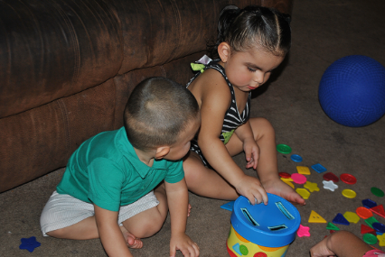
Home Visitors Can Support Subitizing

