Slide 1
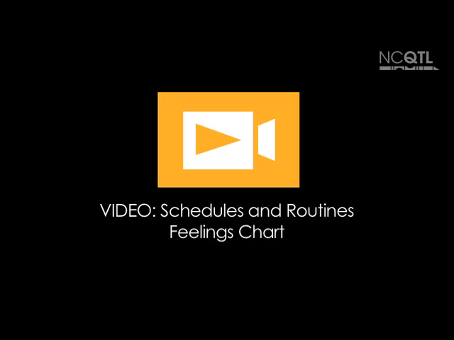
Notes:
Name of video: Schedules and Routines: Feelings Chart
Key ideas: Developing a routine; using a visual
Summary: During a circle routine, a teacher describes what a girl said earlier about her feelings that day as the girl chooses her current feeling on a chart. After the children in circle identify the emotion the girl picks, the teacher asks the girl to describe why she chose that feeling.
Length of video: 30 seconds
Suite name: Schedules and Routines

Slide 2
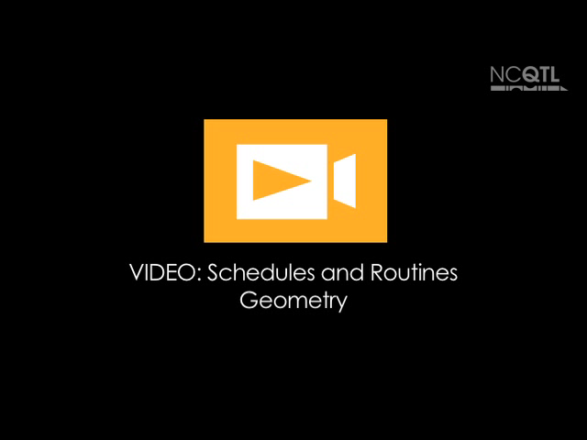
Notes:
Name of video: Schedules and Routines: Geometry
Key ideas: Developing a routine; using visuals
Summary: To help children find their spots during circle time, a teacher points to individual pictures of each child, framed by geometric shapes. The children help the teacher identify the shape and color of each child’s picture frame and call out this information.
Length of video: 57 seconds
Suite name: Schedules and Routines

Slide 3

Notes:
Name of video: Schedules and Routines: Morning Routine
Key ideas: Developing a routine for transitioning to school; using visuals
Summary: A teacher welcomes a girl to school then reminds her to move her “car” on the whiteboard to the “parking lot” so the teacher knows she is at school. The child gets her car, and the teacher says hello to the next child coming in the door.
Length of video: 24 seconds
Suite name: Schedules and Routines

Slide 4

Notes:
Name of video: Schedules and Routines: Picture Cards
Key ideas: Referring to the schedule; creating a visual schedule
Summary: A teacher reviews a schedule made of picture cards with a small group of children. She and the children identify the first activity in the schedule, which is reading a book. Later in the day, the group reviews the schedule again and the teacher removes a card that represents an activity they already did. The group sees that the next activity is making a snack and, at 00:36, the teacher points to the first step in another card sequence that shows the steps for making the snack.
Length of video: 41 seconds
Suite name: Schedules and Routines

Slide 5

Notes:
Name of video: Schedules and Routines: Present Means?
Key ideas: Reviewing the schedule; developing a routine
Summary: A teacher shows children a picture card of circle time and asks them whether they are doing the activity in the past, present, or future. After they decide they are participating in circle time now, the teacher places the card in the present category. Next she asks the group if she should place the card for home in the past, present, or future. When a child answers, “Future,” the teacher puts the card in that column.
Length of video: 25 seconds
Suite name: Schedules and Routines

