Slide 1
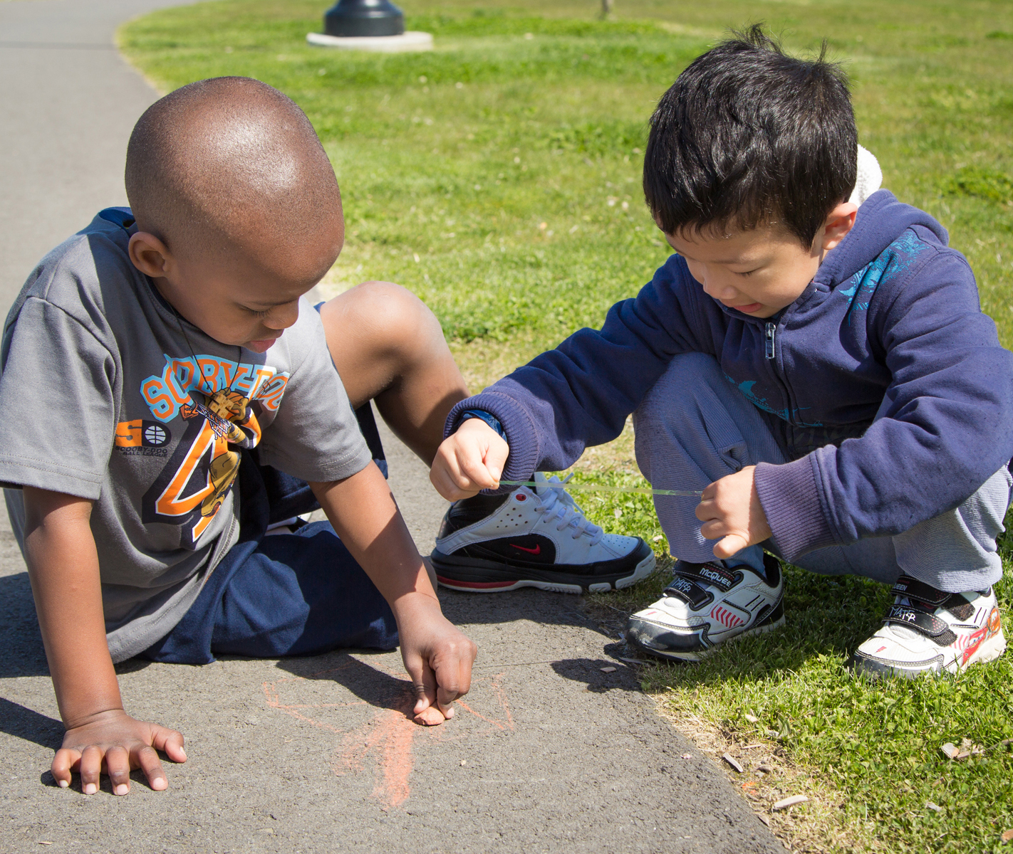
Language modeling and conversations: Expansions
FALL 2012

Slide 2
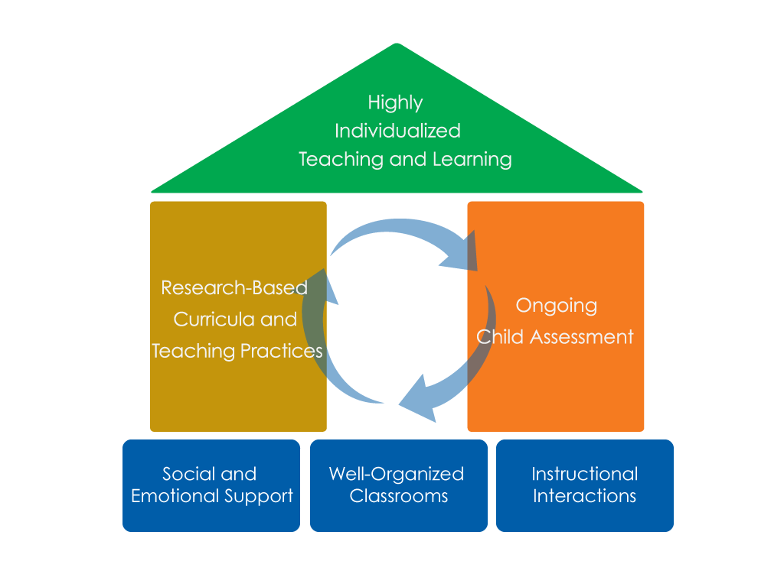
FRAMEWORK FOR EFFECTIVE PRACTICE SUPPORTING SCHOOL READINESS FOR ALL CHILDREN
FOCUS ON
FOUNDATION

Slide 3
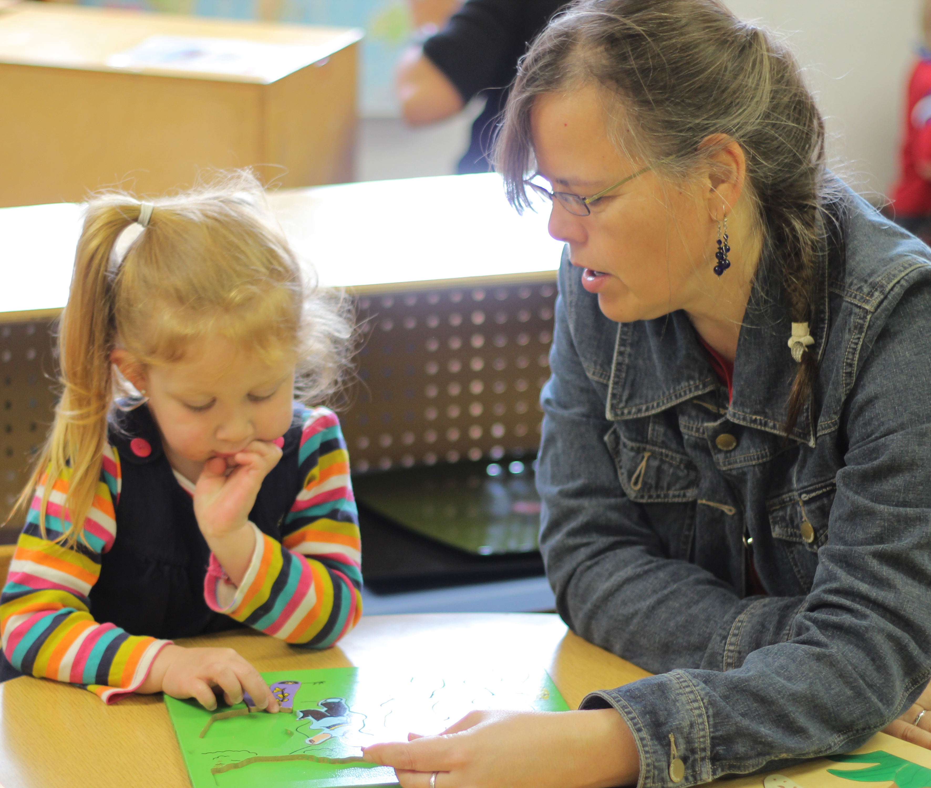
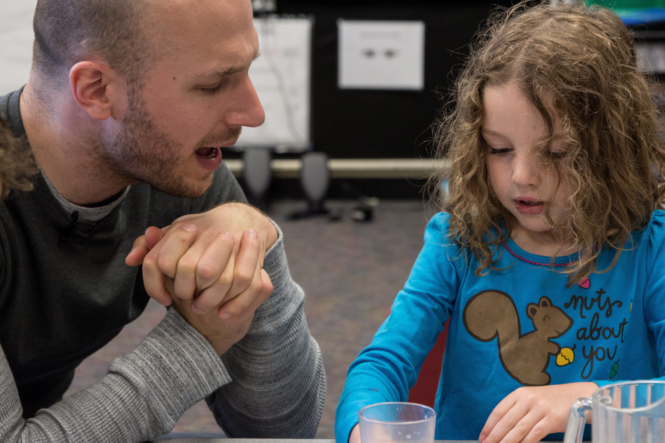
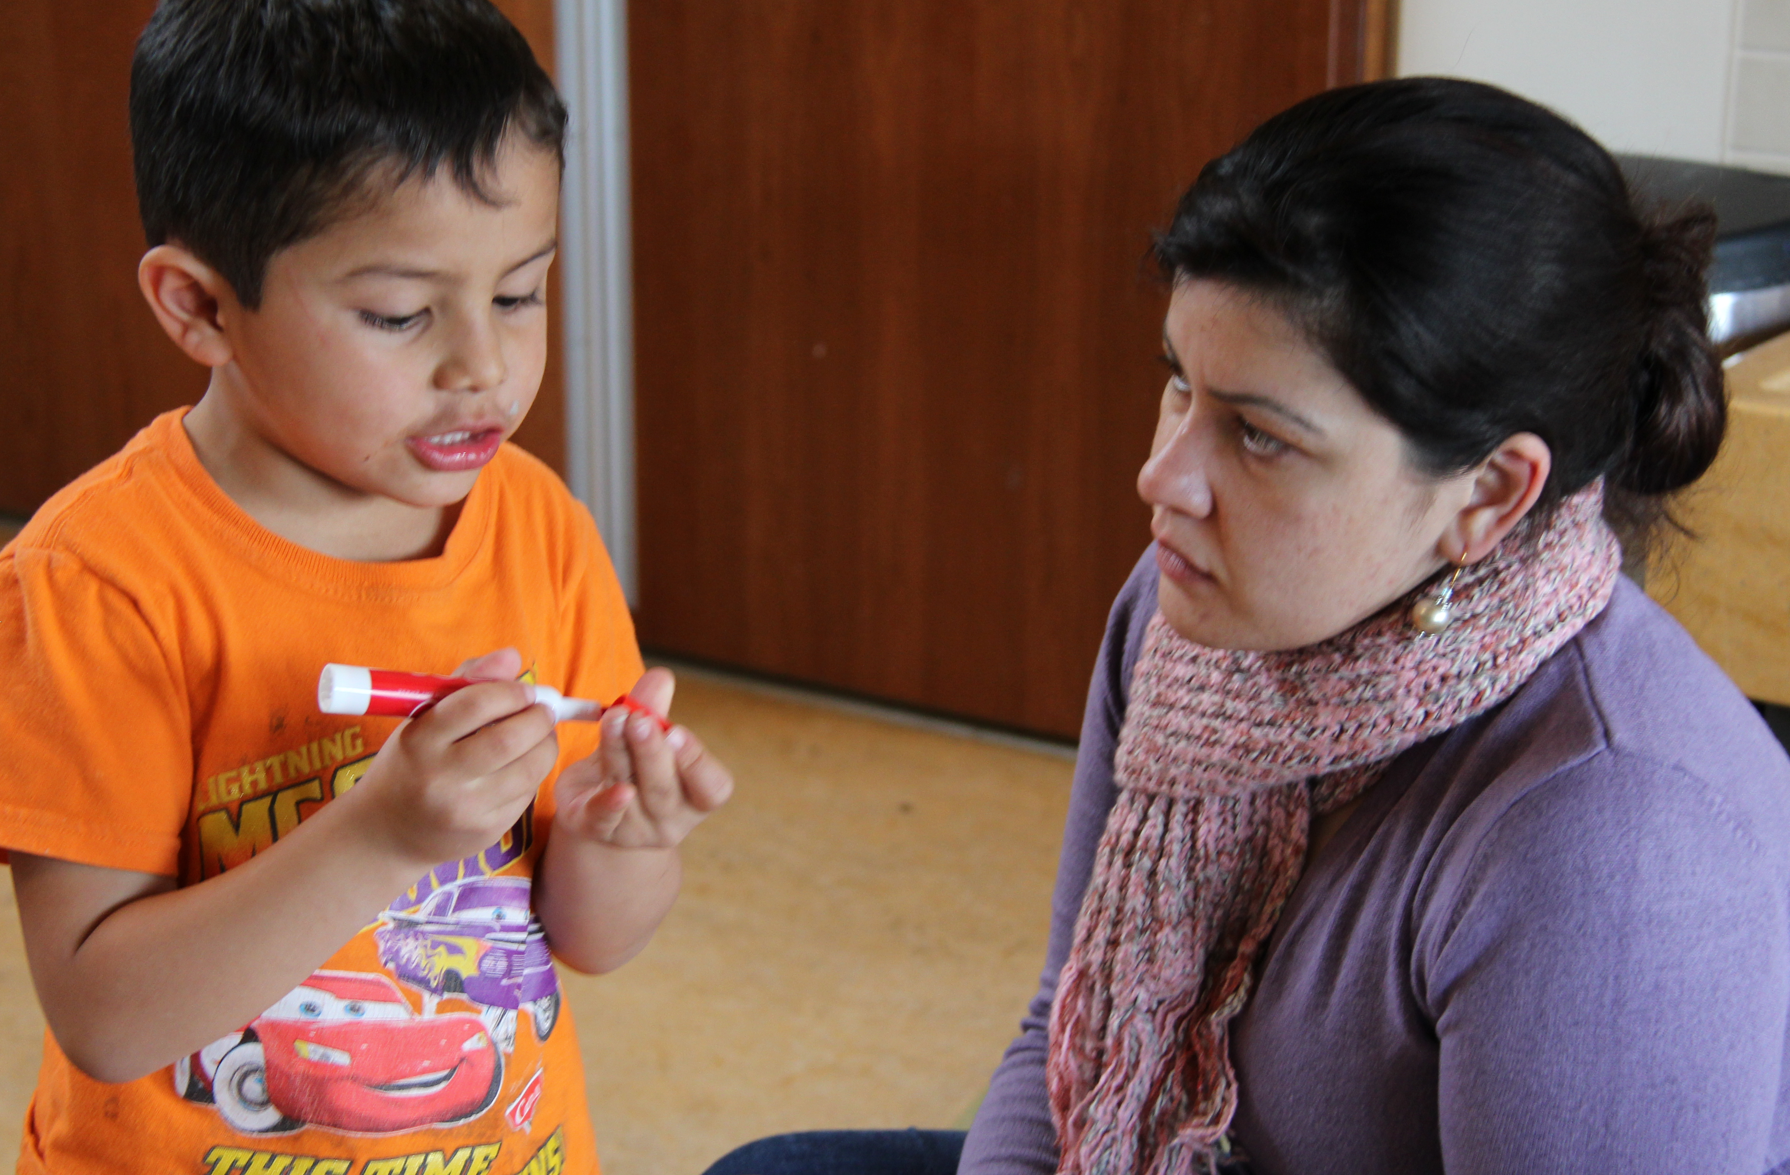
OBJECTIVES
To understand how expansions create opportunities for extended conversation
To learn how expansions promote children’s language and thinking
To identify strategies used to expand on what children say

Slide 4
What are extended Conversations?
Extended conversations are rich back-and-forth exchanges that help children develop more complex language and thinking skills.

Slide 5
Expanding on what Children Say Scaffolds Conversations
Expansions provide additional language in response to children’s words to extend conversations.
Look a plane!
I see a plane flying high in the sky.
I go on a plane with my grandma before.
You went on a plane with your grandma. Where did the plane take you?

Slide 7
How does EXPANDING ON WHAT CHILDREN SAY benefit children?
Introducing Novel Words
Engaging in Thick Conversations
Models back-and-forth exchanges
Assists children in learning how to communicate more clearly and accurately
Increases vocabulary
Helps children learn more language to understand their actions and to express their ideas
Extended Conversations
Expanding on What Children Say
Asking Questions
Develops knowledge of new concepts and skills
Enhances children’s understandings throughout the conversation
Expands higher level thinking skills
Provides opportunities for children to think about their thinking and evaluate their understandings

Slide 8
How does Expanding on what children say benefit teachers?
These conversations provide me with a great opportunity for ongoing child assessment and ideas for my curriculum planning.
I can add new information to the conversation.
Tells me what children understand and comprehend.

Slide 9
Expand on children’s words to scaffold Language
Make my phrase more complete.
Ways to Expand on MY Words
Make my phrase more complex.
Add novel and interesting words.

Slide 10
Expand on children’s words to scaffold thinking
Summarize my thoughts.
Link to what I already know.
Ways to Expand on MY Words
Apply to my world.
Connect concepts.
Relate to my life.
Relate to my actions.
Explain thinking.
Invite me to think deeper.

Slide 12
Now it’s your turn!
Expand on children’s words.
Add more complex language.
Add new information to support higher-level thinking.

Slide 13
FALL 2012

