Slide 1

Notes:
Name of video: Conversations: A New Bus
Key ideas: Reciprocal exchanges; matching tone to the child’s affect; active listening; being at the child’s level
Summary: A teacher talks with a boy at the end of class about which children will leave first. The boy starts to talk about a new bus he will ride that day. He expresses excitement about the new bus and the teacher responds with laughter and makes comments in a warm tone of voice.
Length of video: 58 seconds
Suite name: Engaging Children in Conversations

Slide 2
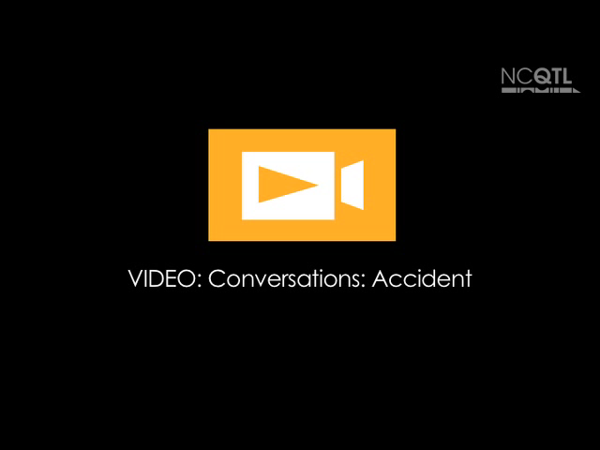
Notes:
Name of video: Conversations: Accident
Key idea: Active listening; being at the child’s level; reciprocal exchanges
Summary: A teacher and a group of children are drawing and talking about cultural backgrounds. After one boy misunderstands another boy when he says, “Vietnam,” the teacher helps the two boys explain their feelings and intentions.
Length of video: 1 minute 11 seconds
Suite name: Engaging Children in Conversations

Slide 3
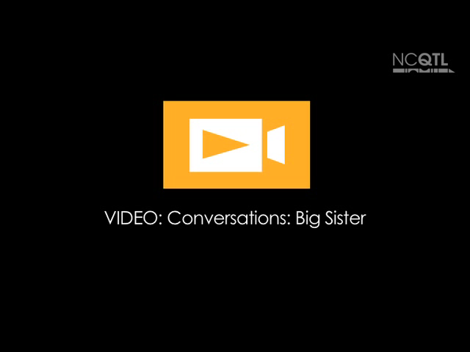
Notes:
Name of video: Conversations: Big Sister
Key ideas: Active listening; reciprocal exchanges; being at the child’s level; matching tone to the child’s affect
Summary: A teacher asks a girl holding a baby doll about her pregnant mother’s visit to the doctor. The girl talks about taking care of babies and what she will do to help when she becomes a big sister. The teacher listens and asks clarifying questions.
Length of video: 59 seconds
Suite name: Engaging Children in Conversations

Slide 4
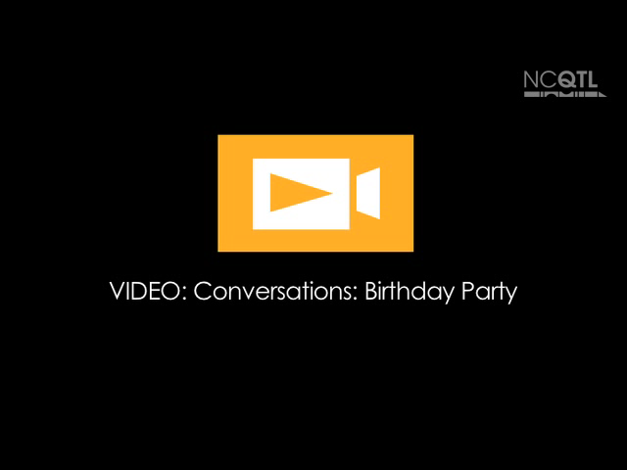
Notes:
Name of video: Conversations: Birthday Party
Key idea: Reciprocal exchanges; being at the same level; matching tone to child’s affect
Summary: A girl tells her teacher that the puzzle she is working on shows a birthday party. The teacher asks questions about how she knows that, and the girl explains her ideas.
Length of video: 27 seconds
Suite name: Engaging Children in Conversations

Slide 5

Notes:
Name of video: Conversations: Garden
Key idea: Reciprocal exchanges; being at the same level
Summary: A girl playing with other children in the water at the sensory table talks to a teacher about what she would like to plant in a garden. The conversation continues as the teacher listens and asks questions to understand the details of the girl’s plan.
Length of video: 1 minute 22 seconds
Suite name: Engaging Children in Conversations

Slide 6

Notes:
Name of video: Conversations: Woof Woof
Key idea: Reciprocal exchanges; being at the child’s level; matching tone to the child’s affect; active listening
Summary: Two boys and a teacher are talking about their dogs. The teacher asks questions and makes comments that build on what the boys say.
Length of video: 1 minute 2 seconds
Suite name: Engaging Children in Conversations

