Slide 1
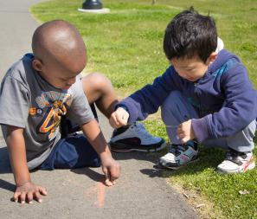
Language Modeling and Conversations: Asking Questions
FALL 2012

Slide 2
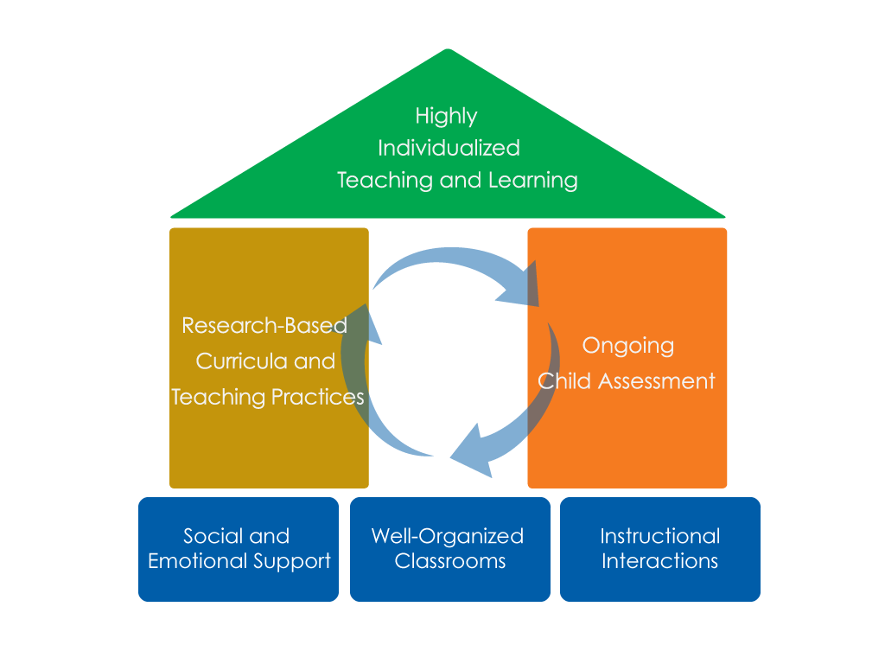
FRAMEWORK FOR EFFECTIVE PRACTICE SUPPORTING SCHOOL READINESS FOR ALL CHILDREN
FOCUS ON
FOUNDATION

Slide 3
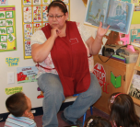
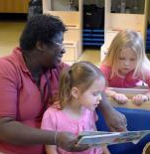
OBJECTIVES
To understand how asking questions enhances conversations
To identify qualities of questions that extend conversation
To gain knowledge of types of questions that strengthen conversations

Slide 4
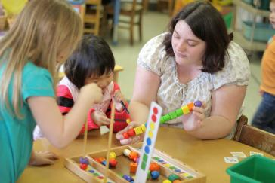
What are extended conversations?
Extended conversations are rich back-and-forth exchanges that help children develop more complex language and thinking skills.

Slide 5
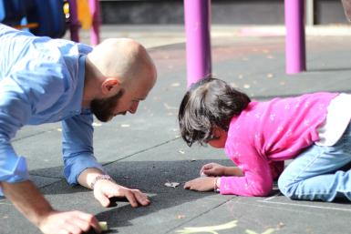
Asking questions
Asking children meaningful questions helps them focus on their own thinking and actions.

Slide 7
How does Asking Questions benefit children?
Introducing Novel Words
Engaging in Thick Conversations
Models back-and-forth exchanges
Assists children in learning how to communicate more clearly and accurately
Increases vocabulary
Helps children learn more language to understand their actions and to express their ideas
Extended Conversations
Expanding on What Children Say
Asking Questions
Develops knowledge of new concepts and skills
Enhances children’s understandings throughout the conversation
Expands higher level thinking skills
Provides opportunities for children to think about their thinking and evaluate their understandings

Slide 8
How does asking Questions benefit teachers?
Provides a lens into children’s perspectives
Informs teachers of children’s thinking processes
Assists with curriculum planning and assessment

Slide 9
Questions that continue conversation
Focus on children’s interests and excitement
Request information teachers do not already know
Match children’s language abilities
Stimulate creative thinking
Show a teacher’s interest.

Slide 10
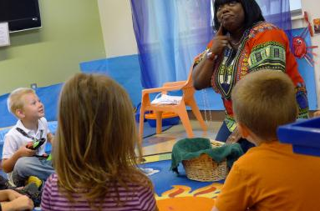
What are Open-Ended Questions?
A question with many answers
Require more than a one-word response
Allow children to express their ideas and opinions.

Slide 11
Questions that Stop Conversation
Intended to test
Rhetorical, no response really needed
Too simple or complex
Close-ended examples:
What is this called?
Are you having fun?
Did you play in the block area?
That’s a large tree, isn’t it?
How are the balls the same as the oranges?

Slide 12
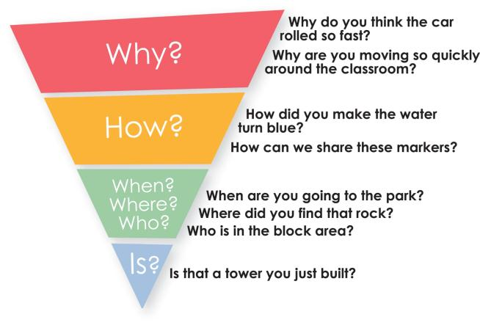
Asking Children Questions
Apply
Analyze
Problem Solve
Predict
Create
Open-Ended
Close-Ended
Memorize
Recall

Slide 13
Asking Meaningful Questions
Ask children about what they are doing.
What are you working on?
Tell me about your project.
Ask children to provide explanations.
Why?
How?
Ask children to make predictions.
What do you think will happen next?
Ask children to connect learning to their own lives.
Have you seen one of these before?
What does this remind you of?

Slide 14
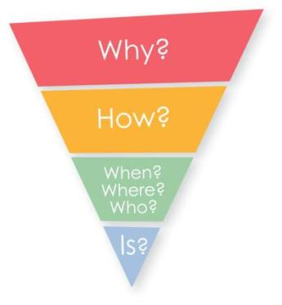
Supporting Children
Progression of difficulty (C.A.R.):
Comment and wait.
Ask a question and wait.
Respond.
Adapted with permission.
Cole, K., Maddox., M., Notari-Syverson, A., & Lim, Y.S. (2006). Language is the key: Video programs for building language and literacy in early childhood. Seattle, WA: Washington Learning Systems.
StoryQUEST: Celebrating beginning language and literacy, first year annual report. (April, 2004). Unpublished report, California Institute on Human Services, Sonoma State University, Rohnert Park, CA.

Slide 16
Now it’s your turn!
Use questions to extend conversations.
Focus questions on children’s interests.
Ask questions that access higher thinking skills.
Provide explanations.
Make predictions.
Connect learning to their own lives.
Support children when a question is too hard.

Slide 17
FALL 2012

