Slide 1
Ongoing Child Assessment: using data to inform teaching
SPRING 2014

Slide 2
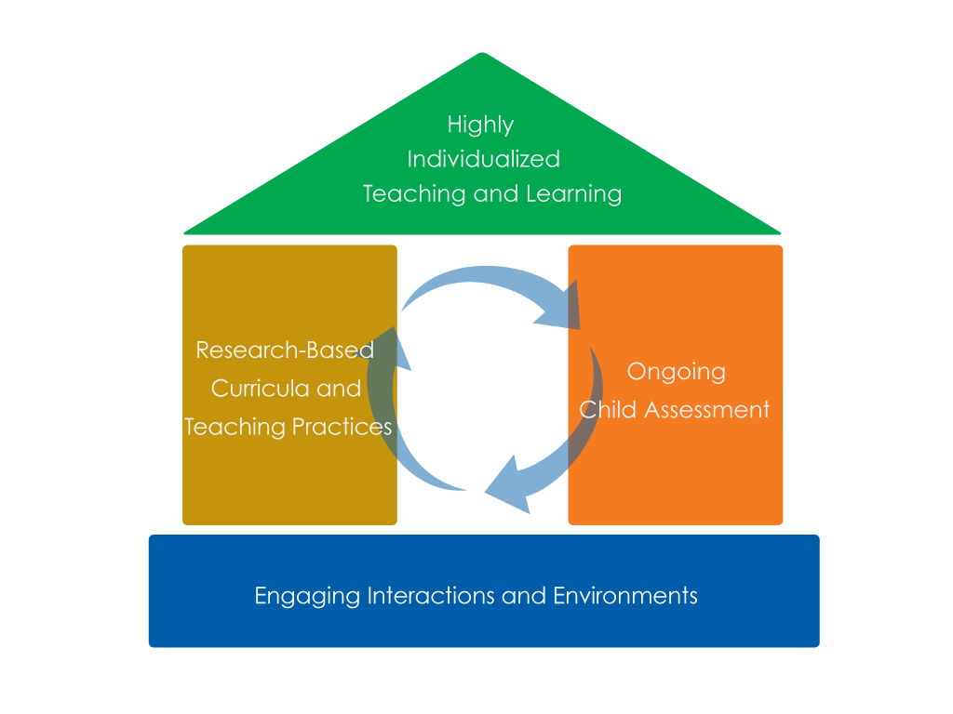
Framework for Effective Practice Supporting school readiness for all children

Slide 3
OBJECTIVES
Interpret assessment data
Make decisions based on how children are making progress
Adjust teaching

Slide 5
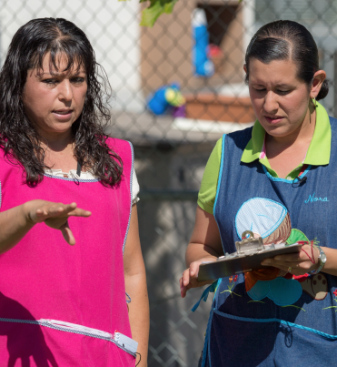
Adjusting Teaching
How do you use the assessment information you have collected to adjust teaching in your program?

Slide 6
Interpreting Assessment Data: PATTERNS
Early Writing Skills
 | Scribbles | Letter-like forms | Letters | Invented spelling
John | √
Anna | √ | emerging
Tyler |  | √
Bethany | √
Mee | √

Slide 7
Interpreting Assessment Data: INCONSISTENCIES
Dina’s’s sentences:
4/9 (play on slide) up Dina go
4/10 (art area) crayon more
4/17 (snack table) apple more milk
4/19 (planting seeds) Push the seed down in the dirt.
4/25 (snack table) red plate

Slide 8
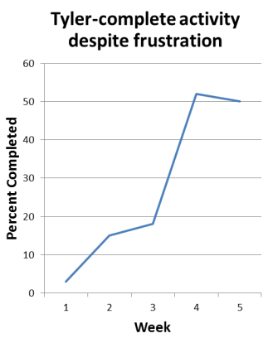
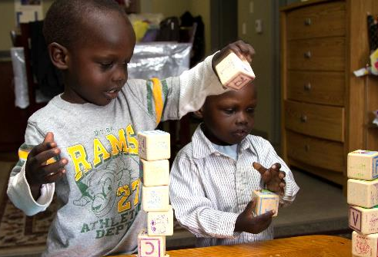
INTERPRETING Assessment DATA: When A Child is Progressing
Continue with what you have been doing.

Slide 9
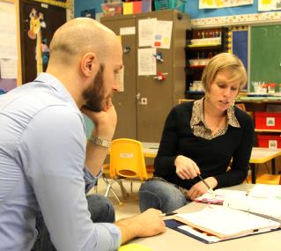
INTERPRETING Assessment DATA: When A Child iSN’t Making Progress
Change what or how you are teaching.
Make the goal or task simpler
Change the setting or schedule
Increase learning opportunities or time allotted
Adjust the type of assistance
Provide additional resources

Slide 10
INTERPRETING Assessment DATA: When A Child has Reached a Goal
Move on to something more challenging.
Consider the assessment data
Consider the curriculum

Slide 11
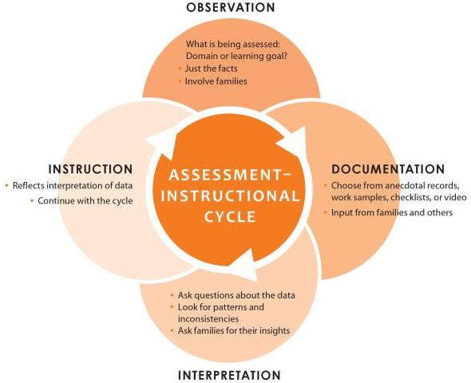
the Assessment–Instructional Cycle

Slide 13
Summary: Using Data to Inform Teaching
Assessment data should be interpreted.
Decide whether children are progressing.
Decide how to adjust your teaching.
Purposefully plan for groups and individuals.
Continue to collect assessment information and use it to inform teaching.

Slide 14
SPRING 2014

