Slide 1
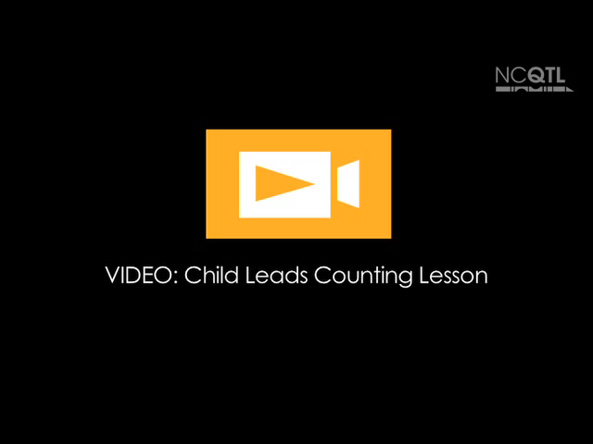
Notes:
Name of video: Child Leads Counting Lesson
Key idea: Letting children lead
Summary: A child leads a group of children in counting in Tagalog. The child points to the word and says it first. The group repeats after him.
Length of video: 40 seconds
Suite name: Giving Children Responsibilities

Slide 2

Notes:
Name of video: Helping Move Materials
Key idea: Encouraging children to help each other
Summary: A teacher notices that a boy needs help carrying a large blue box. He encourages a girl to help. Together, the children are able to get the box to the book area.
Length of video: 28 seconds
Suite name: Giving Children Responsibilities

Slide 3

Notes:
Name of video: Setting the Table
Key idea: Providing meaningful roles
Summary: A teacher gives a boy the responsibility of placing napkins and milk glasses on the table for breakfast while others arrive. (The teacher is speaking in Cantonese.)
Length of video: 59 seconds
Suite name: Giving Children Responsibilities

Slide 4

Notes:
Name of video: Who Let the “A” Out?
Key idea: Letting children lead
Summary: During an alphabet activity at morning circle, a girl leads the whole group in singing “Who Let the ‘A’ Out” while pointing to the appropriate letter.
Length of video: 44 seconds
Suite name: Giving Children Responsibilities

