Slide 1
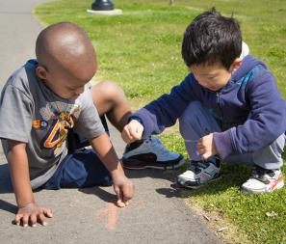
Engaging interactions: Fostering children’s thinking skills
FALL 2012

Slide 2
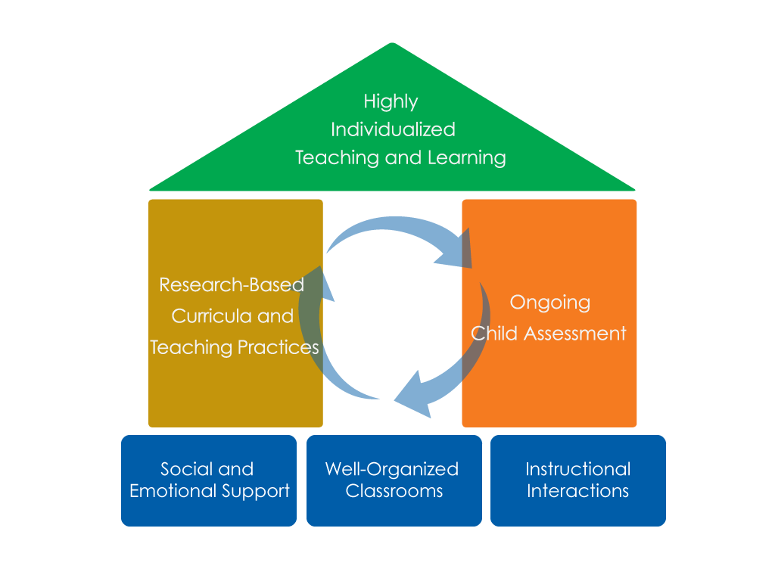
FRAMEWORK FOR EFFECTIVE PRACTICE SUPPORTING SCHOOL READINESS FOR ALL CHILDREN
FOCUS ON
FOUNDATION

Slide 3
Objectives
Provide a definition of fostering children’s thinking skills.
Give examples and strategies for how teachers can foster children’s thinking skills in the classroom.
Connect fostering children’s thinking skills to the Head Start Child Development and Early Learning Framework.
Provide suggestions for teachers on how to improve their ability to foster children’s thinking skills.

Slide 4
Fostering Children’s Thinking Skills
What does it look like?
Classroom interactions that focus on “big ideas” and deepen children’s knowledge of the world around them.
Children’s thinking skills can be fostered during interactions that involve:
Using the scientific method
Problem-solving
Applying knowledge
What does it NOT look like?
Drilling children on facts or skills.

Slide 5
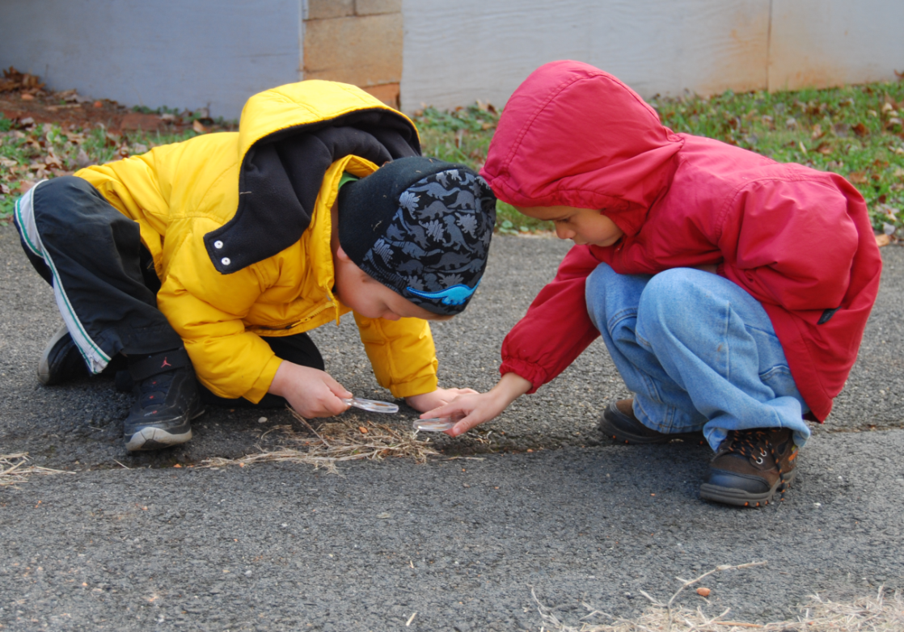
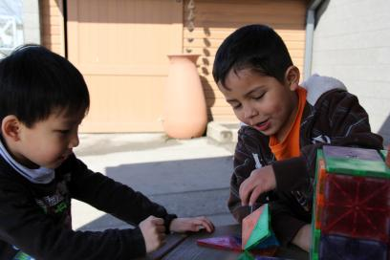
Fostering children’s thinking skills BY USING THE Scientific METHOD
Provide tasks where children can observe, predict, and experiment.

Slide 6
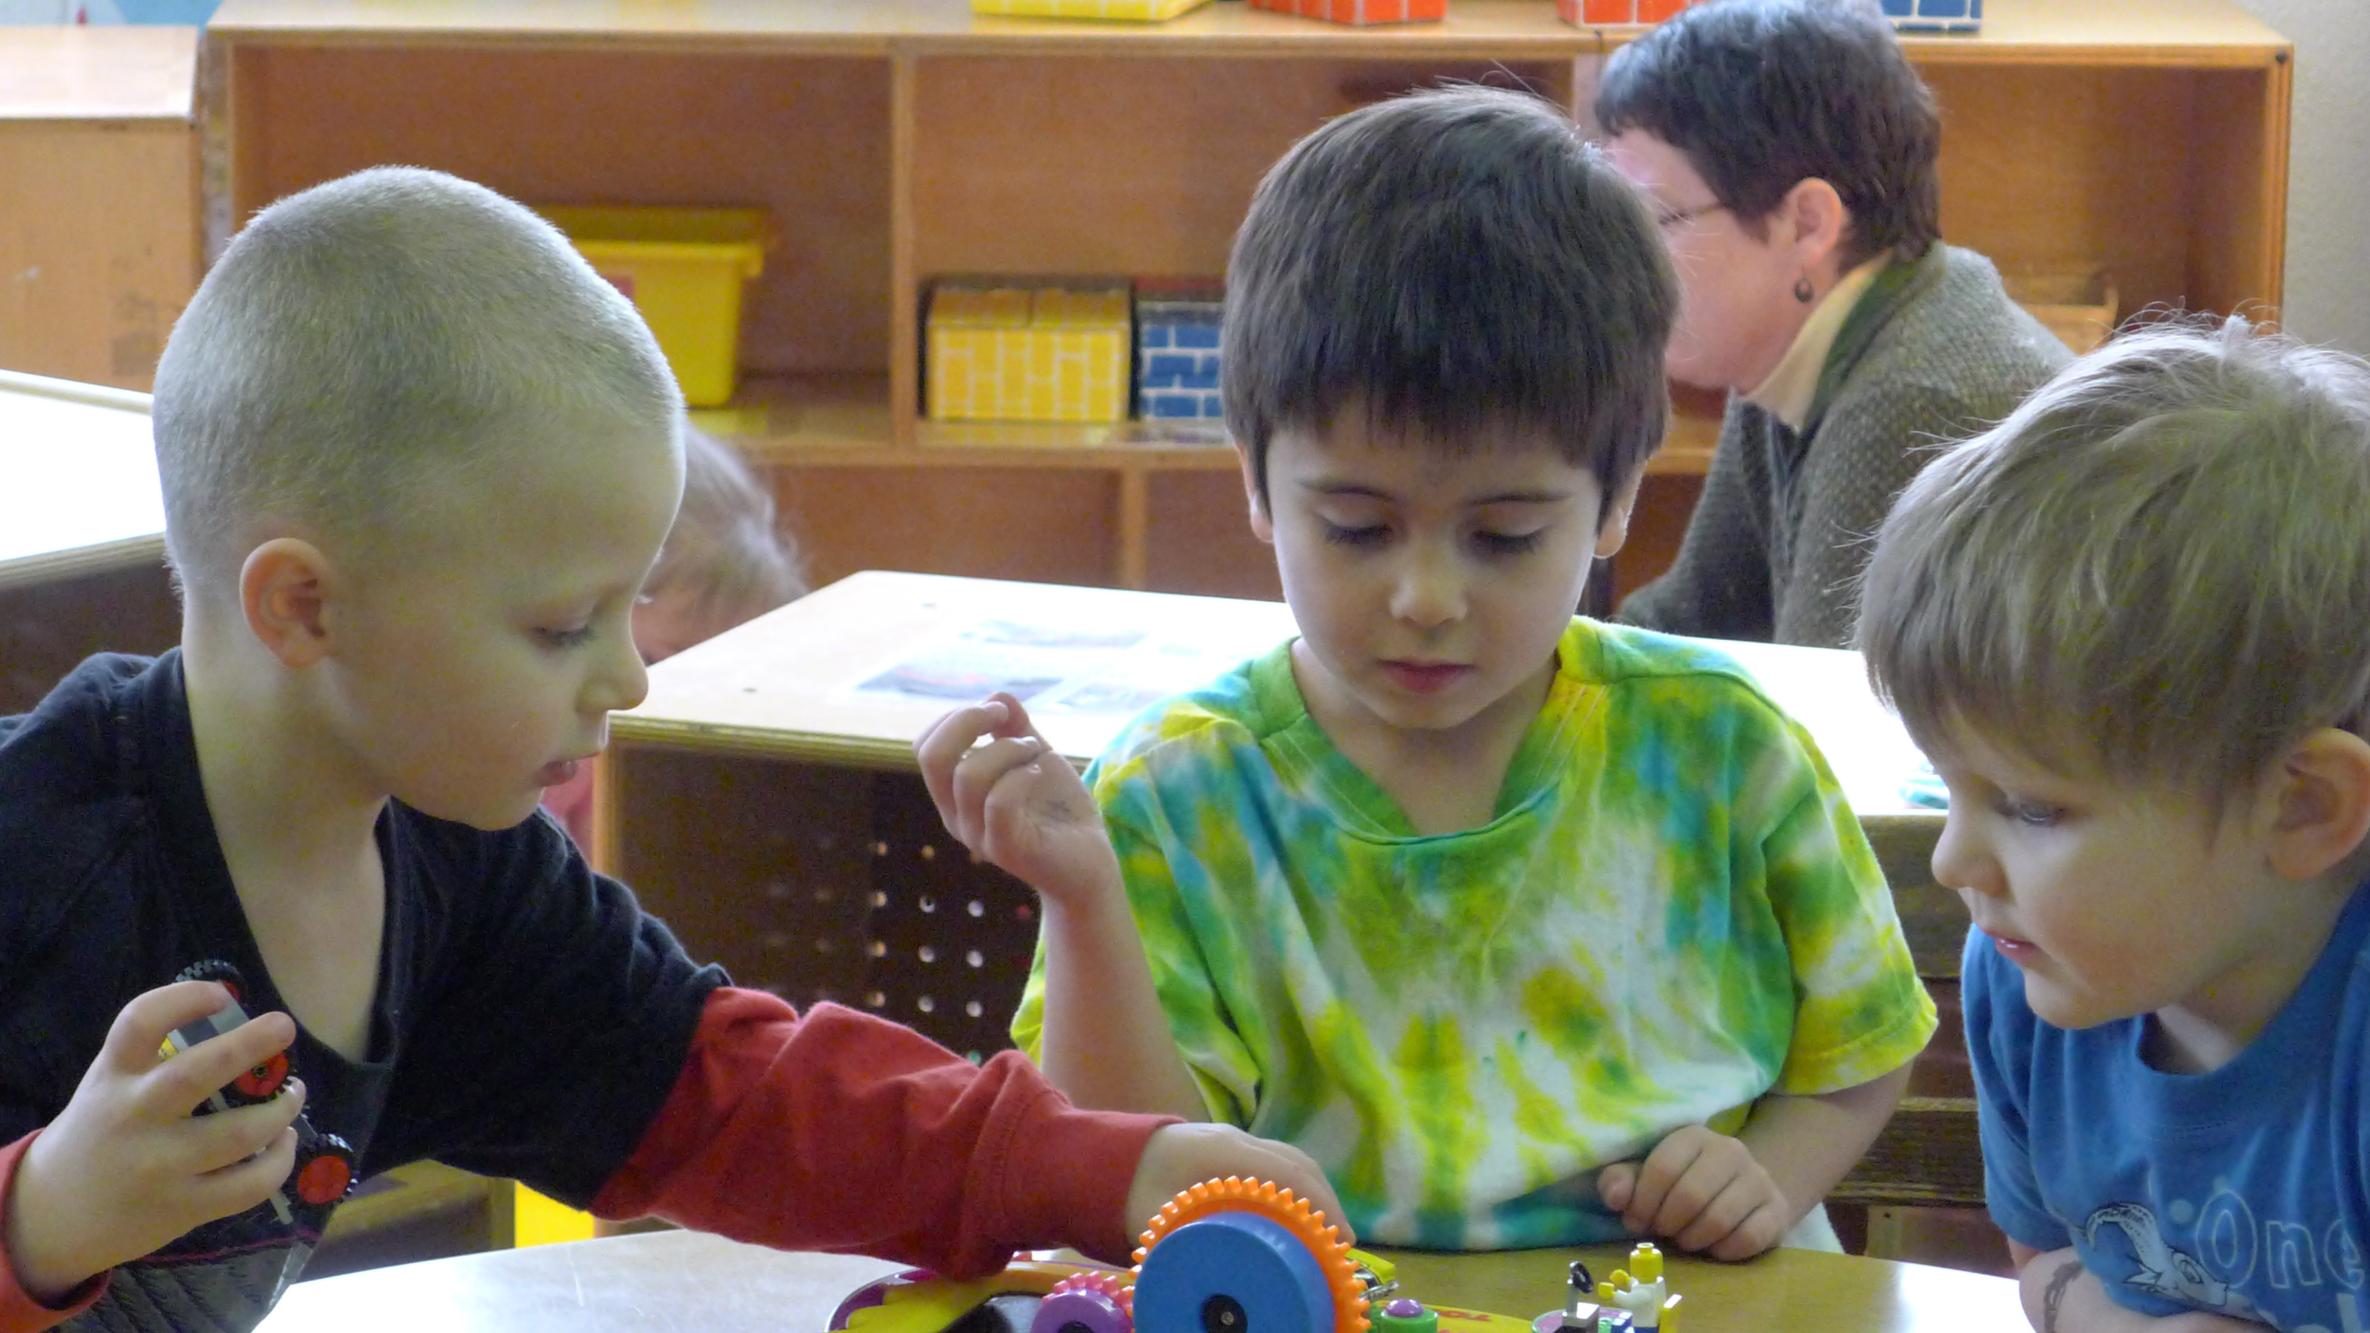
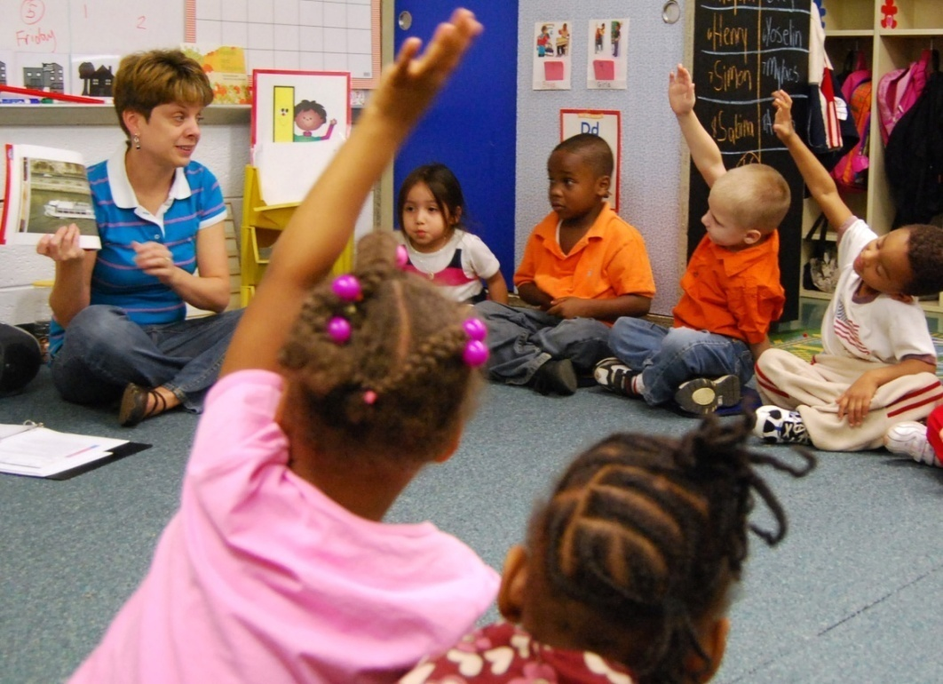
Fostering children’s thinking skills BY problem solving
Create opportunities for children to brainstorm, plan, and solve problems.

Slide 7
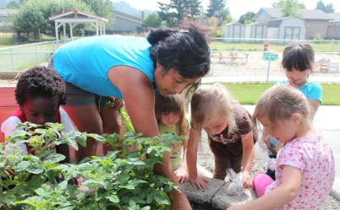
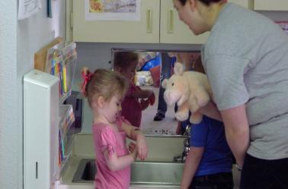
Fostering children’s thinking skills BY APPLYING KNOWLEDGE
Build on children’s natural curiosity by drawing upon their everyday experiences and connecting previous knowledge.

Slide 8
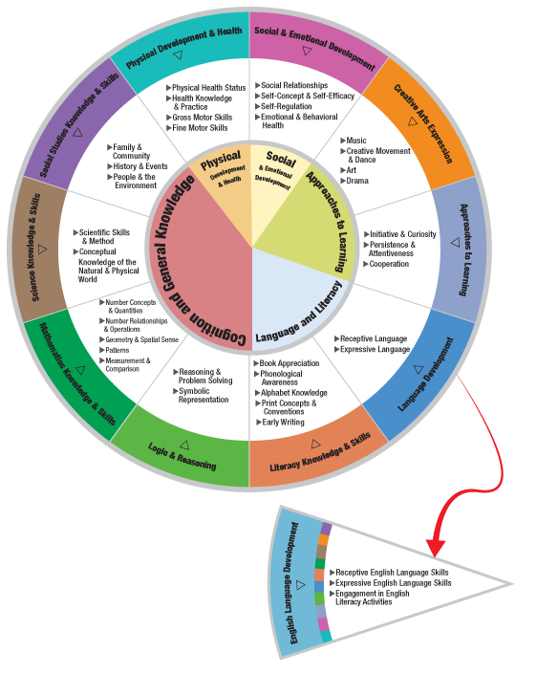
THE HEAD START CHILD DEVELOPMENT AND EARLY LEARNING FRAMEWORK
The scientific method can be incorporated within many areas of the framework.
Some examples are:
Logic & Reasoning
Literacy Knowledge & Skills
Mathematical Knowledge & Skills
Social & Emotional Development
Science Knowledge & Skills

Slide 9
Video: Nature Walk
Source: The Center for Advanced Study of Teaching and Learning (CASTL)

Slide 10
In this clip, the teacher asks children to…
Predict what types of plants they might see on their nature walk.
Supports children’s Logic & Reasoning Skills
Connect ideas about nature with the book the class read the previous day.

Slide 11
Video: BOOK READING
Source: The Center for Advanced Study of Teaching and Learning (CASTL)

Slide 12
In this clip, the teacher asks children to…
Brainstorm about fiction vs. information books.
Supports children’s Literacy Knowledge & Skills
Draw upon their experiences when talking about pets being allowed inside.

Slide 13
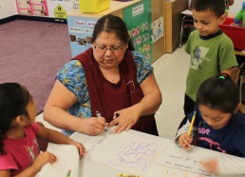
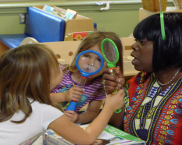
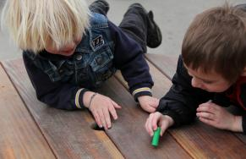
When Can I FOSTER CHILDREN’S THINKING SKILLS?
Teachers can foster children’s thinking and understanding throughout the school day in many classroom activities.

Slide 14
Improving practice
Video record and review your own teaching.
Practice with a peer.
Watch a “master teacher” in action.

Slide 15
Summary
Teachers can foster children’s thinking skills by:
Using the scientific method: Provide tasks where children can observe, predict, and experiment.
Problem-solving: Create opportunities for children to brainstorm, plan, and solve problems.
Applying knowledge: Build on children’s natural curiosity by drawing upon their everyday experiences and connecting previous knowledge.

Slide 16
FALL 2012

