Slide 1
Engaging Interactions: Scaffolding Children’s Learning
Supporting Quality Teaching and Learning in AI/AN Head Start Classrooms
FALL 2013

Slide 2
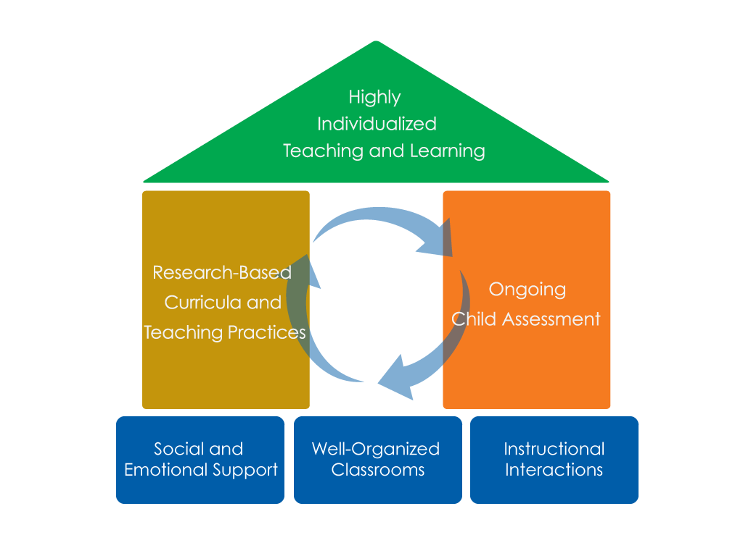
FRAMEWORK FOR EFFECTIVE PRACTICE SUPPORTING SCHOOL READINESS FOR ALL CHILDREN
FOCUS ON
FOUNDATION

Slide 3
Objectives
Provide a definition of scaffolding.
Give examples and strategies of how teachers can scaffold children’s learning.
Connect to the Head Start Child Development and Early Learning Framework.
Provide suggestions for teachers on how to improve their ability to scaffold.

Slide 4
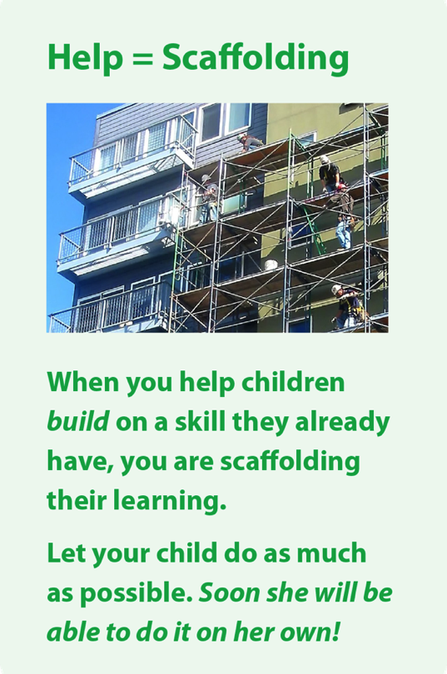
Scaffolding Children’s Learning
What does it look like?
Teachers provide different levels of support and feedback to meet children’s individual needs, which allow children to perform at a higher level than they would independently. Teachers scaffold by:
Provide hints when children struggle to understand concepts.
Offer a range of answers for children to choose from when they need extra support answering a question.
Encourage children to use additional resources to help them understand concepts and ideas.
What does it NOT look like?
Teachers provide children with “right” answers.

Slide 5
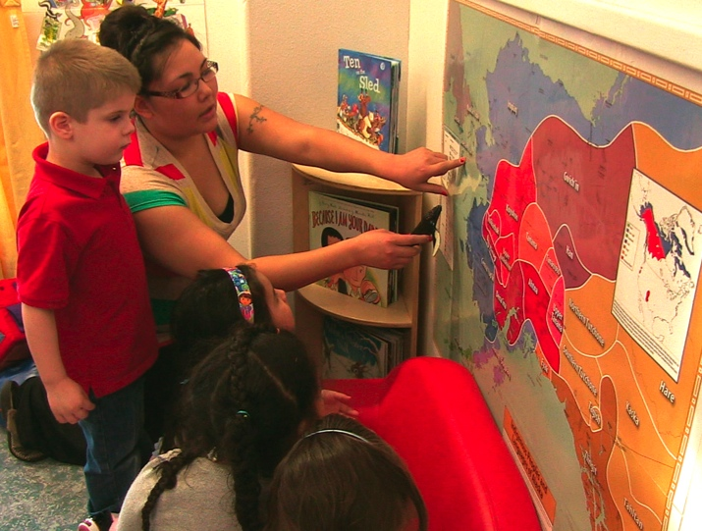
Provide hints
Assist children when they have difficulty understanding, answering, or completing a task by providing hints.
Teacher: Yesterday we talked at circle about whales coming home to Alaska in the spring. Do you remember how far north they swim?
Child: (says nothing)
Teacher: The whales swims north in the Pacific Ocean all the way to another ocean. (Uses whale toy as a prop to show whale swimming.)
Child: The Arctic Ocean!
Teacher: You’re right; they swim all the way to the Artic Ocean!

Slide 6
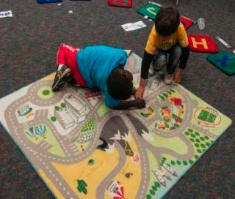
Offer a range of answers
Provide a range of answers for children to choose from when they need extra support.
Teacher: Do you remember which one of our community helpers builds roads?
Child: A policeman?
Teacher: Police officers are seen out on the streets but do they build them?
Child: (shrugs)
Teacher: Let’s look at some choices. We have a dentist, baker, teacher, or construction worker.
Conversation continues…

Slide 7
Use additional resources
Encourage children to use additional resources to help them understand concepts and ideas.
Teacher: Do you know what caterpillars turn into?
Child: I dunno.
Teacher: Why don’t we search for some information about caterpillars and see if we can figure it out.

Slide 8
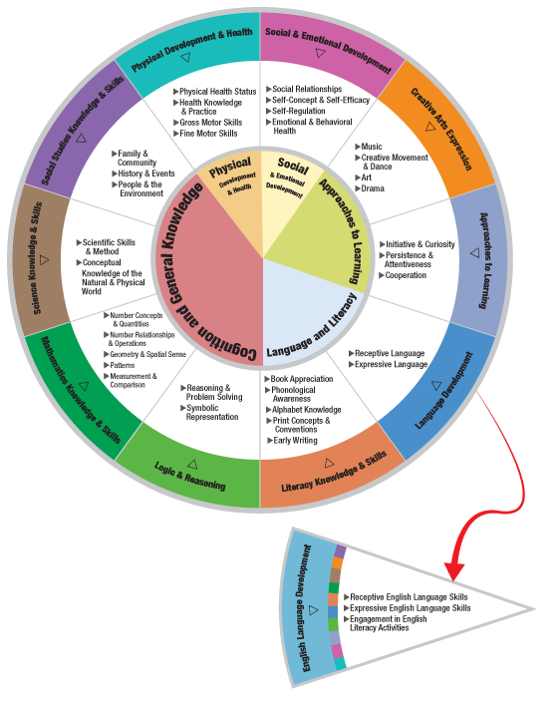
HEAD START CHILD DEVELOPMENT AND EARLY LEARNING FRAMEWORK
Scaffolding can be incorporated within many areas of the framework.
Some examples are:
Literacy Knowledge & Skills
Science Knowledge & Skills
Mathematics Knowledge & Skills
Social Studies Knowledge & Skills
Logic & Reasoning

Slide 10
IN THIS CLIP…
The teacher provides a hint as the child identifies the name of the ocean.
The teacher uses a number chart to help children identify the year that follows 2012.
Supports children’s
Social Studies Knowledge & Skills

Slide 12
IN THIS CLIP…
Teacher #1 provides a range of answers to help children develop a strategy for completing a puzzle independently by asking if the next piece is small, medium, or large.
Supports children’s
Mathematical Knowledge & Skills
Teacher #2 provides children with a range of answers for how a bear might sleep when hibernating. The teacher says, “Do you think they hibernate by…”:
Standing up or laying down?
Curled up in a ball or stretched out long?
Supports children’s
Scientific Knowledge & Skills

Slide 14
IN THIS CLIP…
The teacher uses a map to help children better understand the migration pattern of whales.
Supports children’s
Approaches To Learning

Slide 15
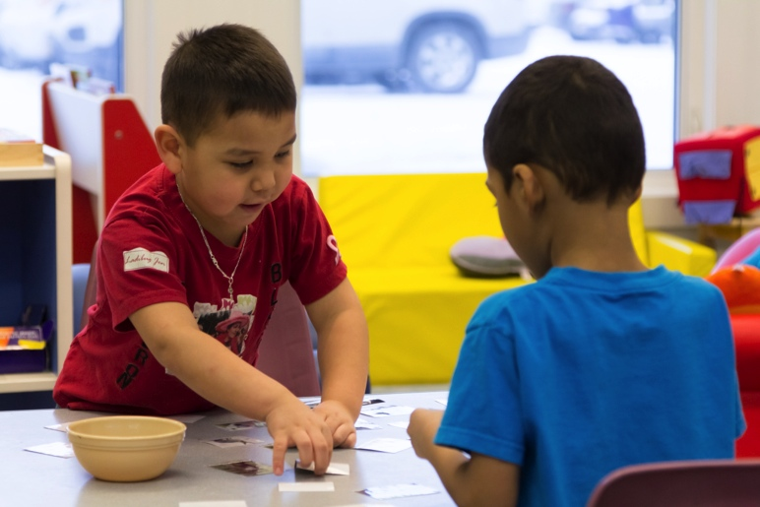
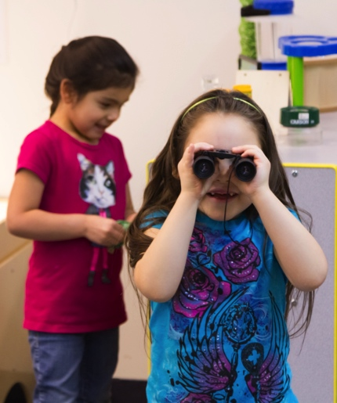
When Can I scaffold?
Teachers may scaffold children’s learning throughout the school day in many classroom activities.

Slide 16
Improving practice
Video record and review your own teaching.
Practice with a peer.
Watch a “master teacher” in action.

Slide 17
Summary
Teachers can scaffold children’s learning by:
Providing hints when children have difficulty understanding concepts.
Offering a range of answers when children need extra support.
Encouraging children to use additional resources to help them understand concepts and ideas.

Slide 18
FALL 2013

