Slide 1
Further Examples of Differentiating
More of the counting learning trajectory.
Let’s start with more of the developmental progression.

Slide 2
Number Sayer
Children begin connecting small quantities to number words to form an initial idea of cardinality, or how-many-ness.
Following their first birthday, children often learn the number word two.
Counting
Strategies
Other general terms such as many and less usually follow. After that, children often learn one, and for some children, three.
Only over time do they begin to understand that all groups labeled with the same number word…actually have the same amount.
Number Sayer

Slide 3
Chanter
Says numbers in sequence but may run together.
Counting
Strategies
Chanter
Number Sayer

Slide 4
Reciter
Verbal counting to 5, then 10.
Counting
Strategies
Reciter
Chanter
Number Sayer

Slide 5
Corresponder
Counts correctly using 1-1 correspondence, up to 5 objects in a line.
Counting
Strategies
Corresponder
Reciter
Chanter
Number Sayer

Slide 6
Counter/Producer
Counts out a collection up to 5.
Counting
Strategies
Producer (Small Numbers)
Counter (Small Numbers)
Corresponder
Reciter
Chanter
Number Sayer

Slide 7
Counter & Producer
Counts and counts out objects accurately beyond 10 (usually to 30 or more). Keeps track of objects that have and have not been counted, even in different arrangements.
Counting
Strategies
Counter and Producer (10+)
Producer (Small Numbers)
Counter (Small Numbers)
Corresponder
Reciter
Chanter
Number Sayer

Slide 8
LT^{2:} A Counting Example
LearningTrajectories.org
Example…click here

Slide 9
Differentiating Teaching
Notice and encourage children’s natural development through the developmental progression.
Count in rhymes, finger plays, stacking blocks—emphasize one or two numbers past where children are.
Don’t underestimate! Higher numbers helps.
Mothers use two more than three and three more than four.
From ages 1-9 and 3-9, children used the word two 158 times, three 47 times, four 18 times, and five only 4 times!

Slide 10
Supporting Teaching and Learning: Examples
Small Groups
Naturalistic Observation
Templates for differentiation
Support from LT²
The Role of Feedback Cycles

Slide 11
Small Groups
Research suggest small groups are the most effective teaching strategy.
There are benefits and misuses of grouping by children’s level of thinking.
Use small group work to differentiate teaching, based on children’s needs and learning trajectories.

Slide 12
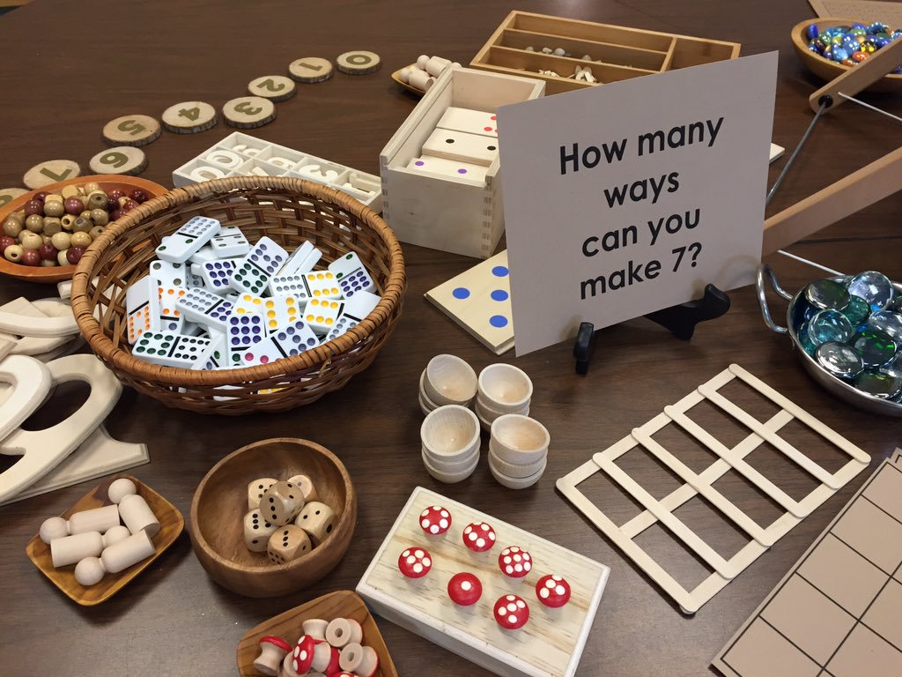
Free Explore—With Observation
4-year-olds explore manipulatives, interacting with each other and the teacher.
Example of teacher’s notes:
Child | Numbers Counted/Produced | LT Level
Nita | VC “2 4…3”; C 2 some corr.; P 1 | Number Sayer
Ming | None in English | ? Check first language
Maria | C 1-5 (card.); P 1, 2, 3 | Counter Small Numbers
José | C 3, 4 corr., no cardinality | Corresponder

Slide 13
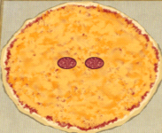
Making Number Pizzas
1. Verbal counting with guided correspondence to 3 or 4. [Repeat informally throughout week.]
2. Count 1-4, emphasis on cardinality. [Repeat on Friday, increasing numbers.]
3. Produce to 5, explore larger numbers.
4. Explore with interpreter.
Child | Numbers | LT Level
1. Nita
2. José
3. Maria
4. Ming

Slide 14
Assessment from Making Number Pizzas
1. Verbal counting with guided correspondence to 3 or 4. [Repeat informally throughout week.]
2. Count 1-4, emphasis on cardinality. [Repeat on Friday, increasing numbers.]
3. Produce to 5, explore larger numbers.
4. Explore with interpreter.
Child | Numbers | LT Level
1. Nita | VC 1-4; C 2 corr. | Reciter
2. José | C 1-5, some cardinality | Corresponder+
3. Maria | C to 6, P to 5 | Producer (Small Numbers)
4. Ming | C to 8, possibly more; P to 6 | Producer (Small Numbers)+

Slide 15
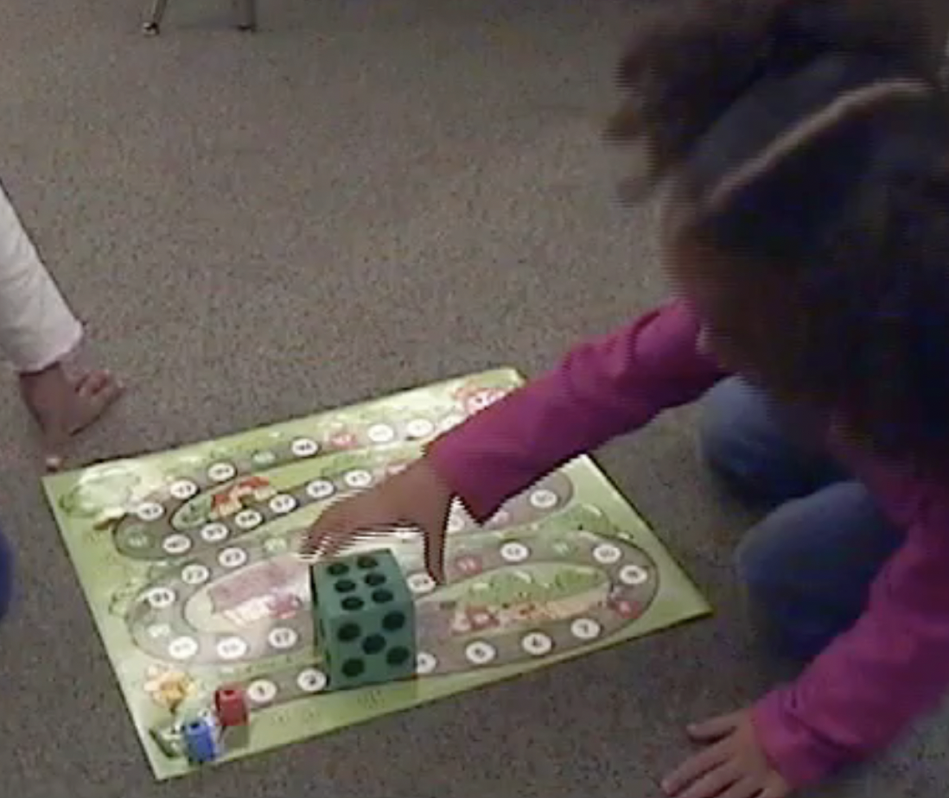
Formative Planning for Board Game
Cube with 1-2, then 1-3 dots.
Cube with 1-6 dots.
Cube with 1-6, then 3-8 dots.
Cube with 3-8, maybe numerals.
Child | Numbers | LT Level
1. Nita
2. José
3. Maria
4. Ming

Slide 16
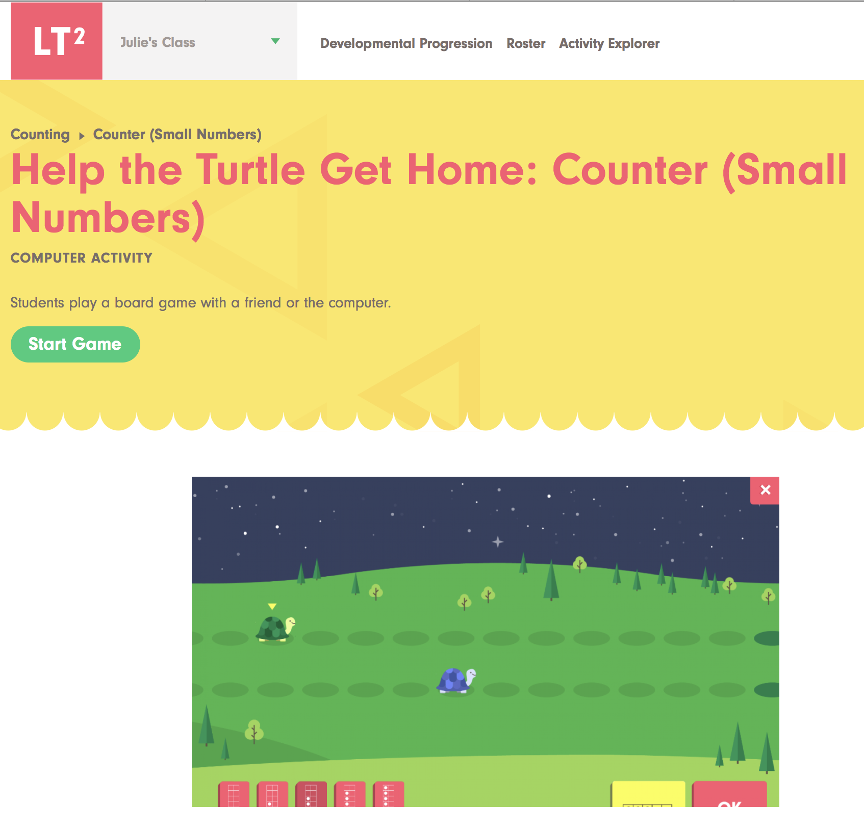
At the Same Time…
LT² games that adjust dynamically with the children’s level.
Immediate feedback, multiple representations.

Slide 17
LT^{2:} An Instructional Example
LearningTrajectories.org
Example…click here

