Slide 1
Curriculum modifications:
Special Equipment

Slide 2
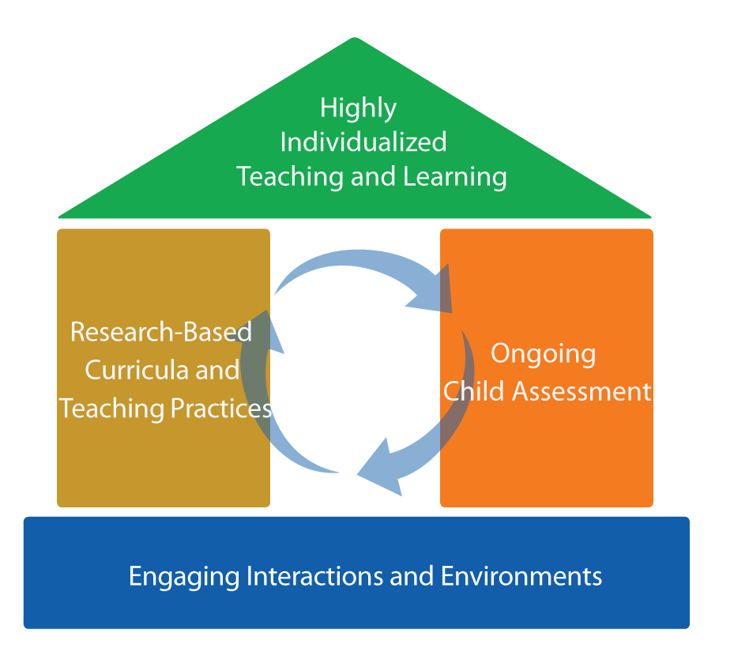
Focus on the roof
FRAMEWORK FOR EFFECTIVE PRACTICE
SUPPORTING SCHOOL READINESS FOR ALL CHILDREN

Slide 3


Curriculum Modification
Intensive,
Individualized
Teaching
Embedded Teaching
Curriculum Modification

Slide 4
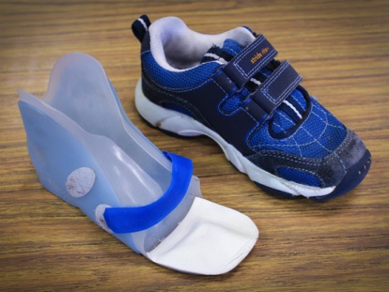
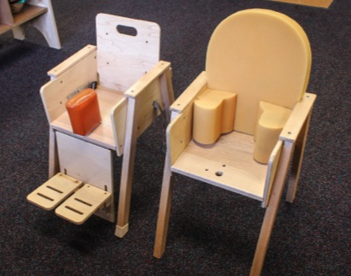
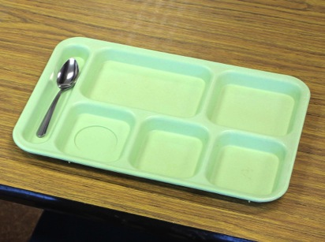
objectives
Define
special equipment.
Give examples of special equipment.
Discuss application based on individual children's needs.

Slide 5
What is curriculum modification?

Slide 6
Types of Curriculum Modifications
Environmental Support
Special Equipment
Materials Adaptation
Adult Support
Simplify the Activity
Peer Support
Child Preferences
Invisible Support

Slide 7
Special equipment
“
Using special or adaptive devices that allow a child to participate or increase
the child’s level of participation.
“
— Sandall & Schwartz, 2008

Slide 8
Why
Use Special Equipment?
Increased learning!
Access
Participation

Slide 9
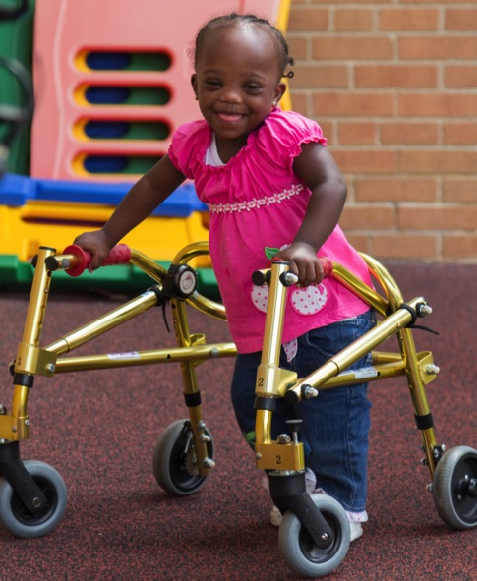
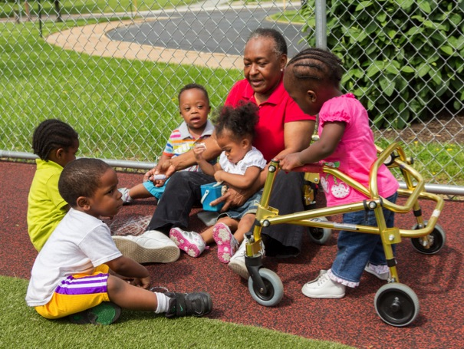
Special equipment strategies
Increase
participation
Give access

Slide 10


Slide 11
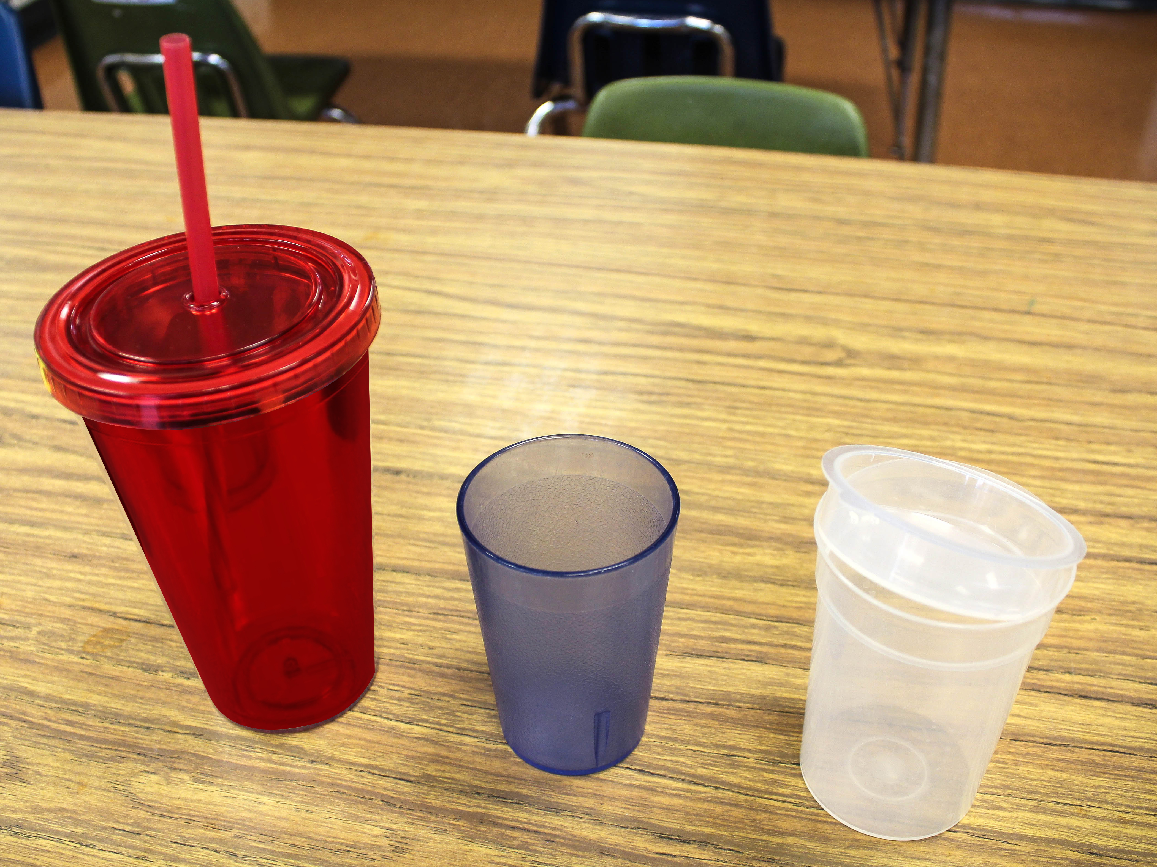
Special Equipment can be...

Slide 12

Video

Slide 13


Slide 14


Slide 15
Review
Curriculum modification promotes participation.
Special equipment increases access and participation.

