Slide 1
Curriculum modifications:
Materials Adaptation

Slide 2
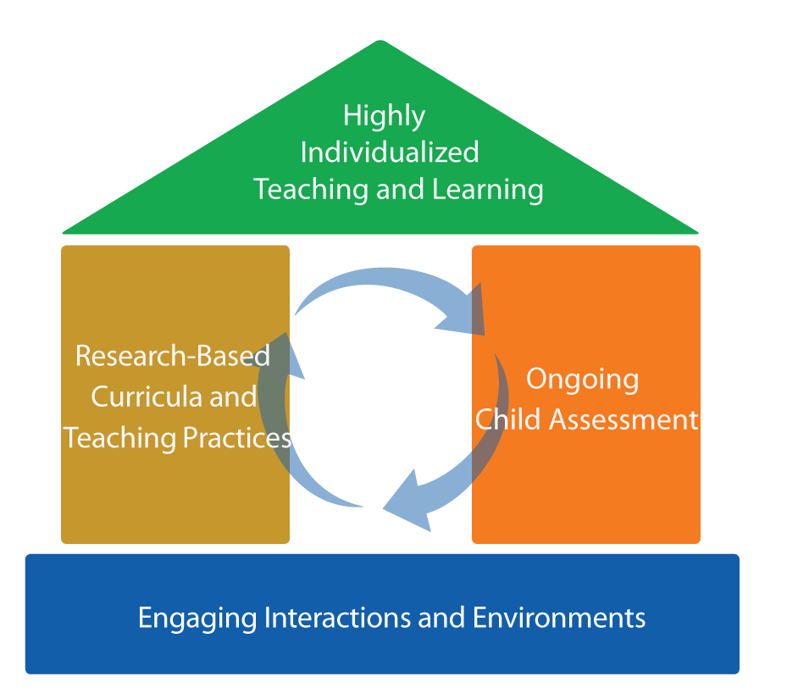
Focus on the roof
FRAMEWORK FOR EFFECTIVE PRACTICE
SUPPORTING SCHOOL READINESS FOR ALL CHILDREN

Slide 3

Curriculum Modification
Intensive,
Individualized
Teaching
Embedded Teaching
Curriculum Modification

Slide 4
objectives
Define materials adaptation.
Give examples of materials adaptation.
Consider where and when to adapt.
Discuss application based on individual children's needs.

Slide 5
What is curriculum modification?

Slide 6
Types of Curriculum Modifications
Environmental Support
Special Equipment
Materials Adaptation
Adult Support
Simplify the Activity
Peer Support
Child Preferences
Invisible Support

Slide 7
MATERIALS ADAPTATION
“
Modifying materials so that the
child can participate as independently as possible.
“
— Sandall & Schwartz, 2008

Slide 8
Why
Adapt materials?
Increased learning!
Access
Participation

Slide 9
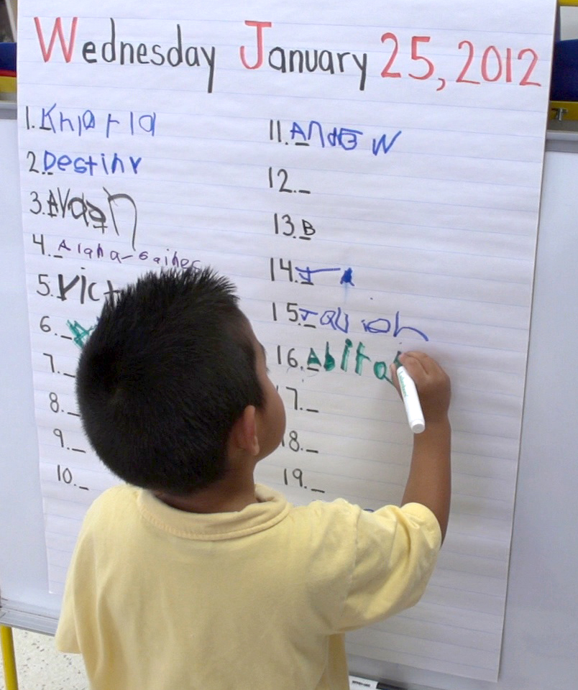

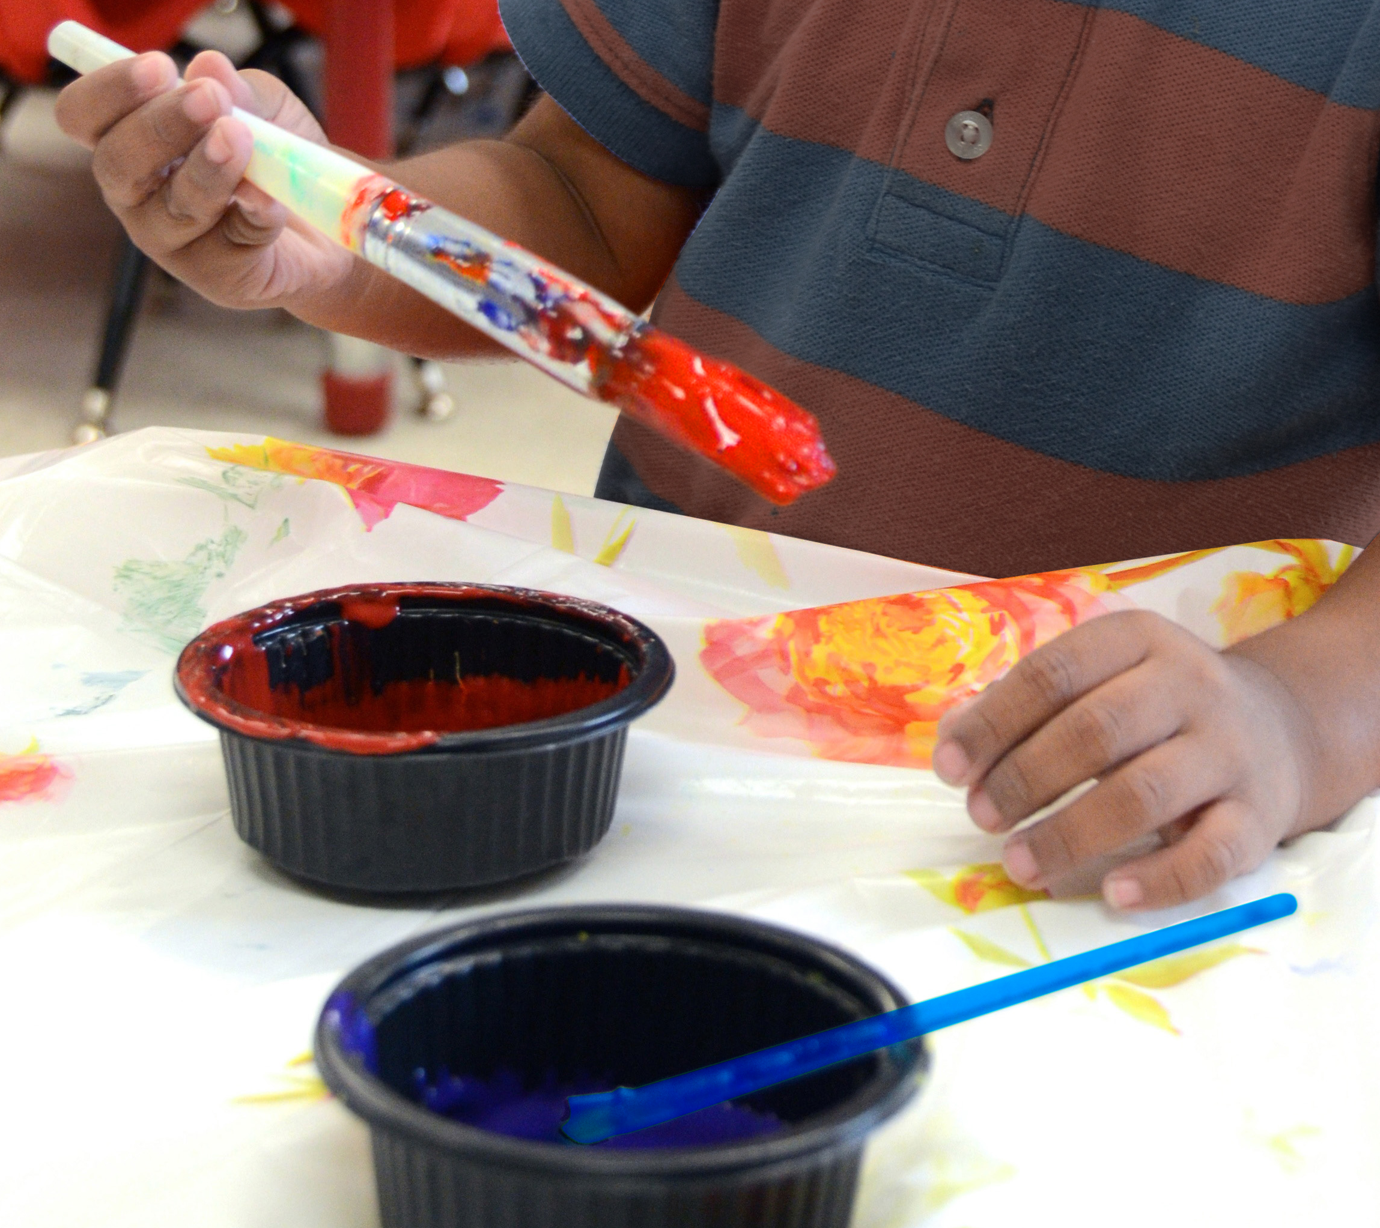
Strategies for Materials adaptation
Optimal position
Stabilize
Modify response
Larger or brighter

Slide 10
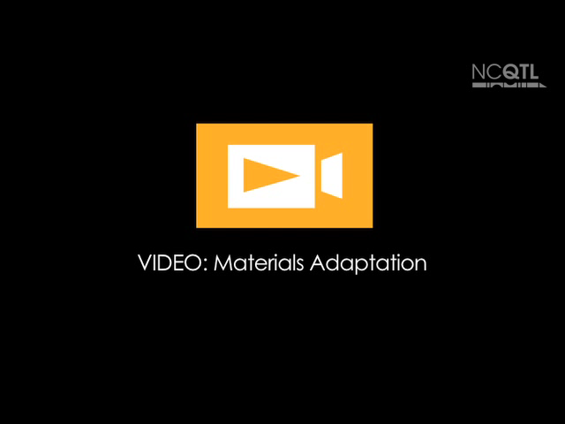
Materials Adaptation

Slide 11
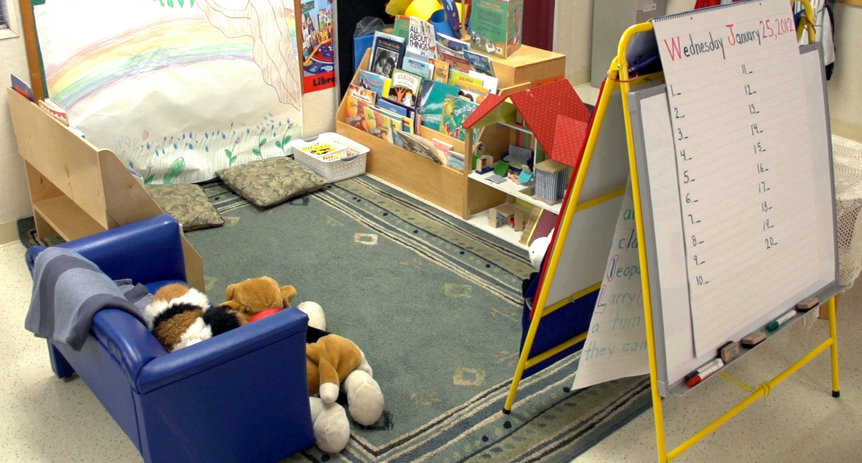
review
Curriculum modifications promote participation.
  Materials Adaptation:
    Optimize positioning
    Stabilize materials
    Modify the response
    Make materials larger
    or brighter

Slide 12
WINTER 2014

