Slide 1
HSPPS Supports Cultural Responsiveness
Education and Child Development Program Services Subpart C – 1302.30
A program must deliver developmentally, culturally, and linguistically appropriate learning experiences in language, literacy, mathematics, social and emotional functioning, approaches to learning, science, physical skills, and creative arts.
Family and Community Engagement Program Services Subpart E – 1302.50 (b)(2)
Develop relationships with parents and structure services to encourage trust and respectful, ongoing two-way communication between staff and parents to create welcoming program environments that incorporate the unique cultural, ethnic, and linguistic backgrounds of families in the program and community;

Slide 2

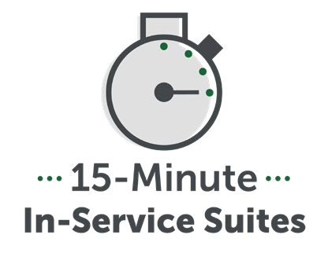
What is Culture?

Slide 3
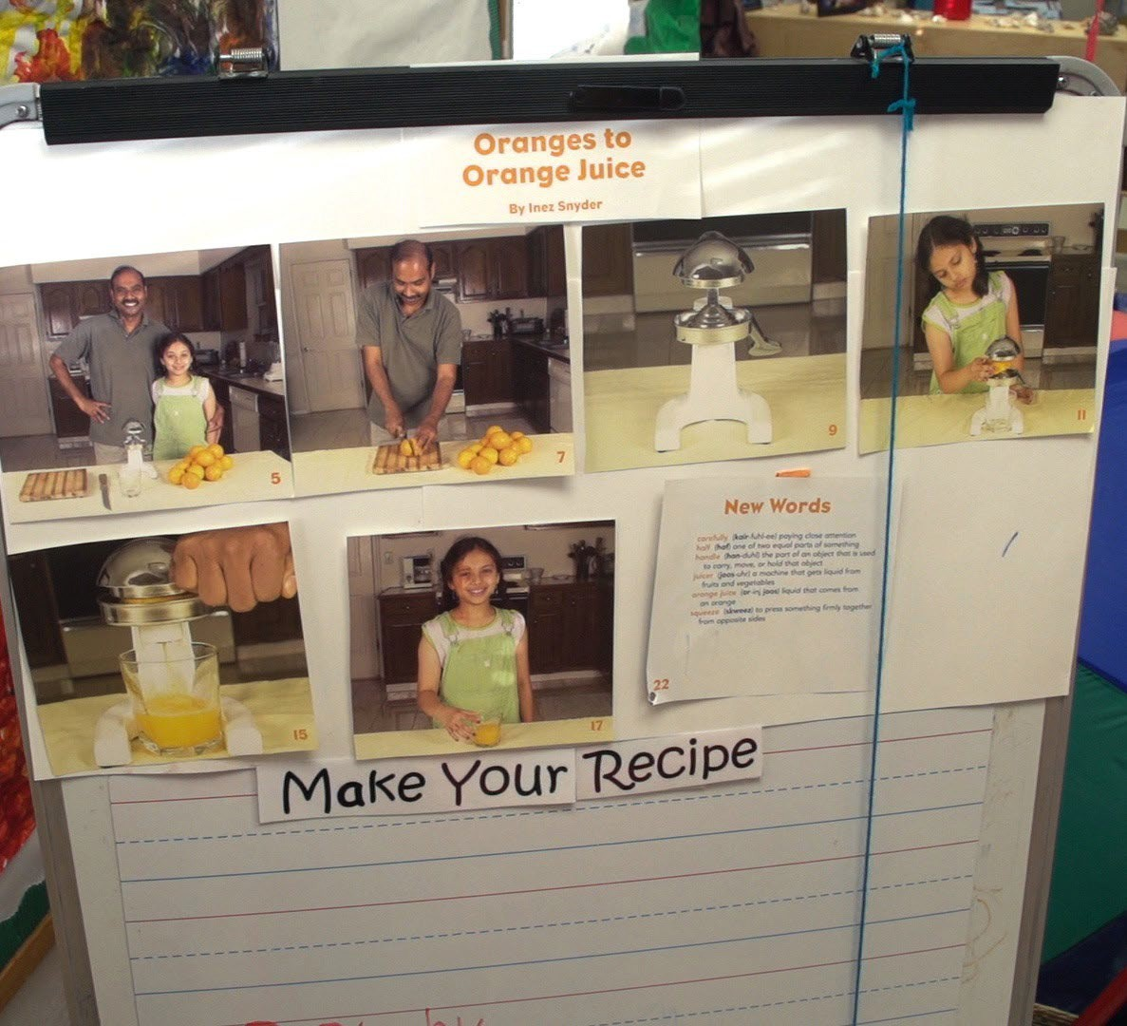
Exploring How Your Curriculum Supports Cultural Responsiveness

Slide 4
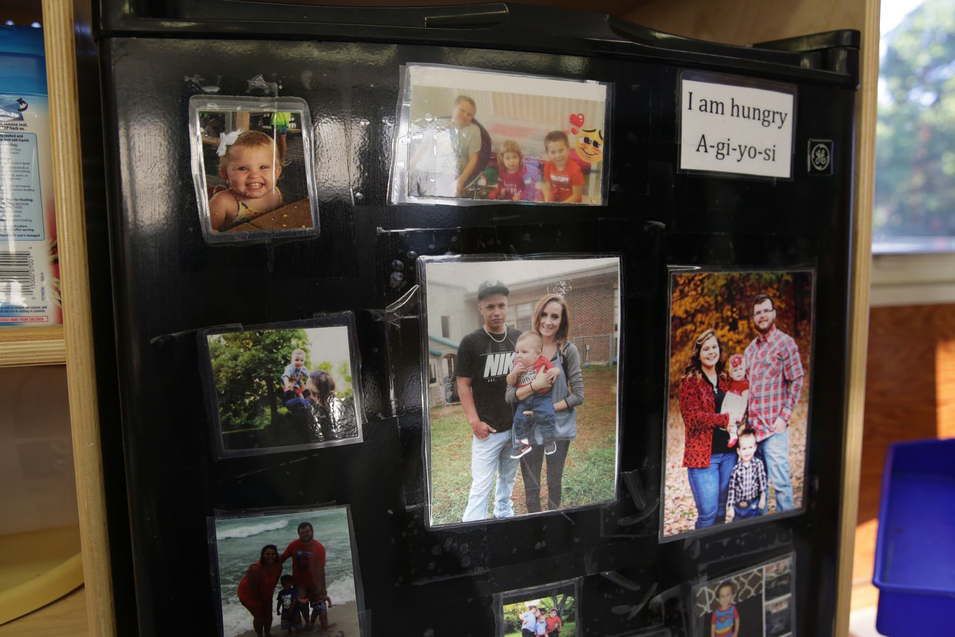
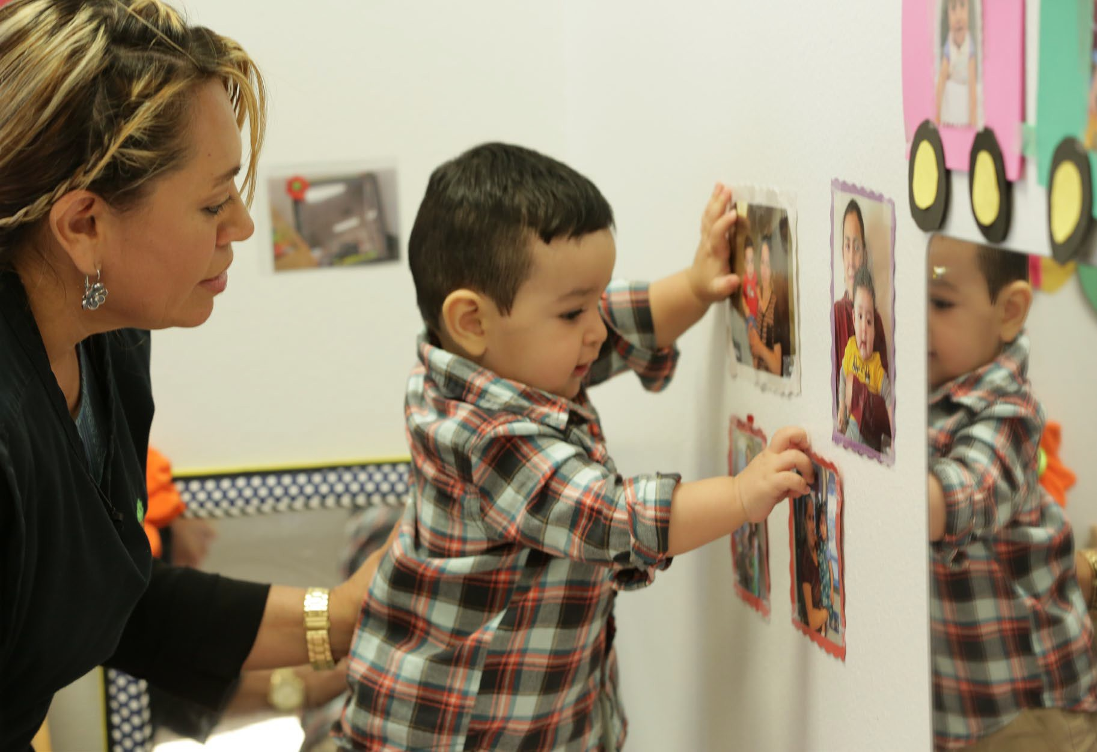
Inviting Families to Share their Cultures in the Early Learning Setting

