Slide 1
BEHAVIOR GUIDANCE: STATING BEHAVIORAL EXPECTATIONS
FALL 2012

Slide 2
FRAMEWORK FOR EFFECTIVE PRACTICE SUPPORTING SCHOOL READINESS FOR ALL CHILDREN
FOCUS ON
FOUNDATION

Slide 3
what will I learn?
To define behavioral expectations
To identify benefits of stating behavioral expectations in advance
To learn the steps for developing and teaching expectations for children’s behaviors

Slide 4
WHAT ARE BEHAVIORAL EXPECTATIONS?
Appropriate behaviors expected from children during specific activities and routines.
Ongoing moment-to-moment teaching practice
Teachers SAY what they want to SEE

Slide 5
BENEFITS of Behavioral Expectations
Prepare children for success!
Maximize children’s learning time.
Build a common language.
Provide a consistent message to children.
Set the stage for learning.
Help prevent behavior problems before they happen.

Slide 6
DEVELOPING AND TEACHING EXPECTATIONS
STEPS:
Anticipate unfamiliar activities.
Plan for appropriate behaviors.
Prepare children for what you want to see.
Recognize children’s appropriate behavior.

Slide 7
Step One: Anticipate unfamiliar activities
Teachers anticipate by:
Thinking through daily activities that may be unfamiliar for children.

Slide 9
Step Two: PLANNING
Teachers plan by:
Writing out expectations in positive terms.
“Say what you want to see”
Preparing needed materials.

Slide 11
Step Three: Preparing children
Teachers prepare children by:
Stating expected behaviors in advance.
Posting expectations:
At children’s eye level.
With simple words and pictures.
Repeating expectations often.

Slide 12
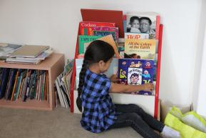
Preparing Children: book area

Slide 13
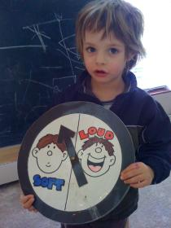
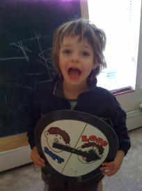
Preparing Children: voice volume

Slide 14
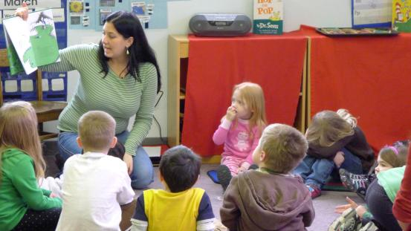
Preparing children
Teachers prepare children by:
Using a variety of strategies

Slide 15
Preparing: Teaching Quiet walking

Slide 17
Step Four: Recognize children’s appropriate behavior
Teachers recognize children’s appropriate behavior by:
Acknowledging appropriate behavior.
Encouraging behavior to continue.

Slide 19
Review: Stating Behavioral EXPECTATIONS
STEPS:
Anticipate behaviors.
Plan for appropriate behaviors.
Prepare children for what you want to see.
Recognize children’s appropriate behavior.

Slide 20
FALL 2012

