Slide 1
Behavior Guidance: Problem solving in the moment
FALL 2012

Slide 2
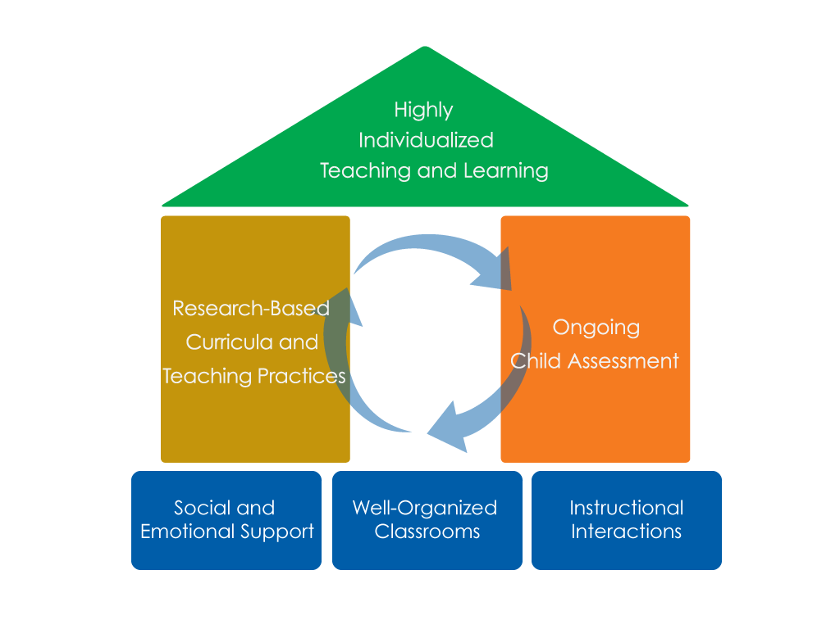
FRAMEWORK FOR EFFECTIVE PRACTICE SUPPORTING SCHOOL READINESS FOR ALL CHILDREN
FOCUS ON
FOUNDATION

Slide 3
Objectives
Guide children’s behavior
Support children in solving problems

Slide 4
Benefits
Common strategy for all adults in classroom
Useful with a variety of problem solving approaches
Allows for flexibility and adaptations for individual children

Slide 5
Think five
4. Multiple
solutions
2. Be close
3. Provide support
5. Celebrate
success
1. Anticipate

Slide 6
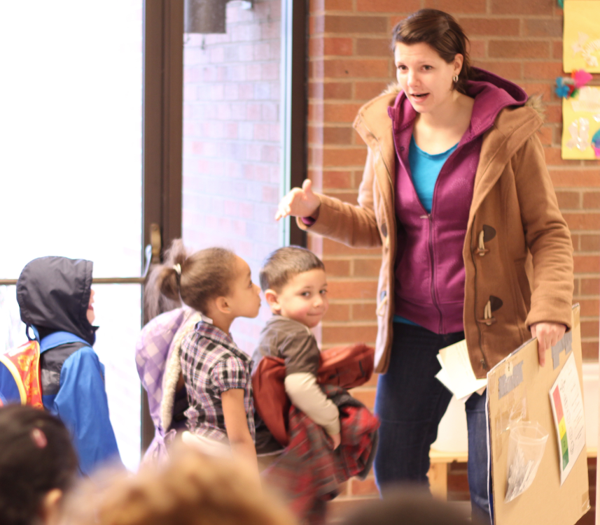
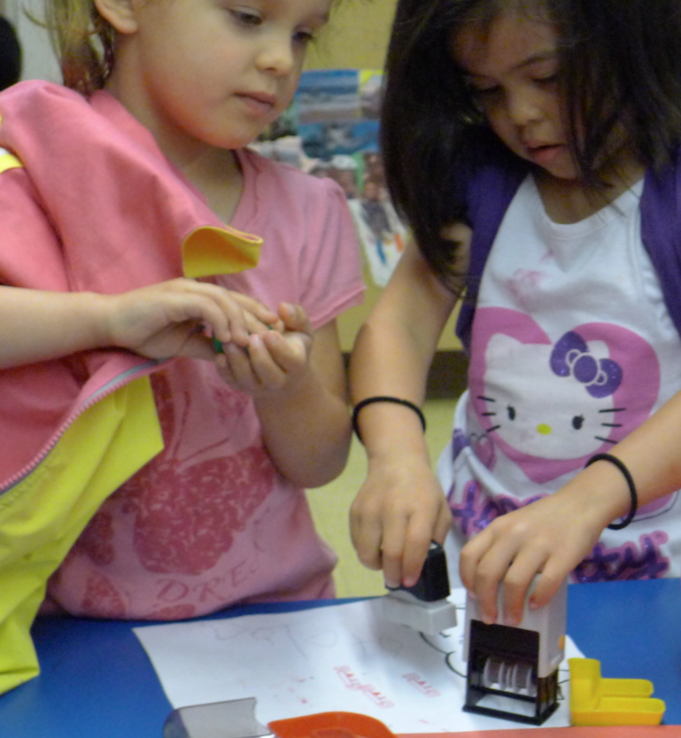
STEP 1: Anticipate
Sense
Be Aware

Slide 7
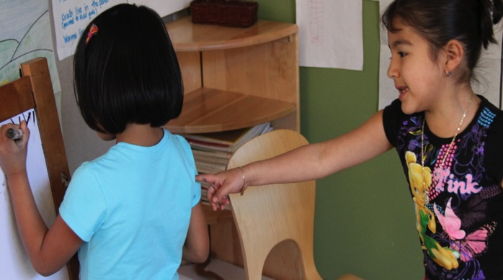
STEP 2: Be close

Slide 8
GET close Video
Educare Quinn UWTV 139
Group of children outside playing with chalk and the teacher is near the group
(Use entire clip.)

Slide 9
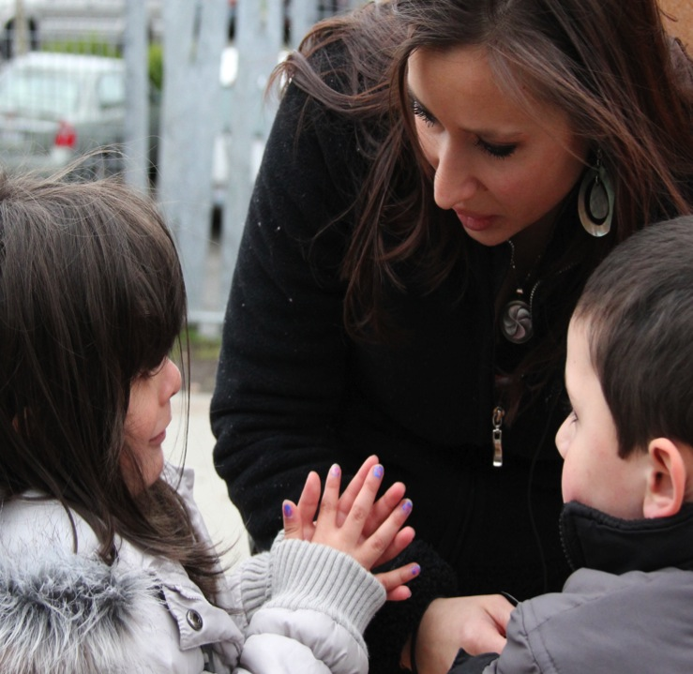
Step 3: Provide Support
Sometimes support means…
Helping children stay near
Sometimes support means…
Prompting
Sometimes support means…
Visuals

Slide 10
Step 4 Multiple solutions
First solutions may not work
Generate multiple solutions

Slide 11
Multiple solutions video
Port Townsend 275 (00.26 – 01.35)
Children playing in a cardboard house– teacher helping to solve problem; several solutions generated and one selected.

Slide 12
Step 5: Celebrate Success
Super Problem Solver
<your name here>
Was a SUPER PROBLEM SOLVER on
<date>
for
<task>

Slide 13
REVIEW
4. Multiple
solutions
2. Be close
3. Provide support
5. Celebrate
success
1. Anticipate

Slide 14
FALL 2012

