Slide 1

Head Start A to Z, 2.0
Data and Evaluation
Notes:
Slide 1
Facilitator Notes:
Welcome participants to the session and introduce yourself. If you have co-facilitators, invite them to introduce themselves as well. Begin the session with an introductory activity to create a positive group climate and begin the engagement process. Then explain the following.
Say to Participants: “The National Center on Program Management and Fiscal Operations has updated Head Start A to Z to align with the revised Head Start Program Performance Standards that became effective November 2016. Head Start A to Z was originally designed to support new leaders in their Head Start roles. The term ‘leaders’ ensures that anyone at the management level, or in some cases the governing body, Tribal Council, or Policy Council level, can attend the sessions or use the materials for independent learning.
“The updated Head Start A to Z, 2.0, learning modules provide baseline-level information primarily through a leadership and management systems lens. The presentations are modeled on ‘learning organization’ concepts. In each of the modules, we recognize key characteristics of learning organizations, including a supportive learning environment, openness to new ideas, and time dedicated for reflection.
“Each attendee has an important role to play in the success of this session. Those with experience remind us where we’ve come from and what we must do to maintain our identity and uniqueness. New members bring a fresh perspective and remind us what we must do to prepare for the future. All roles are essential for Head Start to be a learning organization that continues to grow and flourish.
“Head Start A to Z, 2.0, is most successful when it helps us share the best of what we have to offer with a strength-based focus. As you engage in this session, we hope that you will support one another in the learning process by generously sharing your knowledge, experience, and perspective.”

Slide 2
Learning Objectives
As a result of this session, participants will:
Develop an awareness of the role of the leader in creating a data culture
Learn how to create an organizational culture of data use
Understand the regulatory requirements for data use
Learn how to build organizational capacity in the four data activities
Notes:
Slide 2
Facilitator Notes:
Distribute the Reflective Practice Tool handout.
Say to Participants: “In this module, participants will:
Develop an awareness of the role of the leader in creating a data culture
Learn how to create an organizational culture of data use
Understand the regulatory requirements for data use
Learn how to build organizational capacity in the Four Data Activities
“Let’s start with an activity to get us thinking about data and evaluation. Think about a time in your life when you used data and information to change your behavior; for example, counting calories or steps to lose weight or become more fit. Think about the kind of data you were looking at and how frequently you monitored the data. Did you take the time to stop and analyze the data? Did the data prompt any changes in your behavior? How was that behavior change related to your larger goal?”
Give participants a few minutes to reflect on their own experience and then ask for volunteers to share with the group.
Say to Participants: “What does all this have to do with our work in Head Start? Can using data lead to behavior change? If so, how?”
Facilitate a discussion about how trustworthy data is a powerful tool for change in our organizations. Note that data can be seen as an objective resource that can help us make effective decisions to improve child and family outcomes.
Guide participants to the Reflective Practice Tool handout.
Say to Participants: “At the end of our session, you will be asked to use this Reflective Practice Tool to write down some key thoughts from your learnings. We encourage you to jot down preliminary ideas as we move through this session.”

Slide 3
Six Guiding Principles for A to Z Trainings
1
3
4
Successful programs are learning organizations.
Sound decision-making is informed by quality data.
Relationship-building is at the heart of transformational leadership.
2
5
6
The effective delivery of services grows out of strong systems.
School readiness for all is our driving goal.
Culturally and linguistically diverse organizations rely on intentional, specific, and coordinated approaches.
Notes:
Slide 3
Facilitator Notes:
Distribute the Head Start A to Z Guiding Principles handout.
Say to Participants: “Head Start A to Z, 2.0, is based on six guiding principles. These guiding principles are foundational to the design of the modules and have been aligned with the HSPPS. Note that for this session, we will focus on Guiding Principle 3: Sound decision-making is driven by quality data.
“Head Start directors and managers come from all walks of life with a wealth of employment experiences. However, we all share a commitment to a comprehensive, high-quality early childhood experience. We recognize that, to promote school readiness and be responsive to the needs of our communities, we must engage in ongoing professional development. Head Start A to Z, 2.0, was created to support professional growth and development for the Head Start leaders.”
Guide the participants to the Head Start A to Z Guiding Principles handout. Review the six principles below. You may paraphrase or slightly summarize.
Successful programs are learning organizations. Head Start is a dynamic organization with high expectations, values, and traditions. Programs are constantly responding to changing community needs and evolving best practices. To cultivate a learning organization that thrives in this environment, program leaders must support all staff in becoming life-long learners who embrace challenges as opportunities for collective problem-solving and innovation.
The effective delivery of services grows out of strong systems. Program leaders must regularly refine their program’s management and fiscal systems. To target community needs and deliver comprehensive services, leaders need to understand systems thinking and view their program through a systems lens. They also need to recognize the relationship between systems, services, and child and family outcomes.
Sound decision-making is informed by quality data. Used in planning, evaluating, and communicating information, quality data is integral to cultivating a culture of continuous quality improvement. To this end, it is critical for leaders to establish efficient processes for collecting, aggregating, analyzing, and synthesizing data. This involves training teachers, home visitors, family advocates, health services workers, and other staff how to integrate data management into their day-to-day work.
Relationship-building is at the heart of transformational leadership. Robust Head Start communities build on authentic relationships between all of their stakeholders, from children, families, staff, and managers to governing bodies, Tribal Councils, and Policy Councils. To cultivate these communities, leaders need to communicate effectively, empower others, foster team-building, and nurture collaboration.
School readiness for all is our driving goal. Head Start leaders play an integral role in conceiving and promoting an inclusive vision of school readiness. To support children with diverse abilities and backgrounds to develop the skills, knowledge, and attitudes needed to be successful in school, effective leaders must stay informed on developments in early childhood education. They also must actively collaborate with parents, staff, governing bodies, local education agencies, and community partners in embedding these best practices into services and programming.
Culturally and linguistically diverse organizations rely on intentional, specific, and coordinated approaches. To ensure the full and effective participation of dual language learners and their families, Head Start leaders must coordinate program-wide plans that involve all service areas and multiple staff. This includes staying connected to the communities served, implementing targeted strategies, and articulating how programs and services address specific linguistic and cultural needs.
Say to Participants: “In addition to anchoring the content in Head Start A to Z, 2.0, you will revisit these guiding principles in all of the trainings offered by PMFO.”

Slide 4
Deep Learning Systems
Data is oxygen for fueling deep learning systems
Notes:
Slide 4
Facilitator Notes:
Deliver this material as a mini-lecture and facilitate a discussion at the end.
Say to Participants: “In 2017, the Harvard Business Review published an article about how data fuels the work of technological systems, and specifically deep learning systems. ‘Deep learning’ is a branch of artificial intelligence modeled on the neural networks in the human brain. The article described how rapid digitization is resulting in the production of huge bodies of data, and that this data essentially acts as oxygen for training deep learning systems.¹
“So what can we take away from that? We know deep learning and artificial intelligence have led to innovations in technology that impact each of us in our daily lives. There are many changes occurring in technology every day. Those changes impact our lives and our work in Head Start.”
“Data collection is everywhere and occurs all around us, even invisibly. Innovations in data storage have markedly reduced the cost of storing data, so today we have more storage capacity than ever. These advances have changed the world for the better in many ways. But, as you know, technology also comes with challenges and hard questions.”
Ask for a show of hands as you ask these questions:
How many of you have a smartphone?
How many of you own a device that tracks movement?
Fitbit might be one answer
What has changed as a result of these devices?
Human behavior is one answer
Say to Participants: “Just as technology affects our personal lives and behavior, we need to ask ourselves how technological changes are impacting our work in Head Start.”
¹ Singh, A. “Deep Learning Will Radically Change the Ways We Interact with Technology,” Harvard Business Review. Jan. 30, 2017.

Slide 5
Head Start Management Systems
Community & Self-Assessment
Fiscal Management
Transportation
Data is oxygen for fueling Head Start Management Systems
Technology & Professional Systems
Facilities & Learning Environments
Program Planning & Service System Design
Training & Professional Development
Data & Evaluation
Recordkeeping & Reprinting
Ongoing Monitoring & Continuous Improvement
Human Resources
Communication
Notes:
Slide 5
Facilitator Notes:
Call participants’ attention to the slide.
Say to Participants: “Head Start programs have always collected a wealth of data. We’ve continually collected information from multiple sources and used the data to better understand and manage our programs. On the slide, you can see the processes and systems that generate data. In some ways, this topic isn’t new.
“In other ways, though, it is new. Changes in technology and a desire to be more intentional about measuring the impact of our work means we need to put special emphasis on data. We need to consider all the ways that data informs us and build more effective systems to collect, manage, and use data. In the same way that data is the oxygen fueling deep learning systems, it is also the oxygen fueling the Head Start Management Systems. We are dependent on data for all we do.
“How does data support you in your Head Start work? How does data help us answer important questions?”
Facilitate a brief discussion on these questions.

Slide 6
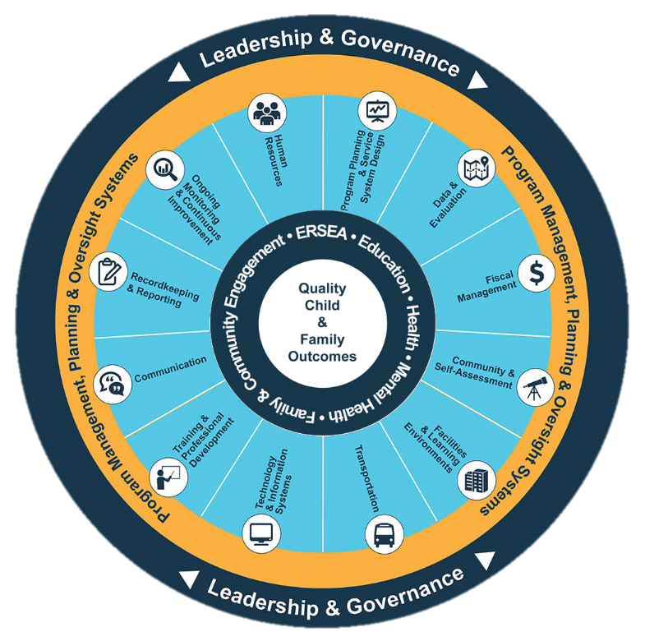
Head Start Management Systems Wheel
Five-Year Project Period
Notes:
Slide 6
Facilitator Notes:
Distribute the Management Systems Wheel with Guiding Questions handout.
Say to Participants: “The Head Start Management Systems Wheel can help us understand how data and evaluation fits into the overall picture.”
In your own words, explain the graphic on the slide by pointing to its various elements and describing each, basing your descriptions on the bullet points below.
The dark blue outer circle includes the functions of leadership and governance. They are the bedrocks of effective management, encompassing and informing the 12 management systems.
The yellow circle outlines the scope of these systems.
The segmented aqua blue ring outlines each of the 12 management systems. These systems work together to inform and influence the program’s service delivery. These services include education, health, mental health, community partnerships, family engagement, and eligibility, recruitment, selection, enrollment, and attendance (ERSEA).
Say to Participants: “You see that one of the aqua blue wedges is labeled ‘data and evaluation.’ That’s the management system we’re looking at in this module. In Head Start, all of these systems work together to inform and influence the program’s service delivery, which you see in the dark blue inner circle. When innovative leadership, strong management systems, and well-designed services are working together, we produce quality child and family outcomes.”

Slide 7
Data and Evaluation System
Informs data-based decision-making
Informs each stage of the program planning cycle
Uses qualitative and quantitative measures to ensure effective program management
45 CFR §1302.101(b)(4)
45 CFR §1302.102(c)
Notes:
Slide 7
Facilitator Notes:
Review each of the bulleted points on the slide.
Say to Participants: “As we can see on the slide, 45 CFR §1302 Subpart J addresses how program data should be used. It says data must be managed so that it:
Is available
Is usable
Has integrity
Is secure
“Subpart J also says programs must have procedures on data management that address:
Data quality
Effective use and sharing of data
Privacy protections of child records consistent with federal, state, local, and tribal law
Say to Participants: “Subpart J recognizes the importance of data in the program planning process. Data informs all the major components of the program planning cycle, including qualitative and quantitative program evaluation. Some key questions to ask regarding data and evaluation are:
How does data help us tell the story of how we are making a difference for children, families, and the community?
How can data be an effective tool for measuring the impact of what we do each day?
“We’re going to be looking much deeper at requirements for data use later in this session.”

Slide 8
Overview
A
The leader's role in data use is critical
An organizational culture of learning facilitates effective data use
B
Using data for continuous improvement is embedded in the HSPPS
C
Develop your capacity in the Four Data Activities
D
Notes:
Slide 8
Facilitator Notes:
Review the four key sections on the slide.
Say to Participants: “This session is broken into four sections. In each section, we will review the main concepts, provide resources and tools for how to better understand those concepts, and look at how we can use what we learn to support our work in Head Start.”

Slide 9
Section A
The leader's role in data use is critical
Notes:
Slide 9
Facilitator Notes:
Begin your mini-lecture on the leader’s role in data use.
Say to Participants: “In Section A, we will look at how important the role of a leader is in creating the context for using data effectively. Leadership can be found at many levels of an organization; it is also situational and not necessarily based on a job title. Though leadership looks different in each organization, the importance of a leader modeling data use for continuous improvement cannot be overstated. Next, we’ll discuss work conducted by the Office of Planning, Research, and Evaluation, known as OPRE, that highlights the importance of leadership and the qualities that make a strong leader.”

Slide 10
A Leader’s Role: Engage Stakeholders
“Research suggests that data use is most effective when organizations involve staff from all across the organization, engage their governing bodies, and encourage stakeholder involvement.”
— Moving Beyond a Culture of Compliance to a Culture of Continuous Improvement, OPRE, January 2015
Notes:
Slide 10
Facilitator Notes:
Call participants’ attention to the slide.
Say to Participants: “Good leadership ensures the organization has the required resources, analytic capacity, and professional development to use data. That means leaders must involve staff and other stakeholders in using data. Let’s look at some of the ways they can do this.
“Leaders can involve staff:
Through reflective supervision
By reviewing data in regular staff meetings
By engaging staff in self-assessment
Through strategic planning and the development of five-year goals and objectives
“Leaders can also use data in new employee training, formal workshops, and procedural manuals.
“It’s important to find ways at all levels of the organization to incorporate data use for moving the program forward, while keeping our focus on the impact of our work. Leaders should involve Policy Councils and governing bodies or Tribal Councils in reviewing or analyzing data to obtain different perspectives and identify potential strategies for improvement.
“Leaders should involve families by providing them with meaningful and understandable information on their children’s learning and development.”

Slide 11
Conceptual Elements of Continuous Quality Improvement
Organizational Characteristics
Commitment of Resources
History of improvements
Program characteristics
Size
Structure
Commit, finance, and sustain technology
Commit leadership time
Commit staff time
Analytic Capacity
Leadership in Data Management
Culture of Collaborative Inquiry
Assess technological capital
Assess human capital
Assess data capital
Quality Child & Family Outcomes
Be transformational
Adopt and lead change strategy
Communicate clearly
Motivate for innovation and creativity
Distribute responsibilities
Be a role model
Promote systems thinking
Share learning
Engage partners
Create safe space
Management of Program Data
Security of data
Usability
Integrity
Availability
Professional Development
Understand data systems
Develop analytic capacity
Integrate knowledge
Environment
Non governmental funders
Government mandates
Accreditation, licensing and professional systems
Time
Source: T. Derrick-Mills, H. Sandstrom, S. Pettijohn, S. Fyffe, and J. Koulish. (2014). Data use for Continuous Quality Improvement: What the Head Start Field Can Learn From Other Disciplines, A Literature Review and Conceptual Framework. OPRE Report # 2014-77. Washington, DC. Office of Planning, Research and Evaluation, Administration for Children and Families. U.S Department of Health and Human Services.
Notes:
Slide 11
Facilitator Notes:
Distribute the Conceptual Elements of Continuous Quality Improvement and Understanding the Conceptual Elements of Continuous Quality Improvement handouts. Let participants know they will use these handouts more than once, so they should keep them handy.
Say to Participants: “Researchers at OPRE found the elements that facilitate or impede data use for continuous quality improvement are:
Leadership
Commitment of resources
Culture of collaborative inquiry
Professional development
Organizational characteristics
Analytic capacity
Management of program data
Environment
Based on this research, the Office of Head Start (OHS) created this Conceptual Elements of Continuous Quality Improvement graphic to help programs create a culture of continuous quality improvement.”
Point out the Management of Program Data hexagon on the slide.
Say to Participants: “Based on the HSPPS, PMFO added an element called ‘Management of Program Data.’ The addition of this element highlights the requirement for Head Start grantees to establish procedures on data management.”
Ask participants to take five minutes to read the Understanding the Conceptual Elements of Continuous Quality Improvement handout.
Say to Participants: “Now that you’ve seen the graphic and read about the concepts:
What questions do you have?
What are the important elements for you?
How would you summarize this content?”
Facilitate a brief discussion with the group around these questions, noting important points that emerge.

Slide 12
Leadership in Data Management
Leadership in Data Management
Be transformational
Adopt and lead change strategy
Communicate clearly
Motivate for innovation and creativity
Distribute responsibilities
Be a role model
Notes:
Slide 12
Facilitator Notes:
Deliver the material on this slide in the form of a mini-lecture.
Say to Participants: “As we move through this session, we will explore several of the elements you see in your handout. The first is Leadership in Data Management. Without leadership, you can’t develop a strong data culture. The literature tells us that leaders must:
Be transformational change agents
Be able to communicate their expectations around data use
Motivate others for innovation and creativity
Be willing to distribute responsibilities
“Leaders must act as role models and communicate clear expectations around data use. Strong leadership ensures the organization adopts a change strategy with the leader acting as a role model, heading the change strategy. It is also crucial that the governing body and Policy Council understand the important role they play in creating a culture of continuous improvement.
“We’re going to continue to develop this theme as we go through the next few slides.”

Slide 13
The Leader's Role: To See It All
Notes:
Slide 13
Facilitator Notes:
Call participants’ attention to the slide.
Say to Participants: “This cartoon tells the well-known story of the blind men and the elephant. The story illustrates the problem individuals can have seeing the big picture. All of the men are touching a piece of the elephant and each interprets their piece as being the entire elephant. They do not recognize they are touching only one part of the elephant, and thus never understand what an elephant in its totality really is.
“Seeing the whole elephant is what systems thinking is all about. Systems thinking is:
The ability to see and understand the interconnections and relationships of and between all parts of a system
Understanding those relationships and how they work together to accomplish something bigger
Being aware of the entire system, not just the individual or parts
“To move from conventional thinking to a systems thinking approach, three shifts need to occur. Individuals need to move from:
Seeing just their own part to seeing the whole system
Hoping others will change to considering how they themselves can change first
Focusing on individual events to understanding and redesigning the deeper systems that give rise to events”
Facilitate a brief discussion with participants, making sure they understand the points being made about systems thinking.

Slide 14
Practices of Leadership
“Celebrations are much more than parties; they're ceremonies and rituals that create meaning.”
“Leadership is
not about selling
your dream; it is
about creating a
shared sense
of destiny.”
“The simple act of listening is a profound act of respect.”
Source: The Five Practices of Exemplary Leadership, J.M. Kouzes and B.Z. Posner (2010)
Notes:
Slide 14
Facilitator Notes:
Call participants’ attention to the slide.
Say to Participants: “The quotes on this slide represent some of the things good leaders should be thinking about. As we’ve said, leaders must be transformational change agents. They must be able to communicate a vision that excites others. They must be able to spur innovation and creativity by developing a sense of purpose and shared meaning. Leaders must act as role models, listening to and fully engaging with staff.”

Slide 15
When a Leader Involves Others
By listening to others, leaders:
  Plan effectively
  Tell a compelling story
  Enhance involvement
By celebrating successes, leaders:
  Motivate their team
  Create meaningful work
  Increase program services
By creating a shared destiny, leaders:
  Build a culture of data
  Make strategic decisions
  Visualize the big picture
Notes:
Slide 15
Facilitator Notes:
Continue your mini-lecture on leadership.
Say to Participants: “Let’s dig deeper into this topic, because a leader’s behavior is so critical.”
Ask three volunteers to read aloud the sections on the slide.
Say to Participants: “Think about your own organization. Which practices do you see being carried out?”
Lead a brief discussion.

Slide 16
Leading by Asking the Right Questions
Analyze data through dialogue
Identify challenges
Imagine possibilities
Lead with strengths
Formulate discoveries
Where do the data say that your program has been particularly successful?
What patterns or trends do you see over time?
Where did we fall short of our expectations?
What limitations are we placing on our thinking?
What did your analysis lead you to find?
Why did we fail to make progress?
How can we go beyond what we first thought?
How do your discoveries relate to the program's goals and objectives?
How has the program made progress on its goals and objectives?
What is the story behind the success?
What aspects of "what is working" can be used to find a solution?
Where can we innovate?
How are we doing on our most important measures?
What will success look like?
What connections did you find among discoveries?
What is the impact?
How else can we look at this?
Notes:
Slide 16
Facilitator Notes:
Distribute the Leading by Asking the Right Questions handout.
Say to Participants: “Leaders don’t need to have all the answers; but to get to the right answers, they have to ask the right questions. By asking the right questions, leaders get accurate and relevant information they can communicate to stakeholders. Let’s look at some of the suggestions on the slide.”
Review the slide with participants, highlighting the types of questions that can guide staff through the process of analyzing data, discovering trends, identifying challenges, and drawing conclusions.
Ask participants to identify the questions they personally have found to be most powerful in advancing their organization’s work.

Slide 17
Bringing It Home
For the next few minutes, think about how leaders support data utilization in your program.
Then, share with your tablemates the strategies you have seen leaders use with data.
Notes:
Slide 17
Facilitator Notes:
Introduce this brief activity on how leaders support data use.
Say to Participants: “We have looked at leadership from a broad perspective and at how it impacts data management within the Head Start context.
“Now we want to do some individual reflection. For the next three minutes, think about how you have seen leaders support data use in your program. Then, share your thoughts with the others at your table.”
When tables have finished, ask for volunteers to share some examples.

Slide 18
Leadership in Data Management
Commitment of Resources
Professional Development
Commit, finance, and sustain technology
Commit leadership time
Commit staff time
Analytic Capacity
Understand data systems
Develop analytic capacity
Integrate knowledge and beliefs.
Assess technological capital
Assess human capital
Assess data capital
Notes:
Slide 18
Facilitator Notes:
Guide participants to the two handouts they received earlier in the section, Conceptual Elements of Continuous Quality Improvement and Understanding the Conceptual Elements of Continuous Quality Improvement.
Say to Participants: “As we end this section, let’s circle back to the Conceptual Elements of Continuous Quality Improvement graphic. Look closely at the three elements leaders can have an immediate and direct impact on: commitment of resources, analytic capacity, and professional development.
“Leaders must not only possess certain characteristics, but demonstrate their commitment to data use for continuous quality improvement by:
Channeling resources to support and sustain technology and devoting time to these efforts
Allocating staff time to support data collection, analysis, and use
Providing staff with professional development to increase their ability to collect, analyze, and use data appropriately
“Take a moment to reflect on one or two key concepts from this section that you feel are particularly relevant to your work.”
Lead a brief discussion.

Slide 19
Section B
An organizational culture of learning facilitates effective data use
Notes:
Slide 19
Facilitator Notes:
This is the beginning of section B.
Say to Participants: “We know that leaders play a critical role in creating the conditions for using data in our programs. Let’s take a look at some of the key characteristics we see in organizations that use data to continuously improve. Once again, we will be looking at resources and tools from OPRE.”

Slide 20
The Culture Shift to Continuous Improvement
Curiosity
Reflection
Tolerance for vulnerability
Use of feedback
Systems thinking
Source: Moving Beyond a Culture of Compliance to a Culture of Continuous Improvement, OPRE Report # 2015-02, T. Derrick-Mills et al. (2015)
Notes:
Slide 20
Facilitator Notes:
Call participants’ attention to the slide.
Say to Participants: “The literature shows organizations that use data effectively recognize the importance of these five key qualities.² They intentionally promote:
Curiosity: Asking the ‘how and why’ questions that are critical to understanding our effectiveness
Reflection: Reviewing program policies and continuously seeking feedback
Tolerance for vulnerability: The ability to recognize when things are not working and make course corrections
Use of feedback: Programs have to actually use data to assess whether strategies are making a difference for children and families
Systems thinking: Stepping back and considering the broader context within which our programs operate”
² Derrick-Mills, T., M. Winkler, O. Healy, and E. Greenberg. A Resource Guide for Head Start Programs: Moving Beyond a Culture of Compliance to a Culture of Continuous Improvement, OPRE Report # 2015-02. Washington, DC: Office of Planning, Research and Evaluation, Administration for Children
and Families, U.S. Department of Health and Human Services. 2015. Retrieved from https://www.acf.hhs.gov/sites/default/files/opre/hsleads_resource_guide_122414_final_508_v2.pdf

Slide 21
Core Competencies of Organizations with a Culture of Continuous Improvement
Notes:
Slide 21
Facilitator Notes:
Distribute the Core Competencies of Organizations with a Culture of Continuous Improvement handout.
Say to Participants: “This handout provides a list of core competencies organizations need to develop if they’re going to be successful in using data. Let’s dive into the list and see where you think your program is strong and where it needs some work. Team up with someone next to you and go through the competencies one by one. Identify one to three competencies that your program already exhibits, and one to three you could develop further.”
Circulate around the room and assist groups as needed. After 10 minutes, ask for volunteers to share their lists.

Slide 22
Conceptual Elements of Continuous Quality Improvement (Cont’d)
Organizational Characteristics
Commitment of Resources
History of improvements
Program characteristics
Size
Structure
Commit, finance, and sustain technology
Commit leadership time
Commit staff time
Analytic Capacity
Leadership in Data Management
Culture of Collaborative Inquiry
Assess technological capital
Assess human capital
Assess data capital
Quality Child & Family Outcomes
Be transformational
Adopt and lead change strategy
Communicate clearly
Motivate for innovation and creativity
Distribute responsibilities
Be a role model
Promote systems thinking
Share learning
Engage partners
Create safe space
Management of Program Data
Security of data
Usability
Integrity
Availability
Professional Development
Understand data systems
Develop analytic capacity
Integrate knowledge
Environment
Non governmental funders
Government mandates
Accreditation, licensing and professional systems
Time
Source: T. Derrick-Mills, H. Sandstrom, S. Pettijohn, S. Fyffe, and J. Koulish. (2014). Data use for Continuous Quality Improvement: What the Head Start Field Can Learn From Other Disciplines, A Literature Review and Conceptual Framework. OPRE Report # 2014-77. Washington, DC. Office of Planning, Research and Evaluation, Administration for Children and Families. U.S Department of Health and Human Services.
Notes:
Slide 22
Facilitator Notes:
Guide participants back to the two Conceptual Elements of Continuous Quality Improvement handouts they received earlier.
Say to Participants: “We reviewed this graphic earlier, but now let’s take a deeper look at the elements represented in the hexagons. We’ve talked about the critical role leaders play in setting the stage for continuous improvement. There are three elements on the graphic leaders can directly impact: commitment of resources, professional development, and analytic capacity.
But leaders can also influence another one, creating a culture of collaborative inquiry.”

Slide 23
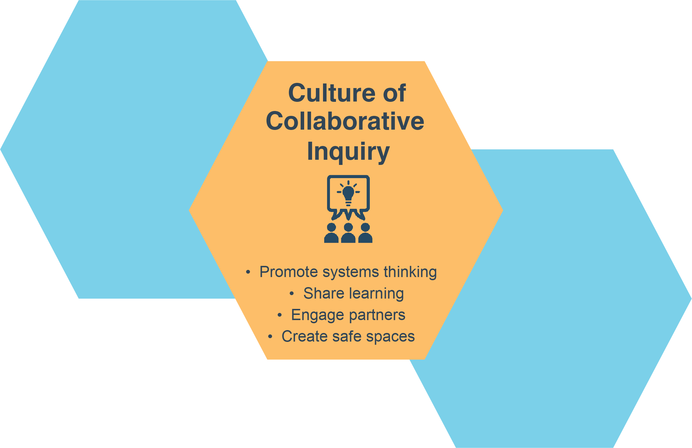
Conceptual Elements of Continuous Quality Improvement (Cont’d 1)
Notes:
Slide 23
Facilitator Notes:
Review the slide with participants.
Say to Participants: “What is a culture of collaborative inquiry?”
Solicit two or three responses.
Say to Participants: “A culture of collaborative inquiry values learning. To learn, staff must have safe spaces where they can openly discuss data and what it reveals. This kind of culture provides opportunities to assess data and determine what it means, and what to do as a result. As you look at the ‘culture of collaborative inquiry’ hexagon, what words or phrases jump out at you? Why are the characteristics listed in this hexagon important?”
Solicit feedback.

Slide 24
Change Leads to Change
Change in Management and Organizational Design
Change in External Environment
Change in Competitive Strategy
Notes:
Slide 24
Facilitator Notes:
Review the slide with participants.
Say to Participants: “Let’s look at an example of using data to be strategic about change. The Head Start community assessment can help your program understand and describe the changes occurring in your community.
“Assessment data is critical to making necessary shifts in strategy. How can you create stronger outcomes for children and families? Will you need to change your program design to improve outcomes? Will shifting it require a change in management structure or design? These are key questions that data can help you answer.”

Slide 25
Reflect on Cultivating a Data Culture
Where do you see a strong data culture in your program?
What are some ways you can begin to build a stronger data culture?
Notes:
Slide 25
Facilitator Notes:
This is the last slide in Section B. Participants will need paper and pens.
Say to Participants: “Let’s take a few minutes to review this section’s theme, which is about how an organizational culture of learning facilitates effective data use. The first question on the slide asks you to identify your organizational strengths and the second is intended to get you thinking about ways to improve your current data culture. Think about these two questions with respect to your own program and brainstorm some answers. You can do this individually or in pairs. Write down your responses to the two questions on a piece of paper. As you’re doing this exercise, think about how you can actually address some of the areas that need attention.”
Give participants five minutes to write down responses, then ask for volunteers to share their answers.

Slide 26
Section C
Using data for continuous improvement is embedded in the HSPPS
Notes:
Slide 26
Facilitator Notes:
This is the start of Section C. Call participants’ attention to the slide.
Say to Participants: “Data is not new to Head Start. We have always used data to plan and improve our services. The regulatory framework for data management is rapidly changing and so are technologies for collecting and managing data. This section identifies how the HSPPS says programs should be using data.”

Slide 27
45 CFR §1302 Subpart J
Management system, 45 CFR §1302.101
Achieving program goals, 45 CFR §1302.102
Notes:
Slide 27
Facilitator Notes:
Distribute the Program Management and Quality Improvement, 45 CFR §1302 Subpart J handout.
Say to Participants: “The introduction to Subpart J says that a program must provide management, ongoing monitoring, and continuous improvement to ensure child safety and deliver effective, high-quality program services. Subpart J focuses on the management system, achieving program goals, and implementation of program performance standards.
“Management system, 45 CFR §1302.101, discusses the requirement to design and implement program-wide coordinated approaches, including management of program data. Let’s take a closer look at this section.”

Slide 28
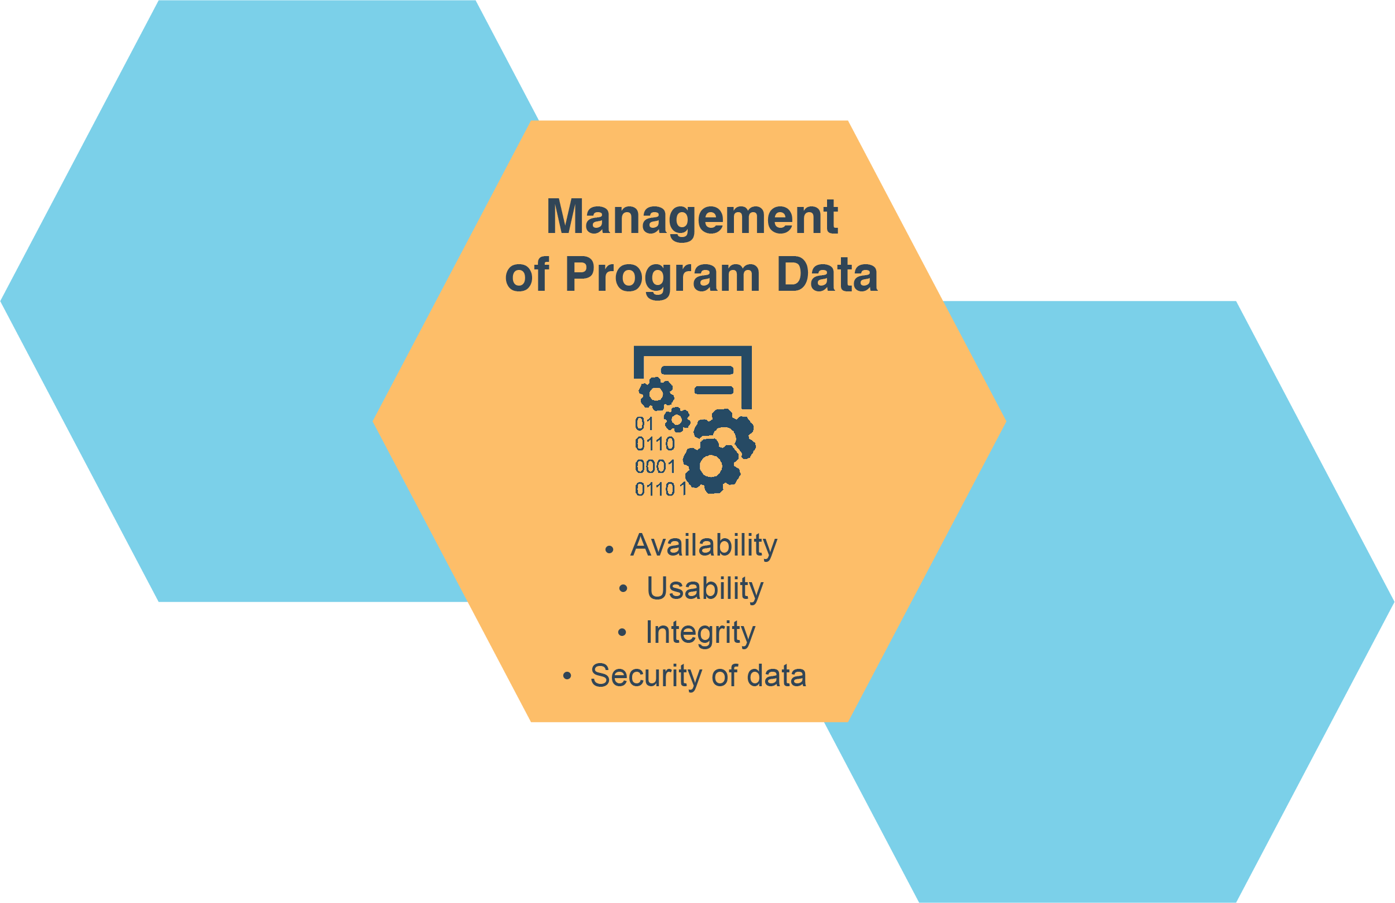
Management of Program Data
Notes:
Slide 28
Facilitator Notes:
Ask participants to look again at the two handouts they received on the Conceptual Elements of Continuous Quality Improvement.
Say to Participants: “Subpart J says that a program must establish procedures on data management and have them approved by the Policy Council and governing body or Tribal Council. Data procedures must address data quality and the effective use and sharing of data. They also need to safeguard the privacy of children’s records.
“These procedures target four critical areas related to data: availability, usability, integrity, and security.
“As technologies change and we move toward increased use of digital data, we have a greater responsibility to manage the risks associated with collecting, storing, and sharing data. The requirement to develop procedures comes from the increased risk that we all bear.”

Slide 29
Management of Program Data (Cont’d)
Program data should:
Be available
Be usable
Have integrity
Be secure
Notes:
Slide 29
Facilitator Notes:
Distribute the Guidance for Management of Program Data handout.
Say to Participants: “Think about your current data management activities and procedures. Where are they strong and where can they be improved? As we just noted, data should:
Be available, meaning that it is accessible
Be usable, meaning it is practical
Have integrity, meaning it is accurate
Be secure, meaning it protects the confidentiality of our families
“To achieve this, you need to have the right policies and procedures in place. Let’s take a minute to review what policies and procedures are.
Policies are principles, rules, and guidelines that have been created or adopted by an organization to reach its long-term goals. They are typically published in a booklet or other form that is widely accessible.
Procedures are the specific methods or steps that organizations use to express policies in the day-to-day operations of the organization. Procedures are much more detailed than policies.
“Take a look at the Guidance for Management of Program Data handout. This tool can be used to assess data practices in each of the four areas listed on the slide. It can also help programs develop action plans for establishing strong procedures. Finally, it can help programs measure the strength of their current data management system and improve it over time.”
Divide participants into four groups and assign each group one of the sections. If there aren’t enough participants to form large groups, have participants work in pairs and fill out as much of the assessment as they can.
Say to Participants: “With your tablemates, review the handout. Each section has statements to rate on a scale from one to five. As you fill out the assessment, think about your program and the ways it manages data. Complete your section, discussing your answers as you go.”
Tell participants they will have 15 minutes to complete the activity. When they have finished, ask volunteers to share any new insights they have about their program’s management of data.

Slide 30
Continuous Improvement
Implementing continuous improvement processes for achieving program goals ensures child safety and the delivery of effective, high-quality program services
Notes:
Slide 30
Facilitator Notes:
Direct participants back to the Program Management and Quality Improvement, 45 CFR §1302 Subpart J handout.
Say to Participants: “Let’s take a few minutes to read the section on using data for continuous improvement, which is on page three of the handout. Think about your program and how it complies with these standards. As you read, highlight anything that stands out, seems confusing, or seems especially important.”
Give participants time to read the section, then ask the following questions and facilitate a brief discussion.
How does your program meet these standards?
What kinds of activities take place in your program to ensure you are in compliance with these standards?
As you read this, what were the most important words or phrases for you?
Is there anything in this standard that confuses you?

Slide 31
A Road Map to Continuous Improvement
Governing body, 45 CFR §1301.2
Determining community strengths, needs, and resources, 45 CFR §1302.11(b)
Child screenings and assessments, 45 CFR §1302.33
Community partnerships and coordination with other early childhood and education programs, 45 CFR §1302.53(b)
Training and professional development, 45 CFR §1302.92
https://eclkc.ohs.acf.hhs.gov/policy/45-cfr-chap-xiii
Notes:
Slide 31
Facilitator Notes:
Continue your mini-lecture on HSPPS data requirements.
Say to Participants: “We’ve already looked at the standards from Subpart J. This slide highlights some of the other key standards that address using data. This is not an all-inclusive list, but just a sample of some of the standards programs refer to frequently.”
Divide participants into small groups and assign each group to one of the standards on the slide. Let them know that they should search by specific section numbers and letters, not by the section titles.
Say to Participants: “Let’s take a closer look at each one of these standards. One person in each group should use their phone or computer to look up the assigned standard online. Read through it and then answer the following questions:
What data is my program currently using to support this standard?
Is there additional data we can or should use to better meet this standard?
What are some strategies for improving our use of data in meeting this standard?”
Give groups 10 minutes to answer their questions, then bring all the participants back together to share answers and have a brief discussion.

Slide 32
Section D
Develop your capacity in the four data activities
Notes:
Slide 32
Facilitator Notes:
Distribute the Four Data Activities handout.
Say to Participants: “The final section of this session looks at the Four Data Activities. As you can see, those activities are:
Prepare
Collect
Aggregate and Analyze
Use and Share
These four activities are foundational to Head Start, and many of us are familiar with them.
“Take a few minutes to review the Four Data Activities handout. Then, team up with someone sitting next to you and discuss which activities you personally have taken part in or have some special knowledge about.”

Slide 33
Four Data Activities
Aggregate and Analyze
Use and Share
Prepare
Collect
Notes:
Slide 33
Facilitator Notes:
Call participants’ attention to the slide.
Say to Participants: “Head Start programs have a strong history of using data to identify both successes and areas for improvements. How have you seen your organization grow from using data?
“What have been some of your program’s biggest challenges in using data effectively?”
Lead participants in a few minutes of discussion.

Slide 34
Four Data Activities (Cont’d)
PREPARE
1
What is the data question? What data do we need? Why does it matter?
Plan how to obtain, keep, and use data
2
Inventory and assess the data
COLLECT
3
4
Administer the data: transfer, access, and store
Collect the data
AGGREGATE & ANALYZE
Do something with the data: discover meaning, find patterns and connections, and guide decisions
POST-DATA ACTIVITIES
5
7
Retain, dispose, or archive the data
USE & SHARE
6
Share, report, and tell your story
Data afterlife?
Notes:
Slide 34
Facilitator Notes:
Distribute the Responsible Data Life Cycle Graphic and the Responsible Data Life Cycle Tip Sheet handouts to participants.
Say to Participants: “Let’s look at these foundational data activities with the help of the Responsible Data Lifecycle.³ It was created by the international aid organization Oxfam, and adapted by PMFO for Head Start’s use.
“Take a look at the slide. PMFO developed this infographic with the parents and children we serve in mind, and always considering the sensitive nature of the information and data we collect and store. Poor data management can cause harm.
On the other hand, if we consider our data as a managed asset, and are intentional in the way we handle it, we can use it for the best possible purpose: to improve services to children and families.
“The Data Life Cycle represents the flow of information through a system, from creation to storage to deletion. This infographic helps us understand the journey that data takes and how we should be using data at every stage. We can use it to develop more effective procedures to manage data.
“As we move through the next few slides, you will see that the Data Life Cycle is based on the Four Data Activities. As we’ve said, these activities are foundational to our programs and have been for several years.”
³ Oxfam. Putting Responsible Data into Practice: The Responsible Data Lifecycle. 2017. Retrieved from https://views-voices.oxfam.org.uk/2017/04/putting-responsible-data-into-practice/

Slide 35
Prepare
PREPARE
1
What is the data question? What data do we need? Why does it matter?
Plan how to obtain, keep, and use data
2
Inventory and assess the data
Notes:
Slide 35
Facilitator Notes:
Distribute the Digital Data Inventory Tool handout. The next few slides will go into more detail about each stage of the Data Life Cycle.
Say to Participants: “The first stage of the Data Life Cycle is to prepare. This includes steps 1 and 2. In the red arrow, we see questions that are basic to our understanding of data use. Step 1 is about thinking through the early stages of a plan for data use. This is where we get a better picture of the data we need and the reason we are collecting it. For example, is it for compliance, or for continuous improvement and innovation? Step 2 is about inventorying and assessing your data. The Digital Data Inventory Tool handout is a good way to do this.”

Slide 36
Collect
COLLECT
4
3
Administer the data: transfer, access, and store
Collect the data
Notes:
Slide 36
Facilitator Notes:
Call participants’ attention to the slide.
Say to Participants: “The next stage is collect, which includes steps 3 and 4. As we think about the data we collect, we should have conversations about risks related to security and confidentiality. This is also where we should think about how we ensure that the people collecting and inputting our data are clear about their roles and responsibilities, and have adequate training in our data systems. In step 4, we should begin to think about where the data will ‘live’ and what additional purposes it could have in the work we do.”

Slide 37
Aggregate and Analyze
AGGREGATE & ANALYZE
Do something with the data: discover meaning, find patterns and connections, and guide decisions
5
Notes:
Slide 37
Facilitator Notes:
Call participants’ attention to the slide.
Say to Participants: “The next stage is aggregate and analyze. What are we doing with the data now that we’ve collected and stored it? How is it guiding our decisions? In our classrooms, are we using data to assist us in strengthening our curriculum and providing individualized services? In our work with families, are we using it to identify the services they need to achieve their goals? In the larger program context, are we engaging our stakeholders in conversations about how data is helping us track progress toward goals and improve services?”
Ask participants to share some of the ways their programs combine and analyze data to inform planning and make program changes. Encourage them to think about how data analysis has led to concrete changes in programming.

Slide 38
Use and Share
USE & SHARE
6
Share, report, and tell your story
Notes:
Slide 38
Facilitator Notes:
Call participants’ attention to the slide.
Say to Participants: “The next stage is about using and sharing the data. How effective are we in using data to tell our story? We see the impact of Head Start every day. Are we using data to report our impact to decision-makers, our internal stakeholders, and our Policy Council and governing body or Tribal Council?”
Facilitate a brief discussion with participants about how their programs have used data to tell stories about the important work they do. Ask for examples and details.

Slide 39
After the Data Activities
POST-DATA ACTIVITIES
7
Retain, dispose, or archive the data
Data afterlife?
Notes:
Slide 39
Facilitator Notes:
Continue your mini-lecture on the Data Life Cycle.
Say to Participants: “The last stage in the Data Life Cycle looks at what we do after the Four Data Activities are completed. In step 7, we consider the ongoing relevance of the data we’ve gathered and stored. We ask ourselves these questions:
How do we safeguard data?
When does data lose its relevance?
When is it time to purge data?
Is there a ‘data afterlife’ that should affect the way we manage information?
This is an important question, because deleting a digital document is not the same as shredding or burning a physical one. Digital records remain on your computer. It’s your responsibility to choose the best solution for permanently deleting data from your technology systems.”

Slide 40
Responsible Data Lifecycle
PREPARE
1
What is the data question? What data do we need? Why does it matter?
Plan how to obtain, keep, and use data
2
Inventory and assess the data
COLLECT
3
4
Administer the data: transfer, access, and store
Collect the data
AGGREGATE & ANALYZE
Adapted from The Responsible Data Lifecycle, Oxfam (2017)
Do something with the data: discover meaning, find patterns and connections, and guide decisions
POST-DATA ACTIVITIES
5
7
Retain, dispose, or archive the data
USE & SHARE
6
Share, report, and tell your story
Data afterlife?
Notes:
Slide 40
Facilitator Notes:
Review the complete slide one more time, summarizing the whole cycle.
Say to Participants: “As we’ve said, we have more ways to collect, store, share, transmit, analyze, and publish data than ever before. Many organizations are looking at policies and procedures on how to manage electronic data ethically and responsibly.
“Responsible data management focuses on treating the people whose data we manage with respect and dignity, and ensuring that we always act in their best interest. This is true throughout the entire life cycle of data. This infographic represents a scaffold or structure for helping grantees think about how they manage and ultimately use their data.”
Ask participants to gather in small groups and answer the following questions:
As you reflect on the infographic, what comes to mind?
Is the Data Life Cycle clear, or are some elements confusing?
How can this infographic assist us in our work with children and families?
After 10 minutes in small groups, ask participants to share their responses with the larger group.

Slide 41
Key Messages
Develop your capacity in the four data activities
The leader's role in data use is critical
An organizational culture of learning facilitates continuous and effective data use
Using data for continuous improvement is embedded in the HSPPS
Notes:
Slide 41
Facilitator Notes:
Review key messages with participants.
Say to Participants: “As we wrap up this module session, let’s review key takeaways.”
Reinforce what participants have learned in this session by reading the key messages on the slide.

Slide 42
Closing Reflections
What have I learned?
*Adapted from: Professional Development Guides for Implementing PFCE
What excites or concerns me about what I have learned?
What will I do with what I've learned?
Notes:
Slide 42
Facilitator Notes:
The final exercise is intended to help participants reflect on and reinforce what they’ve learned. Guide participants to the Reflective Practice Tool handout.
Say to Participants: “Now, let’s take some time to turn inward, to digest and reflect honestly on what we’ve learned and how we will use this information to benefit our Head Start work after we leave.”
Using the handout, direct participants to take a few minutes to reflect and write down their thoughts about the following questions on the handout:
What have you learned?
What excites or concerns you about what you have learned?
What will you do with what you’ve learned?
If time permits, allow volunteers to share their responses aloud, and process the activity using the following questions:
What themes are emerging?
What insights do you need to remember?
How can you use these insights?

Slide 43
Related ECLKC Resources
About Us
https://eclkc.ohs.acf.hhs.gov/about-us/article/office-head-start-ohs
Head Start Programs
https://eclkc.ohs.acf.hhs.gov/programs/article/head-start-programs
Head Start Act
https://eclkc.ohs.acf.hhs.gov/policy/head-start-act
Notes:
Slide 43
Facilitator Notes:
Point out these additional resources to participants.
Say to Participants: “The resources on this slide can help you build your knowledge about PMFO. There are many excellent data resources on the Early Childhood Learning and Knowledge Center (ECLKC), including the Head Start A to Z, 2.0, Recordkeeping and Reporting training.”

Slide 44






Contact PMFO
pmfo@ecetta.info
https://eclkc.ohs.acf.hhs.gov/ncpmfo
Call us: 888-874-5469
Notes:
Slide 44
Facilitator Notes:
Review the contact information on the slide with participants. Invite them to reach out with questions or to delve further into topics discussed in this session.

