Slide 1

Head Start A to Z, 2.0
Communication
Notes:
Slide 1
Facilitator Notes:
Welcome participants to the session and introduce yourself and any co-facilitators. Begin the session with an introductory activity to create a positive group climate.
Say to Participants: “The National Center on Program Management and Fiscal Operations has updated Head Start A to Z to align with the revised Head Start Program Performance Standards that became effective November 2016. Head Start A to Z was originally designed to support new leaders in their Head Start roles. The term ‘leaders’ ensures that anyone at the management level, or in some cases the governing body, Tribal Council, or Policy Council level, can attend the sessions or use the materials for independent learning.
“The updated Head Start A to Z, 2.0, learning modules provide baseline-level information primarily through a leadership and management systems lens. The presentations are modeled on ‘learning organization’ concepts. In each of the modules, we recognize key characteristics of learning organizations, including a supportive learning environment, openness to new ideas, and time dedicated for reflection.
“Each attendee has an important role to play in the success of this session. Those with experience remind us where we’ve come from and what we must do to maintain our identity and uniqueness. New members bring a fresh perspective and remind us what we must do to prepare for the future. All roles are essential for Head Start to be a learning organization that continues to grow and flourish.
“Head Start A to Z, 2.0, is most successful when it helps us share the best of what we have to offer with a strength-based focus. As you engage in this session, we hope that you will support one another in the learning process by generously sharing your knowledge, experience, and perspective.”

Slide 2
Learning Objectives
In this module, participants will:
Learn the foundational elements of internal and external communication
Recognize the central role of leaders in creating and maintaining effective communication
Identify key considerations in communication planning
Learn key elements of branding, social media policy, and crisis communication planning
Notes:
Slide 2
Facilitator Notes: Distribute the Reflective Practice Tool handout.
Say to Participants: “In this module, participants will:
Learn the foundational elements of internal and external communication
Recognize the central role of leaders in creating and maintaining effective communication
Identify key considerations in communication planning
Learn key elements of branding, social media policy, and crisis communication planning.”
Guide participants to the Reflective Practice Tool handout.
Say to Participants: “At the end of our session, you will be asked to use this Reflective Practice Tool to write down some key thoughts based on what you’ve learned. We encourage you to jot down some preliminary thoughts as we move through the session.

Slide 3
Six Guiding Principles for A to Z Learning Modules
1
3
4
Successful programs are learning organizations.
Sound decision-making is informed by quality data.
Relationship-building is at
the heart of transformational leadership.
2
5
6
The effective delivery of services grows out of strong systems.
School readiness for all is our driving goal.
Culturally and linguistically diverse organizations rely on intentional, specific, and coordinated approaches.
Notes:
Slide 3
Facilitator Notes:
Distribute the Head Start A to Z, 2.0, Guiding Principles handout.
Say to Participants: “Head Start A to Z, 2.0, is based on six guiding principles. These guiding principles are foundational to the design of the modules and have been aligned with the HSPPS.
“Head Start directors and managers come from all walks of life with a wealth of employment experiences. However, we all share a commitment to a comprehensive, high-quality early childhood experience. We recognize that, to promote school readiness and be responsive to the needs of our communities, we must engage in ongoing professional development. Head Start A to Z, 2.0, was created to support professional growth and development for Head Start leaders.”
Guide the participants to the Head Start A to Z Guiding Principles handout. Review the six principles below. You may paraphrase or slightly summarize.
Successful programs are learning organizations. Head Start is a dynamic organization with high expectations, values, and traditions. Programs are constantly responding to changing community needs and evolving best practices. To cultivate a learning organization that thrives in this environment, program leaders must support all staff in becoming life-long learners who embrace challenges as opportunities for collective problem-solving and innovation.
The effective delivery of services grows out of strong systems. Program leaders must regularly refine their program’s management and fiscal systems. To target community needs and deliver comprehensive services, leaders need to understand systems thinking and view their program through a systems lens. They also need to recognize the relationship between systems, services, and child and family outcomes.
Sound decision-making is informed by quality data. Used in planning, evaluating, and communicating information, quality data is integral to cultivating a culture of continuous quality improvement. To this end, it is critical for leaders to establish efficient processes for collecting, aggregating, analyzing, and synthesizing data. This involves training teachers, home visitors, family advocates, health services workers, and other staff how to integrate data management into their day-to-day work.
Relationship-building is at the heart of transformational leadership. Robust Head Start communities build on authentic relationships between all of their stakeholders, from children, families, staff, and managers to governing bodies, Tribal Councils, and Policy Councils. To cultivate these communities, leaders need to communicate effectively, empower others, foster team-building, and nurture collaboration.
School readiness for all is our driving goal. Head Start leaders play an integral role in conceiving and promoting an inclusive vision of school readiness. To support children with diverse abilities and backgrounds to develop the skills, knowledge, and attitudes needed to be successful in school, effective leaders must stay informed on developments in early childhood education. They also must actively collaborate with parents, staff, governing bodies, local education agencies, and community partners in embedding these best practices into services and programming.
Culturally and linguistically diverse organizations rely on intentional, specific, and coordinated approaches. To ensure the full and effective participation of dual language learners and their families, Head Start leaders must coordinate program-wide plans that involve all service areas and multiple staff. This includes staying connected to the communities served, implementing targeted strategies, and articulating how programs and services address specific linguistic and cultural needs.
Say to Participants: “In addition to anchoring the content in Head Start A to Z, 2.0, you will revisit these guiding principles in all of the trainings offered by PMFO.”

Slide 4
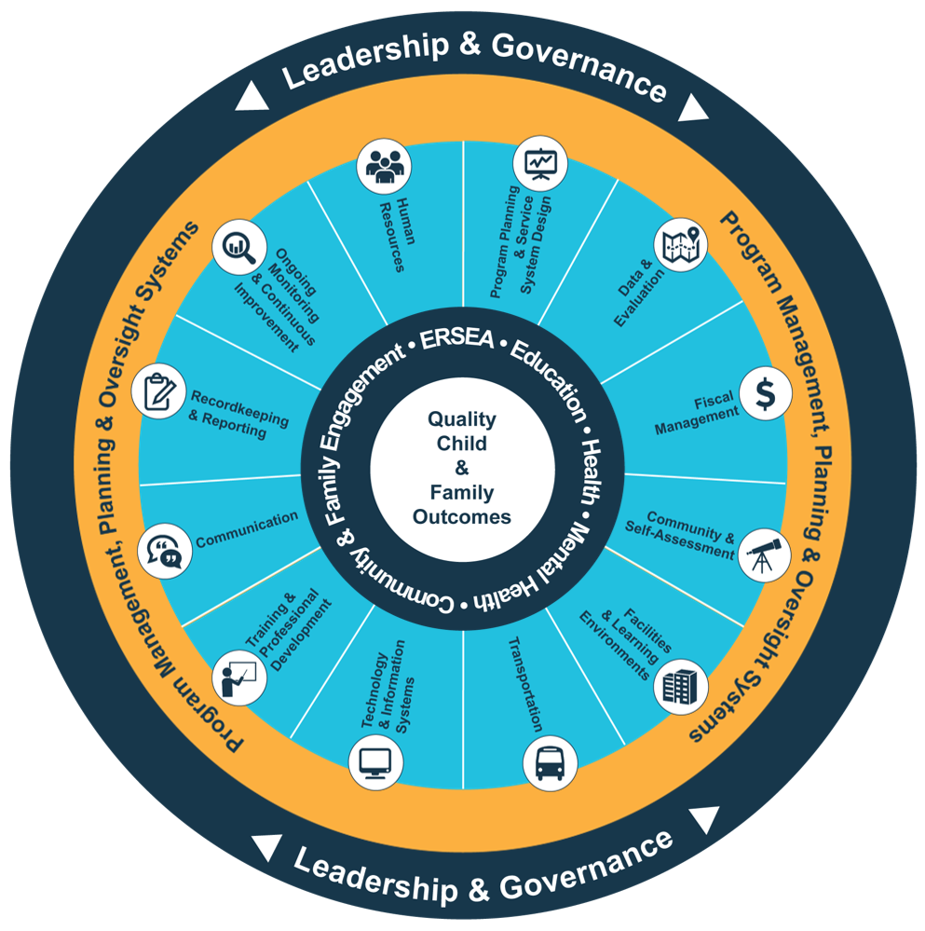
Head Start Management Systems Wheel
Five-Year Project Period
Notes:
Slide 4
Facilitator Notes:
Deliver the following material as a mini-lecture.
Say to Participants: “The Head Start Management Systems Wheel can help us understand how communication fits into the overall picture.”
In your own words, explain the graphic on the slide by pointing to its various elements and describing each, basing your descriptions on the bullet points below.
The dark blue outer circle includes the functions of leadership and governance. They are the bedrocks of effective management, encompassing and informing the 12 management systems.
The yellow circle outlines the scope of these systems.
The segmented aqua blue ring outlines each of the 12 management systems. These systems work together to inform and influence the program’s service delivery. These services include education, health, mental health, community partnerships, family engagement, and eligibility, recruitment, selection, enrollment, and attendance (ERSEA).
Say to Participants: “You see that one of the aqua blue wedges is labeled ‘communication.’ That’s the management system we’re looking at in this module. In Head Start, all of these systems work together to inform and influence the program’s service delivery, which you see in the dark blue inner circle. When innovative leadership, strong management systems, and well-designed services are working together, we produce quality child and family outcomes.”

Slide 5
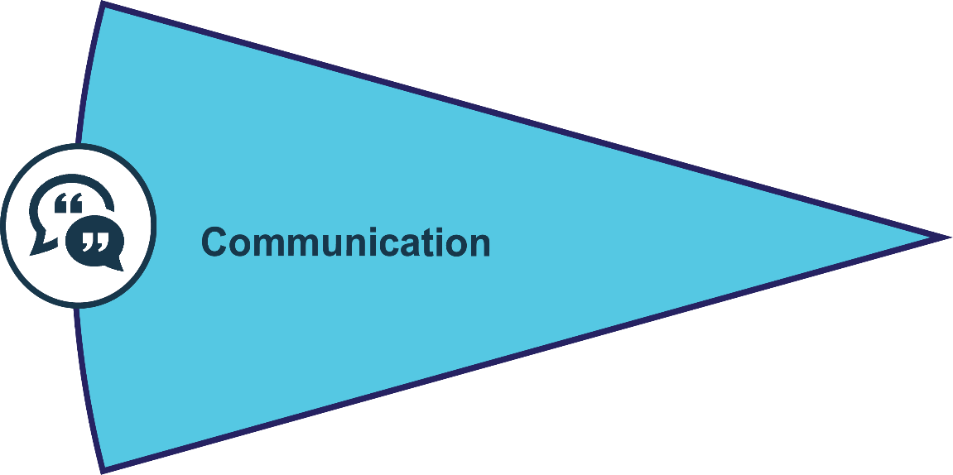
Communication
Builds relationships with internal and external stakeholders
Helps programs "tell their stories" as they pursue program and school readiness goals
45 CFR §1301 – Program Governance
45 CFR §1302 – Program Operations
45 CFR §1303 – Financial and Administrative Requirements
45 CFR §1304 – Federal Administrative Procedures
45 CFR §1305 – Definitions
Notes:
Slide 5
Facilitator Notes:
Review the slide with participants.
Say to Participants: “Communication is vital to high-quality service coordination and delivery in Head Start programs. As we can see, communication:
Builds relationships with internal and external stakeholders
Helps programs tell the story of their successes
“Let’s dig deeper into communication and how it works in your program.”

Slide 6

Communication Requirements
Sec. 644(a)(2)(a–h) – Each Head Start agency shall make available to the public a report disclosing specific program and financial information
Notes:
Slide 6
Facilitator Notes:
Distribute the Communication in the HSPPS and Head Start Act handout.
Say to Participants: “Requirements about communication in the Head Start Act and HSPPS focus primarily on external communication. External communication is the exchange of information between your program, families, community stakeholders, and funders.
“According to the Head Start Act and HSPPS, each Head Start program is required to produce status reports and an annual report. These reports include funding sources and budgets, oversight data, data on children and families served, a community assessment, and other requirements. There are a number of other regulations related to communication within and outside the program, as well. Please take a minute to review the handout.”
After two minutes, solicit questions from participants.

Slide 7
What Communication Is and Does
Notes:
Slide 7
Facilitator Notes:
Begin this section on the meaning and uses of communication.
Say to Participants: “Communication is about using words, images, or symbols to convey or exchange information. Take a moment to think about all the types of communication that occur in your program every day.”
After a few moments, ask for examples and write them on a flipchart.

Slide 8
The Tasks Communication Performs
Exchange information
Prepare plans and policies
Track progress toward goals
Increase efficiency
Troubleshoot problems
Promote services
Manage controversy
Inform stakeholders
Gain support
Notes:
Slide 8
Facilitator Notes:
Call participants’ attention to the slide.
Say to Participants: “Now, let’s think about all the tasks communication performs. As we can see on the slide, communication allows us to:
Exchange information
Prepare plans and policies
Track progress toward goals
Increase efficiency
Troubleshoot problems
Promote services
Manage controversy
Inform stakeholders
Gain support
“Is there anything else you’d like to add to this list?”
Solicit responses and write them on a flipchart.

Slide 9
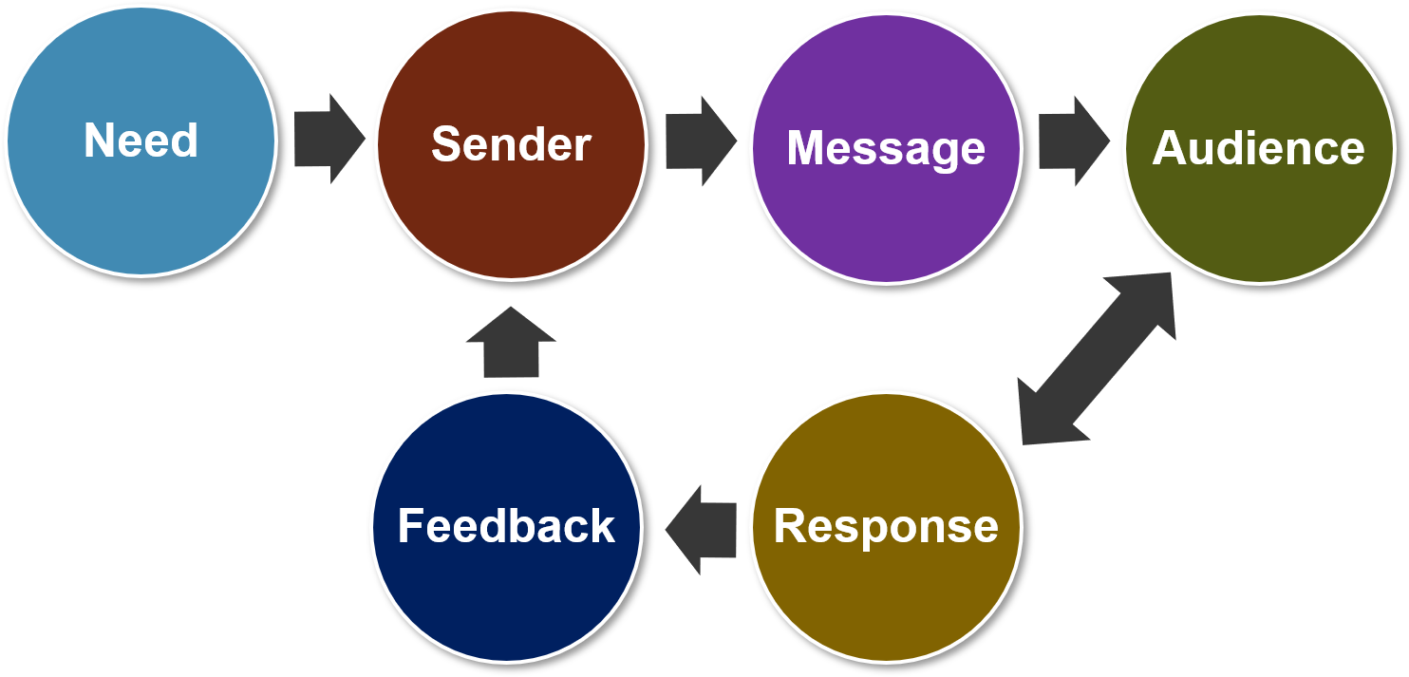
Elements of Communication
Notes:
Slide 9
Facilitator Notes:
Call participants’ attention to the slide.
Say to Participants: “It’s important to communicate effectively at work. Good communication:
Reduces confusion
Creates efficiency
Builds morale
Helps you achieve your program goals
“Yet, we all know that communicating can be difficult. To understand why, let’s look at how communication works.
“The communication process begins when one person needs to deliver information to another person or group of people. Before conveying the message, the sender:
Interprets the context (e.g., the reason for sending the message and how the message is likely to be received)
Identifies and analyzes the intended audience
Determines what the message must achieve
Chooses the medium (e.g., mode or platform for sending the message)
Options might include speaking in person, by phone, email, or even through an internal team-messaging platform such as Slack
“Finally, the sender creates the message. The audience receives it, interprets it, and provides feedback. The feedback creates a new message, and the cycle goes on with each party responding to the previous message until all issues have been resolved.
“Think about the last time you wanted to convey information in your program. How were each of these elements present?”
Ask for volunteers to share their experiences.

Slide 10
Communication Barriers
Limited knowledge or vocabulary
Differences in interpretation
Language differences
Inappropriate use of expressions
Strong or polarized viewpoints
Ambiguity
Notes:
Slide 10
Facilitator Notes:
Begin this section on communication barriers.
Say to Participants: “As we’ve discussed, sending and receiving messages requires that both parties interpret what the other means. It’s complicated, and not surprisingly, a lot can go wrong.
“People attempting to communicate might have:
Limited knowledge or vocabulary to clearly express what they intend
Different frameworks for interpreting the information being communicated
Language differences
Strong viewpoints that prevent them from listening with an open mind
“Finally, the information itself might be overly abstract, or have more than one possible meaning.
“Can you think of other barriers to communication?”
Ask volunteers to share their thoughts, and write them down on a flipchart sheet. Then, ask these questions:
Which barriers have you encountered most in your organization?
What has been useful in helping you overcome these barriers?
Lead a brief discussion.

Slide 11
Types of Communication
Internal or external
Written, verbal, or visual
Formal or informal
Notes:
Slide 11
Facilitator Notes:
Call participants’ attention to the slide.
Say to Participants: “Communication is a big topic. We communicate all the time in many different ways and directions. For our purposes, we’re going to divide communication into two large categories: internal and external. Within each category, communication may be formal or informal; it may be written, spoken, or visual, using photos or infographics.”

Slide 12
Internal Communication
Notes:
Slide 12
Facilitator Notes:
Begin this section on internal communication.
Say to Participants: “Let’s look at internal communication first. According to corporate and nonprofit communication expert Rodney Jordan, good internal communication can achieve three things:
Organizational alignment, so everybody is moving in the same direction and toward the same goals
Employee engagement and connection, so staff feel committed to the organization and its mission
Strong ambassadorship to the community, so staff can amplify the good work your program does”
¹ Rebecca Chamberlain-Creanga, Rodney Jordan, Cierra Selby, and Mike Smith, Best Practices in Internal Communications: Inspiration for the Nonprofit Sector, (Washington, DC: The Communications Network, Oct. 17, 2017), https://www.comnetwork.org/events/best-practices-for-internal-communications-inspiration-for-the-nonprofit-sector/.

Slide 13
Formal and Informal Styles
Notes:
Slide 13
Facilitator Notes:
Call participants’ attention to the slide.
Say to Participants: “Some experts have referred to internal communication as the ‘connective tissue’ between staff at all levels of an organization. On a basic level, internal communication consists of all the exchanges of information that take place within your organization. Think of the interactions between your governing body or Tribal Council, Policy Council, staff, and leadership team.
“Much of this communication is written and formal; it expresses official policies or documents program activities and progress. But communication can also be informal. Consider everything staff and managers say to one another as they go about their day-to-day work. Informal communication allows you to coordinate and accomplish the work at hand in real time. A lot of information, both official and unofficial, gets disseminated informally.
“Formal and informal communication are both essential to your program, and each serves a particular purpose.”

Slide 14
Formal and Informal Styles
FORMAL | INFORMAL
Pre-defined channels | All directions
Official | Grapevine
Timely and systematic | Free-flowing
More confidential | Less confidential
Reliable | Less reliable
Slow | Fast
Maintains written trail | Often doesn't maintain trail
Notes:
Slide 14
Facilitator Notes:
Distribute the Comparing Formal and Informal Communication handout.
Say to Participants: “Looking at this slide, we can see each style of communication has its own strengths and weaknesses.
“Formal communication is important. It represents the official voice of the organization and the information it conveys is usually reliable. However, one drawback is that it can be slow. Another is that it doesn’t always address internal conflicts or differences of opinion.
“This is where informal communication comes in. We all know information can spread very quickly through the grapevine, but word-of-mouth information isn’t always reliable. It can be inaccurate or one-sided. In some cases, it can feed the rumor mill, hurting staff morale and undermining the program.”
Ask participants to read the handout and break into groups of three or four to discuss the roles that formal and informal communication play in their program. After five minutes, bring the group back together and debrief.

Slide 15
Your Internal Communication Map
Notes:
Slide 15
Facilitator Notes:
Make sure participants have paper and markers.
Say to Participants: “Now that we’ve talked about some important features of internal communication, let’s do an exercise. I’d like you to draw a diagram of your own internal communication system. Include all the large and small channels of communication, how they flow, and between whom. You have 10 minutes for this exercise.”
After 10 minutes, ask for two or three volunteers to explain their diagram to the group.
Say to Participants: “Keep this diagram handy. If you learn about policies or practices in today’s session that you think could improve your internal communication system, write them on your diagram.”

Slide 16
Hallmarks of Good Internal Communication
Leaders create a culture where staff ideas are sought and valued.
Leaders are excellent communicators and listeners.
Mechanisms exist to disseminate information to staff and help staff communicate with one another.
Leaders survey staff about communication.
Source: Chamberlain-Creanga, Jordan, Selby, and Smith, Best Practices in Internal Communications (2017), https://www.comnetwork.org/events/best-practices-for-internal-communications-inspiration-for-the-nonprofit-sector/.
Notes:
Slide 16
Facilitator Notes:
Continue your mini-lecture on internal communication.
Say to Participants: “Organizations constantly communicate internally in order to accomplish their work. Communication doesn’t always achieve its intended goals, however. What are hallmarks of good internal communication?
“In an organization with excellent internal communication:
Leaders create a culture where employees’ ideas and opinions are sought and valued
Leaders and managers are excellent communicators and listeners
Mechanisms exist to disseminate information to staff and help them communicate with one another on many different levels (e.g., project management software platforms, internal email systems or bulletin boards, regular ‘lunch-and-learn’ forums, and internal newsletters)
Leaders seek to improve their internal communication by occasionally surveying staff about whether they feel communication is adequate and how it could be improved”
² Chamberlain-Creanga, Jordan, Selby, and Smith, Best Practices in Internal Communications (2017), https://www.comnetwork.org/events/best-practices-for-internal-communications-inspiration-for-the-nonprofit-sector/.

Slide 17
Huddle Technique
Notes:
Slide 17
Facilitator Notes:
Distribute the Tips for Implementing Workplace Huddles handout, chart paper, and markers.
Say to Participants: “We’ve just mentioned how leaders may choose to use internal email or bulletin board platforms to facilitate communication with and among staff. Let’s talk about another communication technique that many organizations are using. It’s called the huddle. How many of you have heard of a huddle, or been in a huddle at work?”
Acknowledge raised hands.
Say to Participants: “Huddles offer several benefits. They enable a team to stay informed, review work, and troubleshoot problems. They also help staff appreciate and respect each other.
“In the next few slides, we’re going to learn how the huddle technique can be used as a communication strategy in your Head Start program.”

Slide 18
Teams
When teams come together on a regular basis to share news and plan, our programs work better and we can accomplish more with children and families.
Notes:
Slide 18
Facilitator Notes:
Distribute the Sample Huddle Agenda handout.
Say to Participants: “When teams come together on a regular basis to share news and plan, our programs work better and we can accomplish more with our children and families. Huddles are about intentionally and routinely coming together. There are three steps to making huddles work.
“You must:
Establish a routine
Develop relationships and designate roles
Improve your process over time
“Let’s practice by forming our own small huddles. Assign one person at your table to lead the huddle. The lead should use the Sample Huddle Agenda handout as a guide. The rest of you should play the role of participants. Take seven minutes.”
After seven minutes, bring the group back together and solicit volunteers to share what the experience was like.

Slide 19
External Communication
Notes:
Slide 19
Facilitator Notes:
Begin this section on external communication.
Say to Participants: “Now, let’s switch our focus to external communication. External communication is the exchange of information between your program, families, community stakeholders, and funders. Let’s name the external audiences your program communicates with. Who are they? Think about funders, families, partner programs, school systems, and others in the community who are interested in your work or invested in the outcomes you produce. Each is a different audience.”
Solicit responses, prompting participants to be as specific as possible. Write their answers on the flipchart.

Slide 20
See Through the Eyes of Your Audience
Notes:
Slide 20
Facilitator Notes:
Give a mini-lecture on communicating in ways that make people care.
Say to Participants: “Now, we’re going to talk about the fundamentals of communicating in ways that make people care. The first thing you need to do is step into the world of your audience. To do that, stop and think about what your audience values.
“Answer these questions:
What does your audience think about every day?
What problems are they trying to solve?
What drives the decisions they make?
“Then, think about areas where your interests and their interests intersect.”
³ Center for Social Impact Communication, Communicating via Imagery, (Washington, DC: Georgetown University, 2016), http://csic.georgetown.edu/wp-content/uploads/2016/12/communicating-via-imagery.pdf.

Slide 21
Communicate in Images
Notes:
Slide 21
Facilitator Notes:
Continue the mini-lecture on communicating to make people care.
Say to Participants: “Images are such powerful conveyors of meaning that all nonprofits should consider them a key part of their communication toolbox. Yet, according to a survey conducted by the Georgetown University Center for Social Impact Communication, only 18% of nonprofits say they intentionally integrate images into their communication planning.
“One of the Center’s key recommendations is that nonprofits maintain a database of images appropriate for different uses. The images should be a combination of photos the nonprofit has taken or commissioned and stock photos it has purchased. You should have a robust mix of:
Headshots and environmental portraits of staff and children, if you have obtained written permission beforehand
Images showing how the work you do accomplishes your mission
Different locations you work in
Your events
Your sponsors or donors
Detail photos in which the focus is on a small, telling feature in an overall scene (e.g., small feet jumping in a game of jump rope)
“Make sure you have permission to take and use photos of staff, families, and children. Signed waivers are always necessary.”

Slide 22
Use Emotion Words
Confidence
Trust
Teamwork
Adventure
Notes:
Slide 22
Facilitator Notes:
Call participants’ attention to the slide.
Say to Participants: “Words can bring to mind powerful images. That’s why you should use ‘emotion words’ to convey your message. Price, confidence, trust, empowerment, and resilience are all emotion words. What particular words resonate with your program’s stakeholders?”
Solicit responses and write them on a flipchart.
Say to Participants: “Emotion words are powerful, so be intentional about what you want to accomplish by using them.”

Slide 23
The Power of Stories
Stories:
  Help us remember
  Influence how we decide
  Link us to our sense of generosity
Stories need:
  Characters
  Desire
  Conflict
  Beginning, middle, and end
Notes:
Slide 23
Facilitator Notes:
Call participants’ attention to the slide.
Say to Participants: “Research shows that stories have a unique ability to move us. That’s why organizations use stories to engage audiences and inspire action. Good stories:
Feature characters with whom people can identify
Have a beginning, middle, and end
Involve solving a problem or overcoming a hardship
Leave room for the audience to supply some of their own details
Break expectations, finding that space between the familiar and the surprising
“There are free apps that can help you create stories with images, text, and narration. You can upload these videos to your organization’s website. It’s an inexpensive way to enliven your website and keep disseminating a positive message about your program.”
⁴ Harrison Monarth, "The Irresistible Power of Storytelling as a Strategic Business Tool," Harvard Business Review (March 11, 2014), https://hbr.org/2014/03/the-irresistible-power-of-storytelling-as-a-strategic-business-tool.

Slide 24
Communication Planning
Notes:
Slide 24
Facilitator Notes:
Begin this section on communication planning.
Say to Participants: “Most organizations, particularly those who work with the public on a daily basis, need an external communication plan. These plans should link communication to your program’s overall strategic plan, including your mission, vision, values, goals, and brand. Plans should name specific, measurable goals and describe the tactics that will be used to achieve each one.”

Slide 25
Creating a Plan
Desired action
Audience
Goal
Message
Modes of communication
Notes:
Slide 25
Facilitator Notes:
Distribute the Communication Planning handout.
Say to Participants: “Let’s do an exercise. Please turn to a neighbor. Using the handout as a guide, identify a program goal that communication can help you achieve. Then, work through the template, filling in each blank. You have seven minutes.”
After seven minutes, call the group back together.
Say to Participants: “What part of the template was easy to fill out?
Which was more difficult?”
Solicit responses.
Say to Participants: “What information would you need to have in order to create a complete communication plan for your program?”
Write the responses on a flipchart.

Slide 26
Your Communication Planners
Program leadership
Communications specialists
Administrative or program staff with responsibility for writing press releases or newsletters, posting on social media, updating the program website, or carrying out other communications activities
Staff responsible for the community assessment, annual report, or other regular processes with strong communication components
Notes:
Slide 26
Facilitator Notes:
Conclude this section on communication planning.
Say to Participants: “Everyone has a role in communicating positive messages about your program. However, the detailed work of actually planning your communication goals and tactics falls to a small group.
“As we see on the slide, your communication planning team should include:
Program leadership
Communication specialists, if your program has them
Administrative or program staff with responsibility for writing press releases or newsletters, posting on social media, updating the program website, or carrying out other communication activities
Staff responsible for the community assessment, annual report, or other regular processes with strong communication components
“Is there anyone else you think should be on the team?”
Solicit responses and write them on a flipchart.

Slide 27
The Importance of Your Brand
A brand is an idea that stakeholders have about your organization's character, core values, and mission.
Developing a strong, well-defined identity is important to Head Start and Early Head Start programs.
Building a recognizable, trustworthy brand is crucial to attracting and retaining a base of stakeholders, donors, and partners who will support your program over time.
Brands are connected to reputation, which means they can be tarnished by scandal or bad press.
Sources: Peter Frumkin, "Eight Building Blocks of Strong Nonprofit Brands," Nonprofit Quarterly (Oct. 2, 2015), https://nonprofitquarterly.org/the-eight-building-blocks-of-strong-nonprofit-brands/
Notes:
Slide 27
Facilitator Notes:
Begin this section on branding.
Say to Participants: “Branding is an important form of external communication. There are several points to remember about branding.
A brand is an idea that stakeholders have about your organization’s character, core values, and mission.
Developing a strong, well-defined identity is important to Head Start and Early Head Start programs.
Building a recognizable, trustworthy brand is crucial to attracting and retaining a base of stakeholders, donors, and partners who will support your program over time.
Brands are connected to reputation, which means they can be tarnished by scandal or bad press. Protecting the brand is an absolute organizational priority.
⁵ Peter Frumkin, “Eight Building Blocks of Strong Nonprofit Brands,” Nonprofit Quarterly (Oct. 2, 2015), https://nonprofitquarterly.org/the-eight-building-blocks-of-strong-nonprofit-brands/.

Slide 28
Branded Promotions Audit
Notes:
Slide 28
Facilitator Notes:
Distribute the Branded Promotions Audit handout.
Say to Participants: “Let’s think more deeply about branding. Look at the handout and work with your table group to answer the first set of questions. You’ll have 10 minutes.”
After 10 minutes, ask for volunteers to share responses. Review them as a group and discuss any questions.
Say to Participants: “Now, review the questions about your program website and other promotional materials. Where do you see opportunities to improve? Take five minutes.”
After five minutes, ask for volunteers to share their thoughts.

Slide 29

Social Media
Notes:
Slide 29
Facilitator Notes:
Begin this section on social media.
Say to Participants: “Now that we’ve talked about branding, let’s move on to social media. As most of us know, social media can be an important way for organizations to disseminate news and updates, particularly to stakeholders who already support them. But it also has some downsides. Head Start and Early Head Start programs need to consider how different social medial tools can help them reach their intended audiences. They also need to develop policies that help manage staff use of social media.”

Slide 30

Benefits and Risks of Social Media
Notes:
Slide 30
Facilitator Notes:
Distribute the Social Media Workplace Policies handout.
Say to Participants: “There are benefits and risks to using social media in the workplace. For both internal and external stakeholders, social media can facilitate dialogue, engagement, relationship-building, and information-sharing. All these activities are critical for building support within your program and in the community. What sort of social media platforms does your program use?”
Solicit responses and write them on a flipchart.
Say to Participants: “What value do you think your program derives from using these platforms?”
Again, solicit responses.
Say to Participants: “We see that social media connects our programs to the community in an important way. Yet, it comes with significant risks. When staff members use social media at work, the boundary between public and private domains can get fuzzy. Organizations can lose control over what employees post, and information can leak out that violates intellectual property or privacy rights.
“For these reasons, public- and private-sector organizations are crafting social media policies that provide guidelines for employees. I’d like each of you to turn to a neighbor and review the sample policies on the handout. As you do so, think about what difference each of the policies would make in your program. If your program already has these or other policies, describe what those policies are and if they have helped you effectively manage social media use.”
After five minutes, bring the group back together and solicit ideas. Lead a brief discussion.

Slide 31
Crafting Social Media Workplace Policies
Who posts on your social media pages, and what guidelines are in place for which information gets posted?
Should you allow individual staff members to use social media for personal reasons at work? If so, what limitations should you impose?
If you prohibit or limit personal social networking at work, how will you enforce the rules?
When employees are posting on social media in their off-duty time, do you want them to identify themselves as employees of Head Start or Early Head Start programs?
Ask employees to behave appropriately online, but define what "appropriate" means.
Ask families in your program to come to you with concerns rather than posting critical comments on social media.
Notes:
Slide 31
Facilitator Notes:
Draw participants’ attention to the slide.
Say to Participants: “When you’re creating social media policies, you need to consider a number of issues.
If your program has social media pages, who posts on those pages and what guidelines are in place for which kinds of information get posted?
Should you allow individual staff members to use social media for personal reasons at work? If so, what limitations should you impose?
If you prohibit or limit personal social networking at work, how will you enforce the rules?
When employees are posting on social media in their off-duty time, do you want them to identify themselves as employees of the Head Start or Early Head Start program?
Employees’ personal social media posts can reflect on the organization, whether or not they identify themselves as employees. Before you remind staff to conduct themselves appropriately online, define what ‘appropriate’ means to your program. Going back to your program’s code of ethics may help you identify online behaviors that could be problematic.
Ask families in your program to come to you with concerns rather than posting comments on social media. Social media posts may not reach the right person quickly and feed the rumor mill.
“Are there other important considerations you’d like to add?”
Write responses on a flipchart.

Slide 32
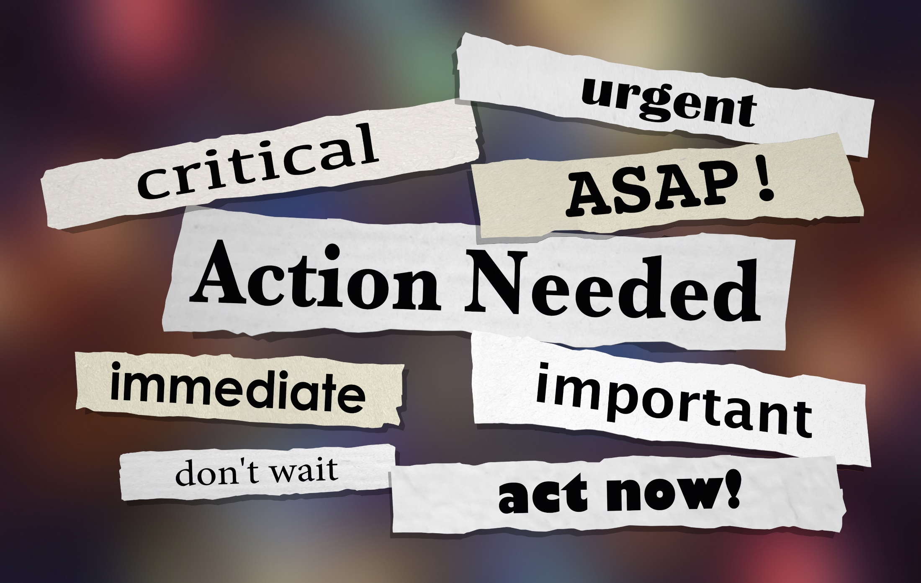
Effective Crisis Communication
Notes:
Slide 32
Facilitator Notes:
Begin this section on crisis communication.
Say to Participants: “Let’s move on to crisis communication. Few circumstances test an organization’s reputation or competency more than a crisis. A crisis can take many forms, including natural or man-made disasters, labor disputes, criminal acts, cyberattacks, power outages, and white-collar crimes. In a time of crisis, conventional ways of responding are usually insufficient. It is critical that Head Start and Early Head Start leaders be prepared to manage communication when a crisis occurs.”

Slide 33

The Crisis Plan
The crisis communications team members and 24/7 contact information
Organizational spokesperson and 24/7 contact information
Which stakeholders needs to be told about the crisis, when they should be told, and by whom
Guidance on what types of information particular audiences need
How information should be communicated (e.g., emails, social media posts, telephone, press briefings or interviews, etc.)
Guidance about when to include an "ask"
Notes:
Slide 33
Facilitator Notes:
Distribute the Creating a Crisis Communication Plan handout.
Say to Participants: “An effective crisis communication plan requires key program staff to gain a full understanding of the crisis and communicate the appropriate level of detail to the right audiences.
“Minimally, the plan provides:
24/7 contact information for:
Leadership
Crisis communication team members
Organizational spokesperson
Information on who needs to be told about the crisis, when they should be told, and by whom
Guidance on what types of information particular audiences need (e.g., parents of enrolled children would require more information about a facilities emergency than other members of the community)
Depending on the type of crisis, your program’s response should acknowledge its cause and impact, specifics on how the organization is managing it, and measures being taken to prevent the crisis from reoccurring
Specifics about how the communication should take place (e.g., via emails, social media posts, telephone, or press briefings or interviews)
Guidance about when to include an ‘ask’ of your audience, such as a request for supplies, donations, or volunteers

Slide 34

Is This Situation a Crisis?
Your reputation could be harmed
The impact or fallout will extend beyond your program
The media is likely to take notice
There will be a backlash from families, supporters, or partners
Funding could be jeopardized
Your program will become a trending topic on social media
Notes:
Slide 34
Facilitator Notes:
Call participants’ attention to the slide.
Say to Participants: “Crisis communication experts say the first step in managing a crisis is knowing for sure you are having one. Not every unexpected and unwanted incident rises to the level of a crisis. When something worrisome occurs in your program, ask yourself if, as a result of the incident:
Your reputation could be harmed
The impact or fallout will extend beyond your program
The media is likely to take notice
There will be a backlash from families, supporters, or partners
Funding could be jeopardized
Your program will become a trending topic on social media
“If you answer ‘yes’ to any of these questions, you are indeed having a crisis, and your plan should kick in.”
Ask participants to break into groups of three or four and discuss an incident in their program they think reached the level of a crisis. How did the program respond? What did participants learn about crisis communication that could have been helpful?
After five minutes, call the group back together. Ask volunteers to share what they heard and learned.
⁶ Spitfire Strategies, Smart Plan: Spitfire's Guide to Crisis Prep and Management (2015), https://www.spitfirestrategies.com/wp-content/uploads/2015/10/SPT-SmartPlan-Updated-1.pdf.

Slide 35
Key Messages
Communication planning is based on organizational goals.
Strong internal and external communication is key to organizational success.
Branding,
social media, and crisis communication are important aspects of overall communication.
Leaders have a central role in creating and maintaining strong communication.
Notes:
Slide 35
Facilitator Notes:
Review key messages with participants.
Say to Participants: “As we wrap up this session, let’s review key takeaways.
Strong internal and external communication is key to organizational success.
Leaders have a central role in creating and maintaining strong communication.
Communication planning is based on organizational goals.
Branding, social media, and crisis communication are important aspects of overall communication.”

Slide 36
Closing Reflections
What have
I learned?
What excites or concerns me about what I learned?
What will I do with what I've learned?
Adapted from Professional Development Guides for Implementing PFCE
Notes:
Slide 36
Facilitator Notes:
The final exercise is intended to help participants reflect on and reinforce what they have learned. Guide participants to the Reflective Practice Tool handout.
Say to Participants: “Now, let’s take some time to turn inward, to digest and reflect honestly on what we’ve learned and how we will use this information to benefit our Head Start work after we leave.”
Using the handout, direct participants to take a few minutes to reflect and write down their thoughts about the following questions on the handout:
What have you learned?
What excites or concerns you about what you have learned?
What will you do with what you’ve learned?
If time permits, allow volunteers to share their responses aloud, and process the activity using the following questions:
What themes are emerging?
What insights do you need to remember?
How can you use these insights?
Ask Participants: “What themes did you hear? What insights do you need to remember? How can you apply these insights?”

Slide 37
Related ECLKC Resources
About Us
https://eclkc.ohs.acf.hhs.gov/about-us/article/office-head-start-ohs
Head Start Programs
https://eclkc.ohs.acf.hhs.gov/programs/article/head-start-programs
Head Start Act
https://eclkc.ohs.acf.hhs.gov/policy/head-start-act
Notes:
Slide 37
Facilitator Notes:
Direct participants’ attention to the slide.
Say to Participants: “Here are several resources on the ECLKC that can help you learn more about some of the topics we’ve discussed in this module. To learn more about communication, type ‘communication’ into the search bar.”

Slide 38





Contact PMFO
pmfo@ecetta.info
https://eclkc.ohs.acf.hhs.gov/ncpmfo
Call us: 888-874-5469
Notes:
Slide 38
Facilitator Notes:
Review PMFO contact information.

