Slide 1
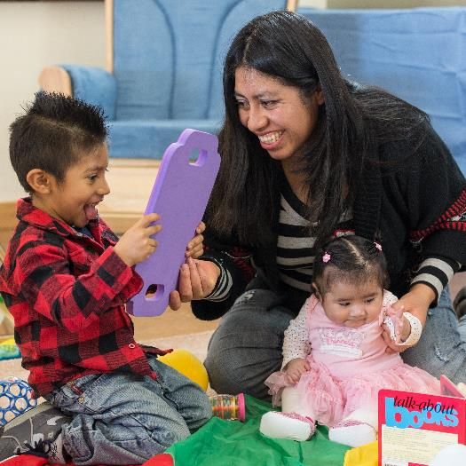
Understanding Children’s Behavior as Communication
Family Engagement in
Early Care and Education

Slide 2
Overview
This module will focus on:
Understanding that children’s behavior has meaning
The importance of responsive relationships between parents and educators for children’s emotional well-being and development
Effective ways to communicate with families about children’s behavior
Partnering with families when adults find a child’s behavior to be challenging

Slide 3
By the end of this module,
you should be able to:
Describe behaviors that children use to communicate and their possible meanings
Explain the effect of responsive relationships on children’s well-being and development
Identify effective elements in communicating with families about behavior
Partner with families seeking help with behavior that they find challenging

Slide 4
How We View Behavior
Form small groups and read the scenarios about children.
In each case, think about the possible perspectives and feelings of the parent, educator, and child.

Slide 5
Understanding the Meaning of Children’s Behavior

Slide 6
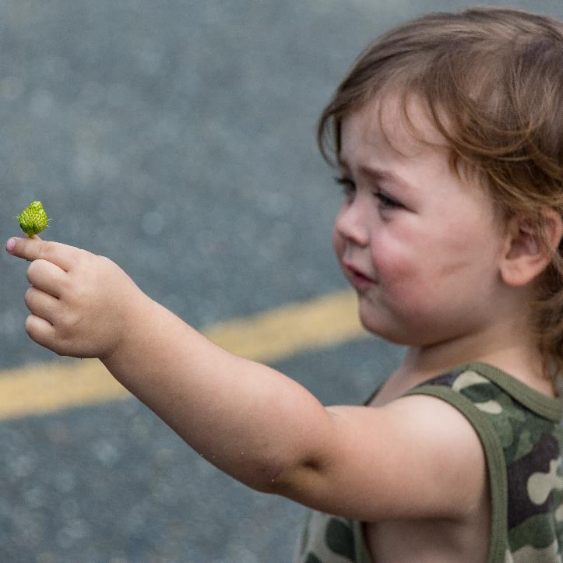
Behavior as Communication
Young children communicate
their needs and wants
through cues or behavior.
Image credit: EarlyEdU

Slide 7
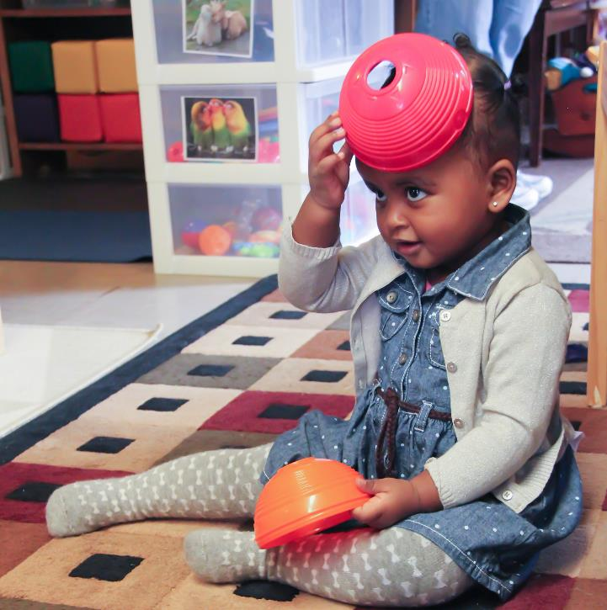
Influences on Behavior
Possible influences:
Typical developmental stages
Relationships with others
Experiences and culture
Individual differences, such as temperament and health issues
Image credit: EarlyEdU

Slide 8
Observing Children’s Cues
How do infants, toddlers, and preschoolers communicate with you and families?
Form groups and brainstorm responses for each age group.

Slide 9
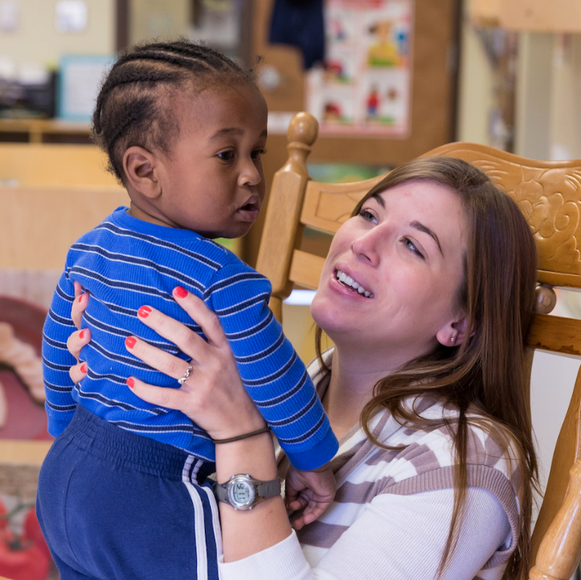
Ways That Infants Communicate
Smile
Cry
Gaze
Reach
Wave arms
Turn away
Arch back, stiffen body
Kick feet
Image credit: EarlyEdU

Slide 10
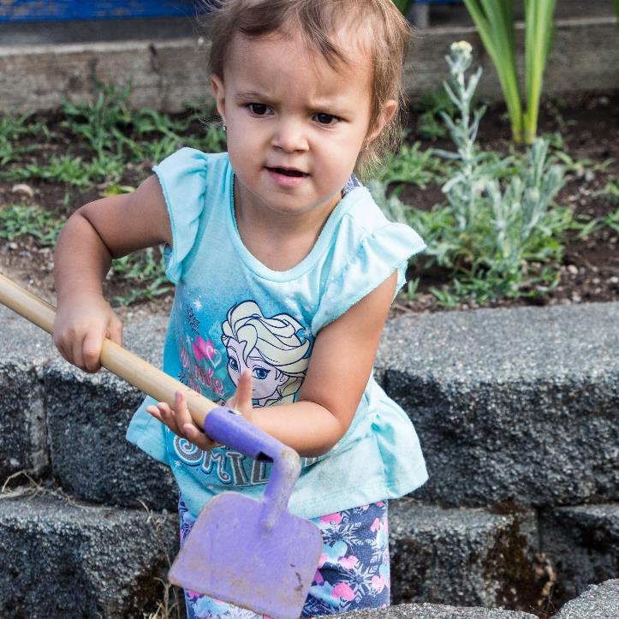
Ways That Toddlers Communicate
Say words
Use facial expressions
Squeal
Walk
Run
Climb
Image credit: EarlyEdU

Slide 11
Ways That Preschoolers Communicate
Preschool-age children typically are beginning to use language, but they also communicate with their bodies.
They may:
Say words and sentences
Smile
Laugh
Scream
Kick
Hit
Cry

Slide 12
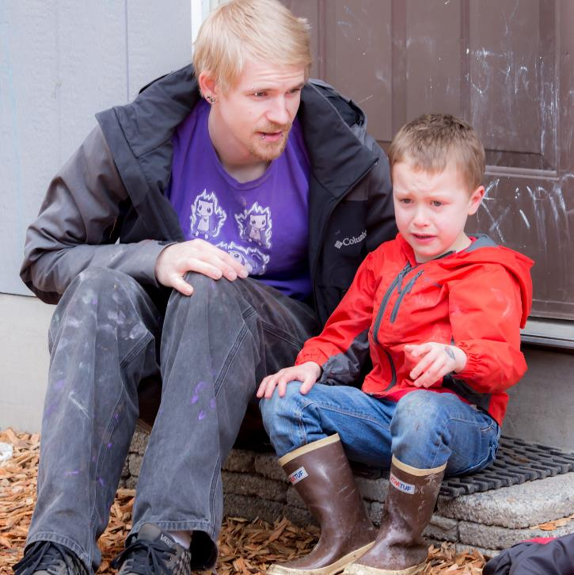
Expressing Emotions
Starting at birth, children quickly develop their abilities to experience and express their feelings as well as their ability to manage them.
Image credit: EarlyEdU

Slide 13
What Could This Behavior Mean?
A young infant arching her back
A mobile infant pulling a peer’s hair
A young toddler holding onto his mother’s leg
A preschooler throwing a toy

Slide 14
Looking for Clues
When you observe children’s behavior, look for clues that indicate what it means.
Sometimes the behavior’s meaning is clear, such as when a child smiles at someone. Other times, you may need to guess.
Over time, you can learn what a particular child’s communication means.

Slide 15
Talking About What Behavior Means
Conversations with parents about children’s behavior are important so that everyone:
Knows what a child is doing in home and early learning environments, and with different adults
Can discuss the meaning of behavior and best responses to support the child

Slide 16
The Tower
Think about these questions while you watch this video:
What is the child in the foreground doing?
What do you think the behavior means? Why do you think that?
How does the adult respond?
What else could the adult have done?

Slide 17
VIDEO: The Tower

Slide 18
Video Debrief
You may have noticed the child:
Trying to put a block on another child’s tower
Turning away and picking up a train when the other child pushes her hand away
Helping to knock down the tower when it starts to fall

Slide 19
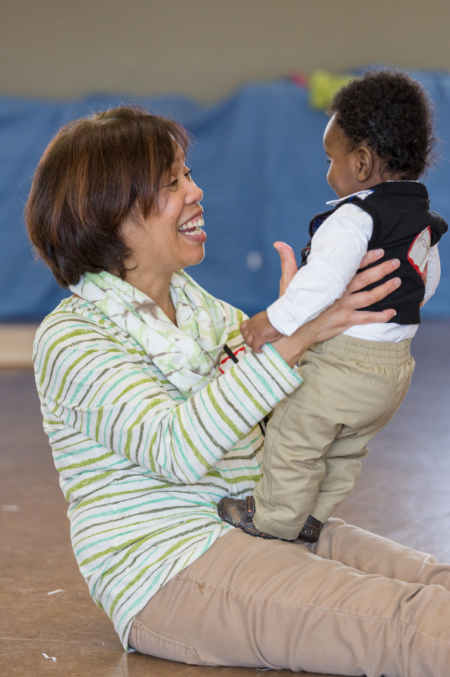
Understanding Your Child’s Behavior: Reading Your Child’s Cues from Birth to Age 2
Image credit: EarlyEdU

Slide 20
The Importance of Responsive Relationships

Slide 21
Noticing Positive Interactions
Describe a time when you noticed a parent’s warm response to his or her child’s behavior and shared that observation with the parent.
What else could you have added to this interaction or to future conversations with parents?

Slide 22
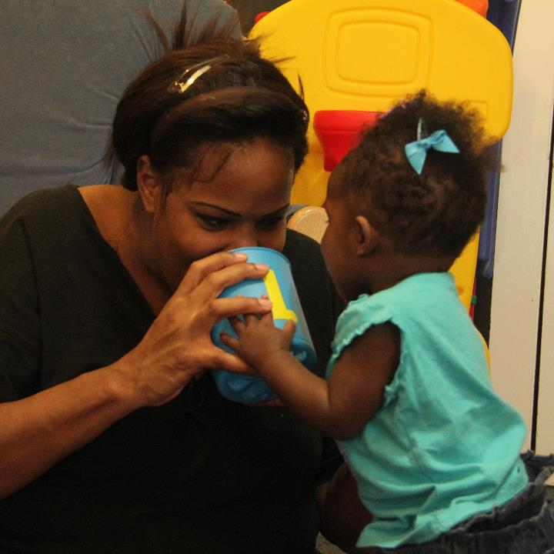
Strong Partnerships With Parents
Ongoing, positive relationships that you form with parents are important for close parent-child relationships
Image credit: EarlyEdU

Slide 23
Supporting Parents and Children
Notice and describe parents’ positive and responsive interactions with their children.
Listen for times when families need help in responding to children; and provide modeling, information, and resources to match the family’s needs.

Slide 24
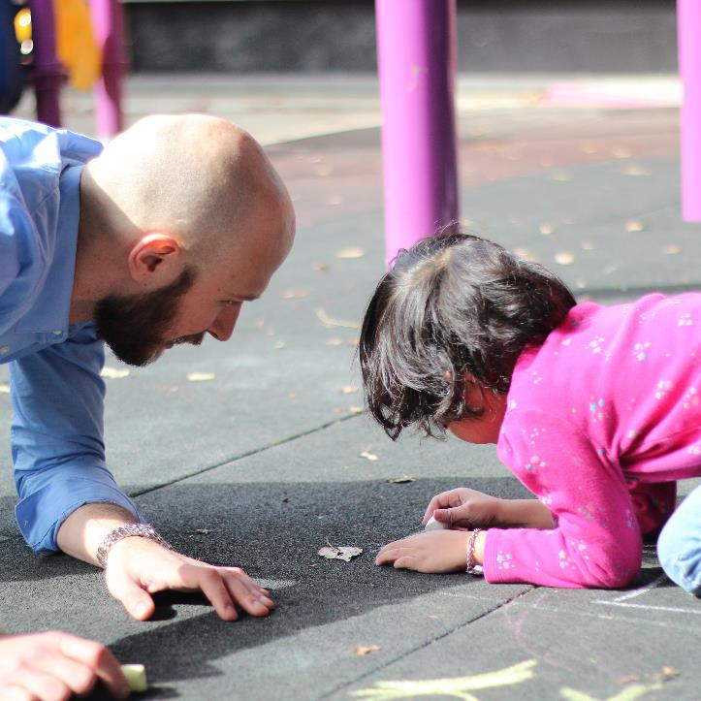
Children Grow in Relationships
Children grow and learn in the context of supportive and reliable relationships with parents and other caregivers.
Image credit: EarlyEdU

Slide 25
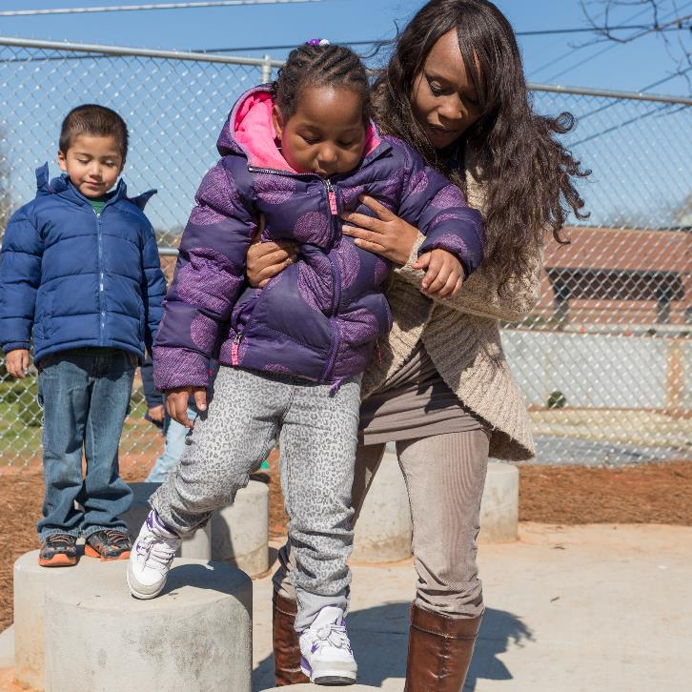
Responsive care of young children requires paying attention to, accurately observing, and responding to their cues.
Image credit: EarlyEdU

Slide 26
Responsive Interactions . . .
Help children to feel safe and to trust that their needs will be met
Build brain architecture and cognitive skills
Help children learn to calm themselves
Teach children that interacting with others can be positive

Slide 27
Reading Together
Watch the upcoming video and think about:
What does this mother do to build a relationship with her child?
How does she respond to the child’s communications?

Slide 28
VIDEO: Reading Together
The Tower
Watch this video
What behavior catches your eye?
What do you think CC is trying to communicate?

Slide 29
Video Debrief
The mother:
Responds to her child’s interest (which is shown by the child’s intense gaze, arms on the book, and waving) by describing with excitement what the child may see
Matches the child’s tone and moves up and down when the infant waves her arms

Slide 30
Responding to Infants and Toddlers
Some ways that educators and parents can respond to the communications of infants and toddlers include:
Matching children’s tone and facial expressions
Commenting on children’s interests
Helping children transition to a new activity

Slide 31
Responding to Preschoolers
Educators and parents can respond to children’s communications and encourage their language skills by:
Expanding their words, or repeating what they say and adding more
Asking open-ended questions
Listening to what children say

Slide 32
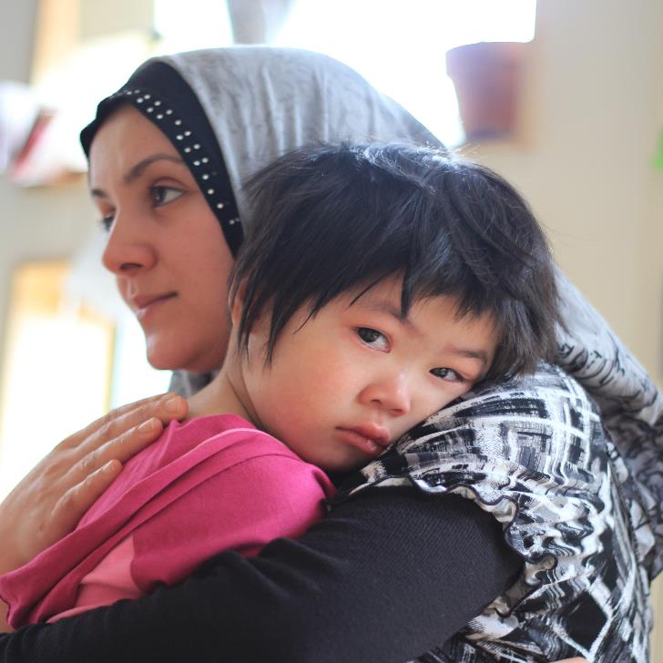
Learning to Manage Emotions
When adults respond to children in a warm and supportive manner, children learn to understand, express, and regulate their emotions and behaviors.
Image credit: EarlyEdU

Slide 33
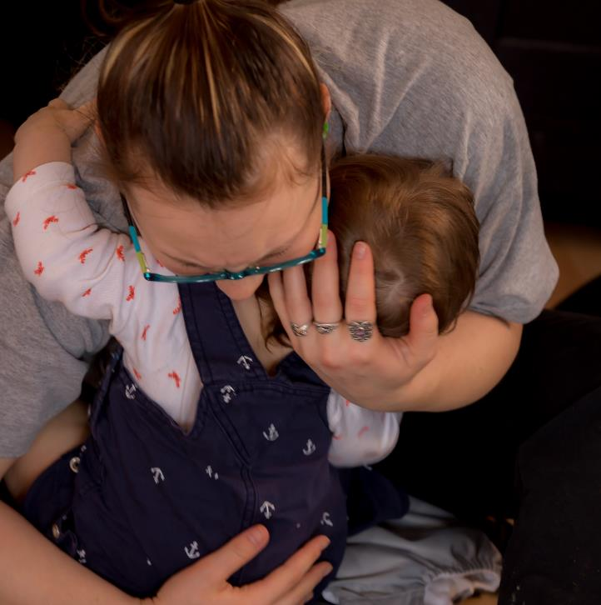
Challenges for Adults
Helping children manage their emotions can be difficult for families and educators.
Image credit: EarlyEdU

Slide 34
Responding to Our Own Feelings
How do you respond when a child’s communication or behavior stirs up negative feelings for you?
What else would you like to do?
Find a partner and share.

Slide 35
Communicating About Behavior

Slide 36
Learning From Families
What strategies do you use to learn from families about their children’s behavior?
How do you demonstrate that you value and use the information they share?
What kinds of information about behavior would be important to share?

Slide 37
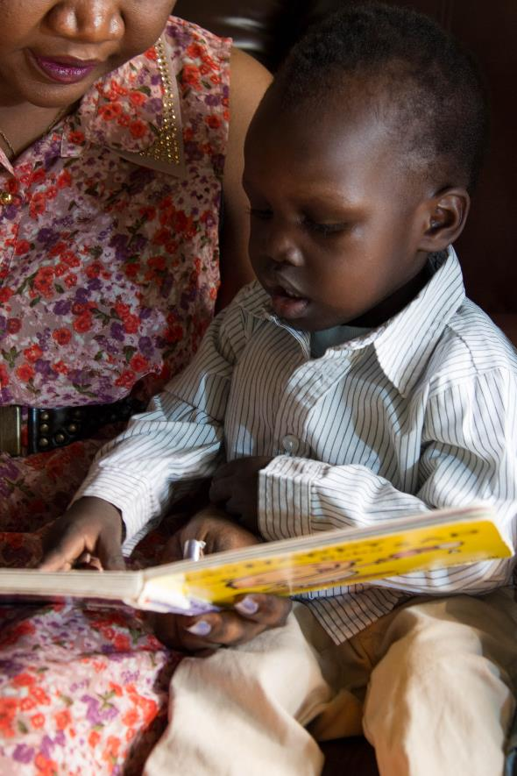
Talking about and responding to children’s cues and behavior should be part of an ongoing relationship that you have with parents that includes:
Strengths-based attitudes
Relationship-based practices
Image credit: EarlyEdU

Slide 38
Viewing Videos With Families
Video can be a useful tool for looking at children’s behaviors with families. You can:
Highlight positive aspects of children’s behavior and the parent-child relationship
Encourage families to guide the discussion and share what they see
Remain strengths-based, and listen to family observations
Acknowledge what families notice, and share feedback

Slide 39
My White Shoes
While you watch the story time in the video, think about positive observations you might share with a parent about De’Angelo.
Consider including the child’s strengths, using specific, objective language and questions for the parent.

Slide 40
VIDEO: My White Shoes

Slide 41
Video Debrief
Find a partner and act out a possible conversation between De’Angelo’s parent and the educator.
Using the reading activity as a focal point, include observations about De’Angelo’s strengths, using specific, objective language and questions for the parent.

Slide 42
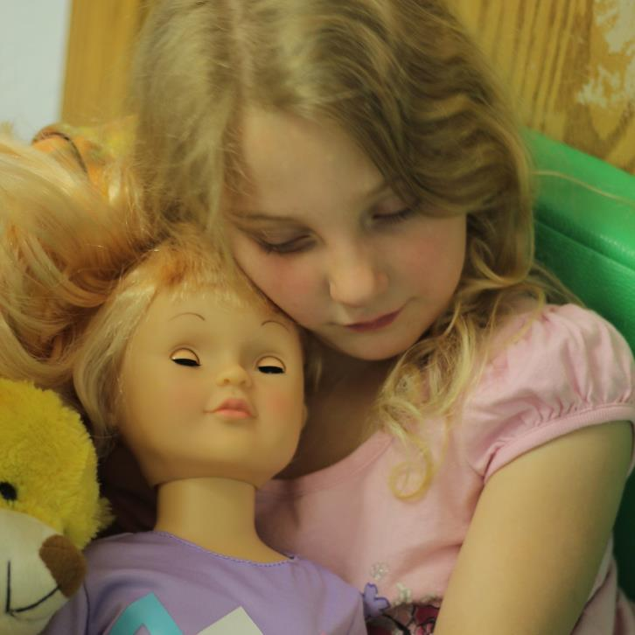
Different Expectations
Parents and educators may have different expectations about how children should behave based on their culture, knowledge, gender, and experiences.
These expectations can influence how parents and educators respond to and guide children’s behavior.
Image credit: EarlyEdU

Slide 43
Cultural Perspectives
Create a list of questions to ask families about their expectations for young children’s behavior and how they model and teach those.
Reflect on your own answers to those questions.
Compare lists with a partner, explaining why you chose the questions you did.
Talk about how you would approach a situation where a family had expectations that were different from yours.

Slide 44
When Adults Find a Child’s Behavior to Be Challenging

Slide 45
Perspectives on Behavior
Adults Find Challenging
What is your definition of behavior that is challenging?
What makes behavior feel challenging?

Slide 46
Behaviors That Adults Find Challenging Send Messages
Children will use certain behaviors until they learn new ways to communicate what they want and need.
To address and influence behavior that adults find challenging, adults need to understand what the behavior means.
Gaining a better understanding of what the behavior means for the child can help the adult develop effective strategies that meet the child’s needs.

Slide 47
GLASS Poster
Image credit: EarlyEdU

Slide 48
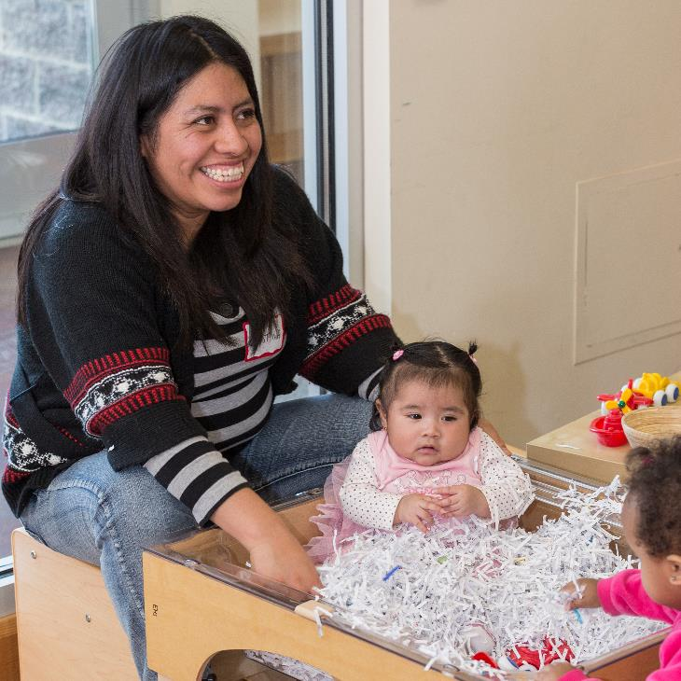
Communicating With Families
An established positive relationship with families helps when you need to discuss child behaviors that adults may find challenging.
Start with the family’s perspective.
Image credit: EarlyEdU

Slide 49
Libby & Kim:
Middle Ground Conversation
As you watch the video on the next slide, think about what effective practices the educator uses that are strengths-based and that help to build the relationship with the parent.

Slide 50
VIDEO: Libby & Kim Middle Ground Conversation

Slide 51
Video Debrief
The educator:
Starts by asking the parent a question about what she sees
Shares a positive observation about the child
Recalls a previous conversation
Describes a challenge the child is having, and asks the parent if she is seeing this at home too

Slide 52
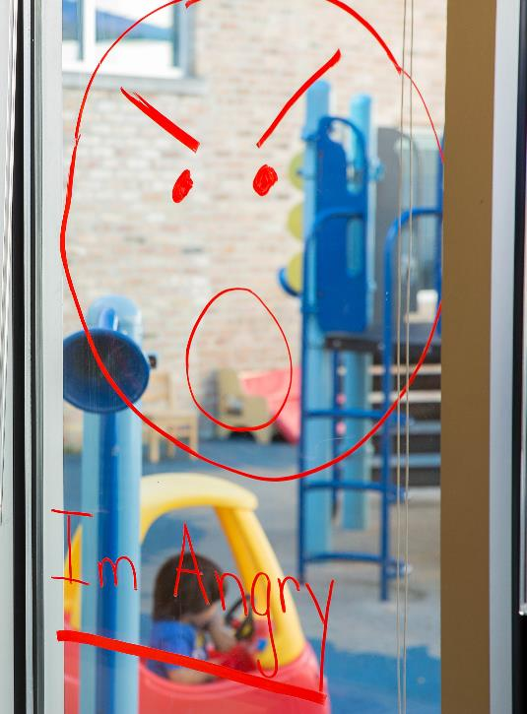
Seeking Help
When behaviors that adults find challenging persist, families and educators may need to reach out for help.
Image credit: EarlyEdU

Slide 53
How Can You Help?
Listen to families’ concerns and priorities for their children.
Check in with families regularly about their progress toward goals, and help them follow through if needed.
Get to know your community agencies.
Connect families with professionals who can help them meet their goals.

Slide 54
Resources for Families
In the video on the next slide, listen to the recommendations of Dr. Kathleen Meeker in the College of Education at the University of Washington.

Slide 55
VIDEO: Resources for Families

Slide 56
Video Debrief
The speaker recommends several possible resources for family members who have concerns about their children:
Pediatricians
Early childhood mental health providers
Local school districts

Slide 57
Who Else Can Help?
A variety of professionals in Head Start can help when families and educators have concerns about their children’s behavior:
Behavior specialists
Mental health consultants
Disability specialists
Family services staff

Slide 58
Factors That Influence Families and Children
Possible factors that influence family well-being and children’s behavior and development are:
Poverty
Unemployment
High housing costs
Food insecurity
Community violence
Poor health
Stressful work environment

Slide 59
Think about a time when your family was facing a challenge.
How did this challenge affect you and your family?
How did you respond to the challenge?
What helped you respond to and manage the challenge successfully?

Slide 60
Bringing It All Together

Slide 61
The Head Start Parent, Family, and Community Engagement Framework
Image credit: Office of Head Start

Slide 62
Where Does It Fit?
Which part of the Framework does this topic relate to?
Form a small group and share ideas.
Be ready to share your thoughts with the whole group.

Slide 63
Families and educators can work together to understand and respond sensitively to children’s behavior.
Positive relationships impact children’s well-being and behavior.
Effective communication about child behavior is an important part of educator-parent conversations and efforts to address behaviors that adults find challenging.

