Slide 1


Head Start A to Z, 2.0 Community and Self-Assessment
Part 1: Community:
Building Responsive Programs
Notes:
Slide 1
Facilitator Notes:
Welcome participants to the session and introduce yourself. If you have co-facilitators, invite them to introduce themselves as well.
Begin the session with an introductory activity to create a positive group climate and begin the engagement process. Then explain
the following.
Say to Participants: “The National Center on Program Management and Fiscal Operations has updated Head Start A to Z to align
with the revised Head Start Program Performance Standards that became effective November 2016. Head Start A to Z was
originally designed to support new leaders in their Head Start roles. The term ‘leaders’ ensures that anyone at the management
level, or in some cases the governing body, Tribal Council, or Policy Council level, can attend the sessions or use the materials for
independent learning.
“The updated Head Start A to Z, 2.0, learning modules provide baseline-level information primarily through a leadership and
management systems lens. The presentations are modeled on ‘learning organization’ concepts. In each of the modules, we
recognize key characteristics of learning organizations, including a supportive learning environment, openness to new ideas, and
time dedicated for reflection.
“Each attendee has an important role to play in the success of this session. Those with experience remind us where we’ve come
from and what we must do to maintain our identity and uniqueness. New members bring a fresh perspective and remind us what we
must do to prepare for the future. All roles are essential for Head Start to be a learning organization that continues to grow and
flourish.
"Head Start A to Z, 2.0, is most successful when it helps us share the best of what we have to offer with a strength-based focus. As
you engage in this session, we hope that you will support one another in the learning process by generously sharing your
knowledge, experience, and perspective.”

Slide 2
Learning Objectives
In this module, participants will:
Understand the requirements for
community assessment
Explore the recommended process
for conducting a community assessment
Recognize the importance of the community assessment as a planning tool
Identify strategies and resources for supporting the community assessment
Notes:
Slide 2
Facilitator Notes:
Distribute the Reflective Practice Tool handout.
Say to Participants: “In this module, participants will:
Understand the requirements for
community assessment
Explore the recommended process for
conducting a community assessment
Recognize the importance of the community
assessment as a planning tool
Identify strategies and resources to support the community assessment”
Guide participants to the Reflective Practice Tool handout.
Say to Participants: “At the end of our session, you will be asked to use this Reflective Practice Tool to write down some key
thoughts based on what you’ve learned. We encourage you to jot down some preliminary thoughts as we move through the
session.”

Slide 3

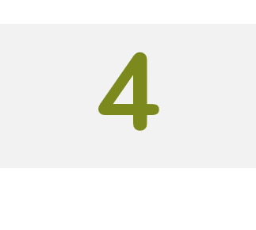
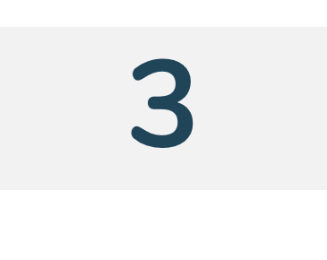
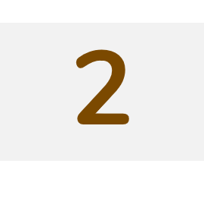
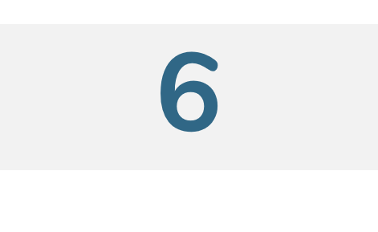

Six Guiding Principles for A to Z, 2.0
Successful programs are learning organizations.
Relationship-building is at the heart of transformational leadership.
Sound decision-making is informed by quality data.
The effective delivery of services grows out of strong systems.
Culturally and linguistically diverse organizations rely on intentional, specific, and coordinated approaches.
School readiness for all is our driving goal.
Notes:
Slide 3
Facilitator Notes:
Distribute the Head Start A to Z Guiding Principles handout. Note that for this session, we will focus on Guiding Principle 3: Sound
decision-making is driven by quality data.
Say to Participants: “Head Start A to Z, 2.0, is based on six guiding principles. These guiding principles are foundational to the
design of the modules and have been aligned with the HSPPS.
“Head Start directors and managers come from all walks of life with a wealth of employment experiences. However, we all share a
commitment to a comprehensive, high-quality early childhood experience. We recognize that, to promote school readiness and be
responsive to the needs of our communities, we must engage in ongoing professional development. Head Start A to Z, 2.0, was
created to support professional growth and development for the Head Start leaders.”
Guide the participants to the Head Start A to Z Guiding Principles handout. Review the six principles below. You may paraphrase or
slightly summarize.
Successful programs are learning organizations. Head Start is a dynamic organization with high expectations, values, and traditions. Programs are constantly responding to changing community needs and evolving best practices. To cultivate a learning organization that thrives in this environment, program leaders must support all staff in becoming life-long learners who embrace challenges as opportunities for collective problem-solving and innovation.
The effective delivery of services grows out of strong systems. Program leaders must regularly refine their program’s management and fiscal systems. To target community needs and deliver comprehensive services, leaders need to understand systems thinking and view their program through a systems lens. They also need to recognize the relationship between systems, services, and child and family outcomes.
Sound decision-making is informed by quality data. Used in planning, evaluating, and communicating information, quality data is integral to cultivating a culture of continuous quality improvement. To this end, it is critical for leaders to establish efficient processes for collecting, aggregating, analyzing, and synthesizing data. This involves training teachers, home visitors, family advocates, health services workers, and other staff how to integrate data management into their day-to-day work.
Relationship-building is at the heart of transformational leadership. Robust Head Start communities build on authentic relationships between all of their stakeholders, from children, families, staff, and managers to governing bodies, Tribal Councils, and Policy Councils. To cultivate these communities, leaders need to communicate effectively, empower others, foster team-building, and nurture collaboration.
School readiness for all is our driving goal. Head Start leaders play an integral role in conceiving and promoting an inclusive vision of school readiness. To support children with diverse abilities and backgrounds to develop the skills, knowledge, and attitudes needed to be successful in school, effective leaders must stay informed on developments in early childhood education. They also must actively collaborate with parents, staff, governing bodies, local education agencies, and community partners in embedding these best practices into services and programming.
Culturally and linguistically diverse organizations rely on intentional, specific, and coordinated approaches. To ensure the full and effective participation of dual language learners and their families, Head Start leaders must coordinate program-wide plans that involve all service areas and multiple staff. This includes staying connected to the communities served, implementing targeted strategies, and articulating how programs and services address specific linguistic and cultural needs.
Say to Participants: “In addition to anchoring the content in Head Start A to Z, 2.0, you will revisit these guiding principles in all of
the trainings offered by PMFO.”

Slide 4
Overview
Notes:
Slide 4
Facilitator Notes:
Begin this section on community assessment.
Say to Participants: “Think of a time when you or something you own underwent an inspection—a physical exam, or a car or
house inspection. Why did you do it? What did you learn from it? How did it impact your future actions?
“We monitor our health through regular physical exams. These exams can tell us if we are on track with our goal of maintaining
good health. They may lead us to set new goals or adopt new strategies to improve our heath. We inspect our cars to make sure
that they are functioning properly so we can get where we want to go safely.
“It’s the same with the assessments we conduct in Head Start. Community assessment provides an in-depth picture of our
community, its people, their strengths and needs, and available resources. It tells us who we should serve and what those services
should look like. The annual self-assessment provides an in-depth picture of the services we are providing.
“Part 1 of this module focuses primarily on community assessment. Refer to Part 2 to learn more about the annual self-assessment.
These assessments are very much linked in the way they inform and adjust our program design over time. While required by OHS,
both assessments are designed by programs themselves, and so will vary a bit depending on program needs.
“Does anyone have additional thoughts or questions about what we’re going to cover in Part 1?”
Take two minutes to discuss any comments or questions.

Slide 5
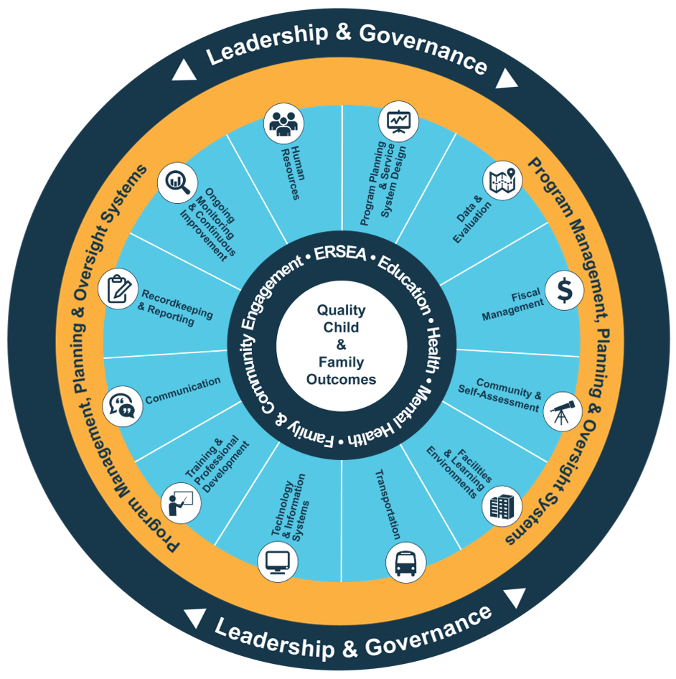
Head Start Management Systems Wheel
Notes:
Slide 5
Facilitator Notes:
Deliver the following material as a mini-lecture.
Say to Participants: “The Head Start Management Systems Wheel can help us understand how community assessment fits into
the overall picture.”
In your own words, explain the graphic on the slide by pointing to its various elements and describing each, basing your descriptions
on the bullet points below.
The dark blue outer circle includes the functions of leadership and governance. They are the bedrocks of effective management, encompassing and informing the 12 management systems.
The yellow circle outlines the scope of these systems.
The segmented aqua blue ring outlines each of the 12 management systems. These systems work together to inform and influence the program’s service delivery. These services include education, health, mental health, community partnerships, family engagement, and eligibility, recruitment, selection, enrollment, and attendance (ERSEA).
Say to Participants: “You see that one of the aqua blue wedges is labeled ‘community and self-assessment.’ That’s the
management system we’re looking at in this module. In Head Start, all of these systems work together to inform and influence the
program’s service delivery, which you see in the dark blue inner circle. When innovative leadership, strong management systems,
and well-designed services are working together, we produce quality child and family outcomes.”

Slide 6
Community and Self-Assessment
Initiates the program planning process
Provides the right services to the right population
Supports continuous quality improvement
45 CFR §1302.11(b)
45 CFR §1302.102(b)(2)(i-iii)
Notes:
Slide 6
Facilitator Notes:
Direct participants’ attention to the slide.
Say to Participants: “Now that we’ve looked at the wheel itself, let’s take a moment to identify the management system that we will
be exploring in this session: community assessment and self-assessment.
“To fully explore this system within our organizations, we need to understand how our data collection and analysis activities inform
the way our programs deliver services.
The community assessment focuses on external factors for new and existing programs, ensuring they are providing the right services to the right population.
The self-assessment focuses on internal factors, including ongoing monitoring data, to support the continuous quality improvement process.”

Slide 7
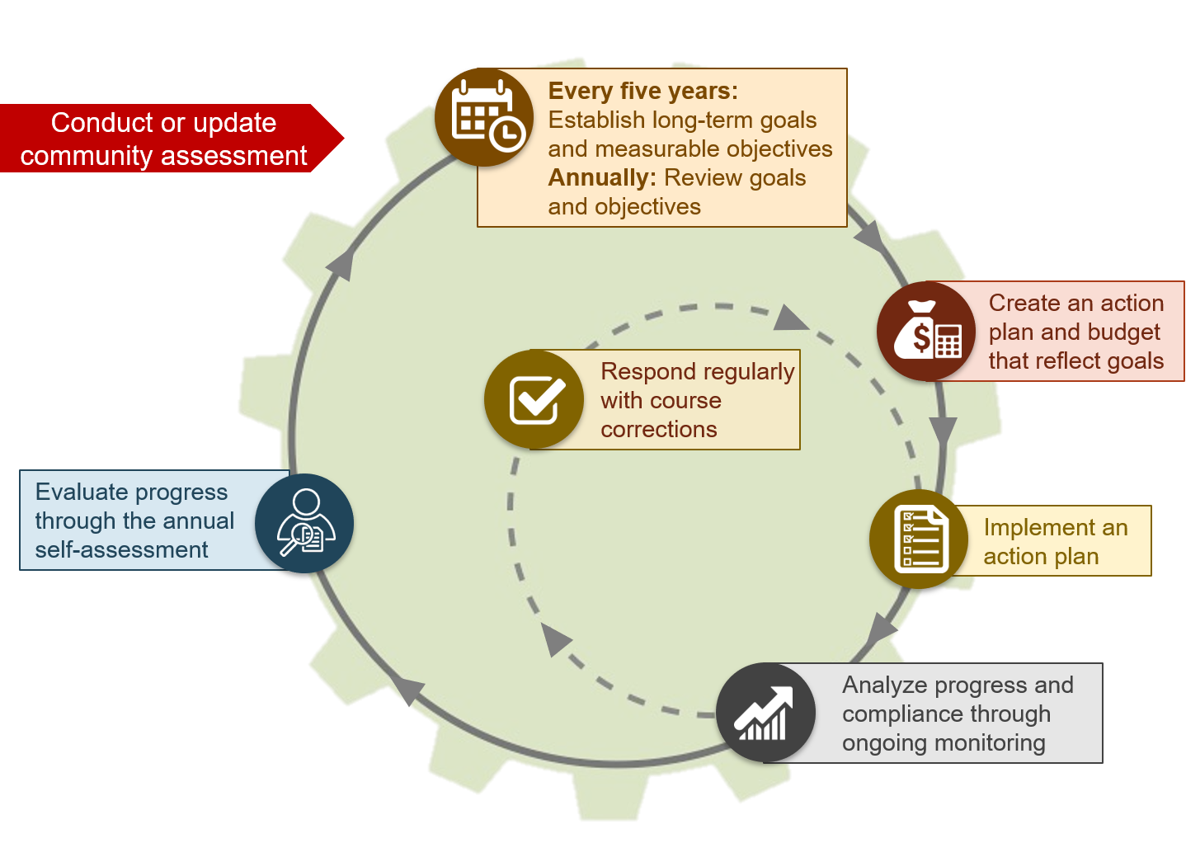
Program Planning Cycle
Notes:
Slide 7
Facilitator Notes:
Distribute the Head Start Program Planning Cycle handout.
Say to Participants: “Before we go any further, we
also need to look at how community assessment and
self-assessment fit into the Head Start program planning cycle.
“Programs use the community assessment process to collect and analyze data about the needs and resources of eligible families,
the program, and the community to inform goal-setting. For their baseline grant applications, programs identify the strategic long
term goals they will accomplish during the five-year project period. They also identify objectives linked to these expected outcomes.
Community assessment—shown at the very top of the program planning cycle—is what feeds all this planning and goal-setting.
“During their annual planning process, programs review their long-term goals and revise them as necessary. They continue to break
down their goals into short-term objectives linked to expected outcomes.
“Moving clockwise around the circle, you see that programs then develop an annual action plan. The action plan outlines what a
program will do to accomplish its goals and objectives. This plan is supported by a budget. As the program implements its plan, it
collects data through technology and information system and manages it through its recordkeeping and reporting system. The
program continually evaluates progress toward its goals and objectives by reviewing the data it gathers. Based on ongoing
monitoring results, programs will continue to implement their action plan as written or make course corrections that require changes
in program activities or levels of effort.
“Finally, the program comes full circle to the annual self-assessment. In this step, the self-assessment team uses its ongoing
monitoring, community assessment, and other relevant data to assess the program’s progress in achieving its goals, objectives, and
expected outcomes, and to evaluate program compliance with federal requirements.
“We can see that planning is a circular process that continues to build and evolve over each program year. You can think of it as a
slow-moving wheel with forward momentum. Now let’s take a deeper look at the community assessment process.”

Slide 8
It All Starts with a Community Assessment
Community assessments must:
Support strategic planning
Be conducted at least once over
the five-year grant period
Describe community strengths,
needs, and resources
Notes:
Slide 8
Facilitator Notes:
Distribute the Community Assessment in the Head Start Act and Community Assessment Requirements in the HSPSS handouts.
Say to Participants: “The community assessment builds a foundation for program structure and services. It is an essential data
source that supports program planning. A community assessment is conducted at least once over the five-year grant period and
updated annually. It helps identify children and families to be served and how they will be served. The community assessment
describes community strengths, needs, and resources. Data from the assessment helps to determine program goals and objectives.
It also helps determine where centers should be located and informs other critical program design decisions.”
Point out the two handouts for this slide.
Say to Participants: “We’ll be referring to these requirements throughout this session, so keep these handouts close by.”

Slide 9
Community Assessment: Key Elements
Aligned with five-year project period
Strengths-based
Focuses on diverse needs of children and families
Requires data on vulnerable populations
Must be updated annually
Notes:
Slide 9
Facilitator Notes:
Deliver the following material in the form of a mini-lecture.
Say to Participants: “A community assessment paints a picture of the community and helps programs identify their service areas,
target population, and needs. The data programs are required to collect for their community assessment include:
Demographic information on eligible children and expectant mothers
Information on children experiencing homelessness, children in foster care, and children with disabilities
The education, health, nutrition, and social service needs of eligible children and families
Typical school or work schedules of parents with eligible children
Information on other early childhood programs in the community and any additional resources that are available to Head Start-eligible children and their families
“Programs can also use community assessment data to consider the appropriateness of mixed-income service delivery, if it does
not result in serving fewer income-eligible children. Research shows that settings with diverse economic groups benefit children and
families at all income levels.”

Slide 10
Community assessments help programs:
Understand the needs of families
Make informed decisions about service area delivery
Recognize demographic changes and address newly identified needs
Identify skills and competencies needed in workforce
Advance cultural competence
Mobilize community resources and partnerships
Notes:
Slide 10
Facilitator Notes:
Make sure participants see only the initial screen until you have posed the question below and had a group discussion about it.
Say to Participants: “What do you think the benefits are of conducting a community assessment?”
Solicit volunteers to share their ideas; lead a brief discussion. Then, select the slide to activate the animation. A list of six benefits
will appear.
Say to Participants: “We’ve just touched on some of these in our discussion. Community assessment helps programs:
Make informed decisions about service delivery
Understand the needs of parents and families in the community by gathering their opinions
Recognize demographic changes happening in the community and address newly identified needs
Identify the skills and competencies their staff needs, including gaps in professional development that need to be addressed
Improve cultural competence and reduce disparities
Mobilize community resources and partnerships”

Slide 11
Community Assessment:
The Foundation for Program Planning
STEP 1: Plan and Organize
STEP 2: Design the Work
STEP 3: Gather Data
STEP 4: Analyze and Make Decisions
STEP 5: Communicate and Incorporate
Notes:
Slide 11
Facilitator Notes:
Prepare index cards with one of the five steps printed on each card in advance, and distribute one card per table. Have the Five
Steps to Community Assessment handout ready to distribute during the exercise.
Say to Participants: “This slide introduces a five-step process to help guide you through your community assessment. We’re going
to go into each step in detail in a few minutes. But before we do, let’s find out what you think each step involves.”
Give each table a card with one of the five steps printed on it. Tell the table groups they have 15 minutes to discuss what
considerations and activities each step involves. Groups may wish to talk about how these steps are like or unlike their own
community assessment processes. Tablemates should use the card to record the activities they think are necessary under their
step. When everyone has finished, distribute the Five Steps to Community Assessment handout so participants can see how their
answers match up.
Say to Participants: “Are there activities you hadn’t thought about?”
Ask volunteers to share.

Slide 12
Step 1: Plan and Organize
Form a community assessment team
Identify necessary resources
Establish a timeline
Communicate a community assessment process
Notes:
Slide 12
Facilitator Notes:
Distribute the Managing the Community Assessment Process handout.
Say to Participants: “As you can see on the slide, this first step of community assessment is about planning and organizing. First,
you will form your team. Who is on your team depends on your organizational structure. Ideally, your team should include:
Head Start director
Key management and other staff
Representatives from your Policy Council and governing body or Tribal Council
Parents
Community partners
“Once you’ve assembled a team, make sure members understand their responsibilities.
“Think about the resources you will need to conduct the community assessment. What will you need in terms of people, money, and
technology?
“Draw up a plan with a timeline and communicate that plan to program staff and stakeholders so they can support this project.”
Refer participants to the Managing the Community Assessment Process handout for additional tips for conducting a community
assessment. Ask if they have questions or comments about any of the tips.

Slide 13
Step 1: Plan and Organize (Cont’d)
Engages more community members in planning and
implementation
Increases access to more data sources
Establishes relationships that will be important for leading actions identified in the community assessment findings
Notes:
Slide 13
Facilitator Notes:
Continue discussing Step 1 of the community assessment process.
Say to Participants: “We just mentioned that you should consider including community partners in your assessment. Let’s pause to
think about the value engaging community partners can add to this process.
Collaborating with partners engages more community members in planning and implementation, which help establish a more comprehensive process.
Partners may have community assessment data to share or expertise they can lend in designing the assessment or analyzing the findings.
Collaboration establishes the relationships you will need to carry out some of the activities suggested by the community assessment.”
Ask participants to identify potential collaboration partners in their community. Solicit volunteers to share their thoughts.

Slide 14
Step 2: Design the Work
Determine data needs
Identify internal and external data
Identify sources
Develop questions
Notes:
Slide 14
Facilitator Notes:
Distribute the Community Assessment Matrix and National Resources for Community Assessment Data handouts.
Say to Participants: “The second step in community assessment is designing the work. This is the step where you determine your
data needs. You’ll want to review the HSPPS to see what data you’re required to collect, and then identify any additional data that
you wish to collect based on your specific community issues and priorities. This step also involves identifying data sources, both
inside and outside your program and in the community. What questions are you going to ask all this data to answer?
“Let’s look at the Community Assessment Matrix handout. Take three minutes to identify the types of data you are required to
collect for your community assessment, along with additional data you would like to collect. Name the potential sources of each type
of data. Be aware that some data sources will be outside your program. They may exist at the community, county, state, or national
level. The National Resources for Community Assessment Data handout provides a list of national data sources.”
After three minutes, ask participants to name a few types of data they identified.

Slide 15
Step 2: Design the Work (Cont’d)
What is data?
Pictures
Words
Numbers
Media Reports
Maps
Notes:
Slide 15
Facilitator Notes:
Call participants’ attention to the Community Assessment in the Head Start Act and Community Assessment Requirements in the HSPPS handouts.
Say to Participants: “Head Start requires the collection of data at various times and in a range of areas. The types of data you
must collect, or might decide to collect, are named in the handouts you have.
“Let’s take a moment to think about all the forms data can take.
Numbers. Teachers count the number of children present in class on any given day; a family service worker records the number of home visits to each family; and the program keeps track of how many children have been referred to health clinics. These are examples of numerical data. Numbers are used in evaluating every aspect of the program’s services and systems.
Words. Staff conduct interviews with family members during home visits; talk with families during parent-teacher conferences; have discussions with peers during in-service training; and share information at Policy Council meetings. All these interactions provide valuable data.
Photos. Photos provide information about a new center, an upgraded community playground, and new staff or governing body members. Information conveyed in photos can be hard to get any other way.
Maps. Maps of the recruitment and service areas are required for the grant application. They are an invaluable resource for other purposes, as well. For instance, maps and map-based graphics can provide a visual depiction of poverty rate, children’s ages, and other factors by census tract.
Media reports. Newspaper articles, TV or radio segments about your program, and interviews with staff and parents that appear in any form qualify as data. A feature story about emerging populations in the service area or a new Head Start center also are sources of information.
“Head Start programs should routinely gather this sort of data. During the community assessment process, your program will
identify the data you need and how you will go about collecting it.”

Slide 16
Step 2: Design the Work (Cont’d 1)
Types of Data
Internal and External
Quantitative and Qualitative
Notes:
Slide 16
Facilitator Notes:
Continue with the mini-lecture on Step 2 of the community assessment process.
Say to Participants: “Your community assessment will use both internal and external data to paint a picture of the community’s
strengths, needs, and attributes. Let’s make sure we all understand internal and external data.
Internal data include past and current program data, such as your Program Information Report (PIR) and agency information, enrollment forms, social service logs, bus logs, children’s health records, Individualized Education Programs (IEPs), family partnership agreements, family engagement data, and tribal agency information.
External data refer to sources outside your program and agency. External data might be created or collected by a variety of entities, including:
Other local community organizations
Indian Health Service (IHS)
Public schools
State agencies
U.S. Census
“Some external data are available to you in the form of published statistics or reports. Other external data you need won’t have
been gathered by anyone else, or won’t be current, so you’ll need to develop your own methods for collecting it.
“As you plan for data collection, another important distinction to keep in mind is quantitative versus qualitative data. The difference
between these two types of data is in how they are expressed.
Quantitative data are expressed in numerical terms. An example is the number of Hispanic children in your service area or the percentage of enrolled families who use public transportation to get to Head Start.
Qualitative data are represented in words. For example, a transcript of a parent focus group discussing immigration issues is qualitative data. A description of pre-kindergarten programs in your service area is also qualitative data.
“In order to have a high-quality community assessment, you will need to collect and analyze both quantitative and qualitative data.”

Slide 17
Step 2: Design the Work (Cont’d 2)
Data Collection Strategies
Collected from multiple sources
Gathered over several years or many times over a single year
Relevant to the client population
Include historical, internal service provision, enrollment, and Program Information Report data
Notes:
Slide 17
Facilitator Notes:
Continue discussing Step 2 of the community
assessment process.
Say to Participants: “As you design your data collection strategies, think about some of the approaches on the slide. You’re not
required to use any particular approach, but you should consider these techniques because they can strengthen your process.
Collect data from multiple sources. Find out if other organizations have needs assessments you can review and draw from as secondary data; there are also many online resources for local and regional data that you may be able to tap.
Use data that has been gathered over time. Data collected over a multi-year period gives you an opportunity to make comparisons and look at trends. For instance, what can see you about waitlist trends in the past year or two? What about trends related to reasons for drops, full-day enrollment, and the enrollment of families experiencing homeless, foster children, or other vulnerable populations? How have family needs changed over the past few years? How about children’s health issues? How have demographics in the community changed?
Make sure your data focuses on your client population. The data you collect should be about Head Start-eligible children and families and their strengths and needs.
Internal family profile and service provision data combined with external data provide a more complete profile. When you put all this data together, you can formulate useful questions. For instance, do the number of children experiencing homelessness in your program reflect the numbers seen in your community at large? Is there an increase in dual-language learners? Analyzing your enrollment and PIR data allows you to identify trends important for planning and make comparisons to state and national data.”

Slide 18
Step 3: Gather Data
Determine:
Data collection methods
The logistics each method requires
How you will keep stakeholders informed
How the data you collect will be managed and organized
Notes:
Slide 18
Facilitator Notes:
Move to Step 3.
Say to Participants: “The third step in community assessment is gathering the necessary data.
“As we’ve said, some of the data you will need has already been collected, either by your own program or by outside organizations.
You should begin your process by pulling all that data together in one place.
“It is likely you will also need new data that you collect only for the purpose of your community assessment. In collecting this new
data, you should consider:
What kind of data collection methods you will need to use
The logistics each method will require
How you will keep stakeholders informed about the assessment
How the data you collect will be managed and organized

Slide 19
Step 3: Gather Data (Cont’d)
Methods for Data Collection
Survey: web-based or on paper
Interview: in person or by phone
Focus group
Large-group discussion
Notes:
Slide 19
Facilitator Notes:
Distribute the Methods of Data Collection handout.
Say to Participants: “As we’ve just noted, there are many ways to collect data for your community assessment. The methods you
use depend on the type of data you want to collect. Every method has its own advantages and disadvantages. Let’s discuss each of
them.”
Review the information on the Methods of Data Collection handout and ask participants which methods they have used in the past.
Are there advantages or disadvantages to these methods not noted in the handout? Ask participants to name any additional
methods they may have used and to share their experiences with them.

Slide 20
Step 3: Gather Data (Cont’d 1)
Survey and Group Process Design
Notes:
Slide 20
Facilitator Notes:
Distribute the Designing a Survey: Response Methods and Conducting Focus Groups and Large-Group Discussions handouts
before reviewing this slide. Keep the Designing a Survey: Response Methods answer key for yourself.
Say to Participants: “We’re going to take a little time to delve into survey design, since surveys are such a popular way to gather
information. Sometimes you need more than a yes or no answer. Consider the following question types when designing a survey.”
Direct participants to the two handouts. Tell them the Conducting Focus Groups and Large-Group Discussions handout is for
reference when they begin designing their next community assessment.
Direct them to the Designing a Survey: Response Methods handout and briefly review it together. Instruct participants to turn to a
partner. The pairs should read each example and identify the type of question being asked. Tell them they have five minutes for this
exercise.
After five minutes, use the Designing a Survey: Response Methods answer key to review the answers with participants.

Slide 21
Step 3: Gather Data (Cont’d 2)
Data Collection Considerations
Notes:
Slide 21
Facilitator Notes:
Distribute the Creating Questions for Stakeholders handout.
Say to Participants: “No matter what data collection tool you use, the questions you ask should be carefully designed for the
intended group. This is how you’ll get the information you are looking for.”
Ask participants to turn to a partner. Using the Creating Questions for Stakeholders handout, partners should identify which
stakeholders they would like to question and design three survey questions for that audience. Tell participants they will have seven
minutes to complete this exercise.
When they are finished, ask for volunteers to share the survey questions that they have crafted.

Slide 22
Step 4: Analyze and Make Decisions
Review data analysis purpose and procedures
Identify trends, strengths, and needs
Make decisions
Notes:
Slide 22
Facilitator Notes:
Distribute the Community Assessment Analysis handout.
Say to Participants: “Step 4 addresses how we analyze data and make decisions. Once you’ve collected your data, the next step
is to look at it and think about what it is telling you. In this step, your team is identifying trends, strengths, and needs.
“Bringing together all of the data and sorting it into appropriate categories helps to identify certain themes. For example, has there
been an increase in public preschool enrollment or a decline in birth rates? If so, what does that mean for the community? Use this
time to identify relevant issues, such as needs related to a changing workforce or higher education for parents in the community,
and highlight the trends you see emerging. Are there unmet needs? What are they and how should you respond?”
Tell participants the Community Assessment Analysis handout will help their program review its analysis process, identify trends,
and assess what impact their findings could have on their program.

Slide 23
Step 4: Analyze and Make Decisions (Cont’d)
Addressing Important Issues
What do the data show?
How will the data affect our program?
How do these findings influence our decision-making?
On what new issues do we need to focus?
Notes:
Slide 23
Facilitator Notes:
Continue with the mini-lecture on Step 4 of the community assessment process.
Say to Participants: “Your analysis of community assessment data is important because it determines how your program will look
in the near future. Think about what the data shows. Are enrollment numbers going up or down, and what does that mean? Are
there demographic shifts that will impact enrollment? What is the data about other child development programs telling you? What
changes must you prepare for based on the trends that you are seeing? For example, based on the data you have collected, should
you consider changing your:
Hours of operation
Program design
Center locations
Community partnerships?
“Should you consider converting slots form part-day to full-day, or from Head Start to Early Head Start? Have stakeholders made
suggestions for improvement? What have families identified as their most important issues?
“Ask yourself what the community assessment team has identified as its greatest concerns, given all the new information and data it
has uncovered. How will you address those concerns to provide the most benefit to children and families?”

Slide 24
Step 5: Communicate and Incorporate
Prepare the community assessment report
Communicate the report, with recommendations, internally and externally
Review and update the community assessment annually
Incorporate the community assessment process into the program’s strategic and ongoing planning
Notes:
Slide 24
Facilitator Notes:
Distribute the Community Assessment Report Sample Outline handout.
Say to Participants: “In the final step, we prepare the community assessment report. Be sure to communicate the community
assessment data and recommendations internally and externally to your governing body or Tribal Council, Policy Council, staff, and
community partners. The fifth step also involves incorporating the community assessment process into the program’s strategic and
ongoing planning. Be aware that the HSPPS require you to include a summary of your program’s most recent community
assessment in your annual report.”
Tell participants that, as with many other handouts they have received in this session, they should take the Community Assessment
Report Sample Outline back to their programs as a reference.

Slide 25
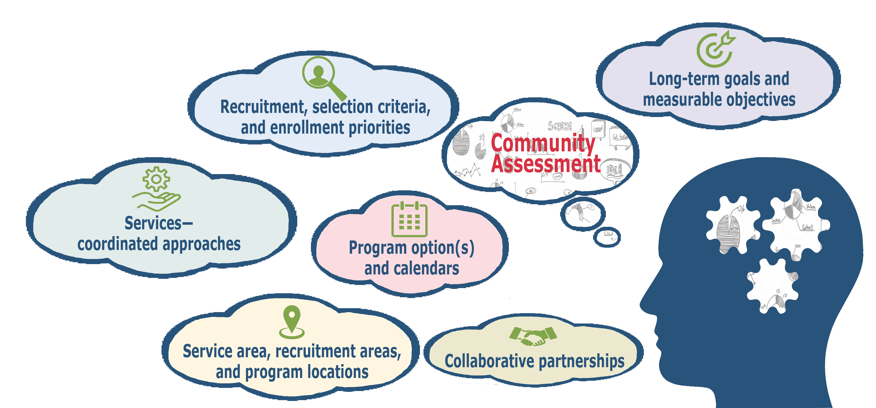
Decision Areas Informed by Community Assessment Data
Notes:
Slide 25
Facilitator Notes:
Give a mini-lecture on the types of decisions informed by the community assessment.
Say to Participants: “Community assessment data informs planning in several areas. It helps to develop long-term goals and
measurable objectives. Programs can also use the data to determine program options, such as Early Head Start or home visiting.
Decisions around service area, recruitment areas, and program locations can also be formed from community assessment data.
“Every year, programs must review eligibility, recruitment, selection, enrollment, and attendance (ERSEA) plans. The community
assessment data will inform changes to recruitment approach or selection criteria. For instance, you’ll want to look at program
services and coordinated approaches regarding services to all children, including those who are dual language-learners, in foster
care, who are experiencing homelessness, and who have disabilities, to make sure your program is serving these populations
adequately. The community assessment will also be helpful in establishing collaborative partnerships that will help you be more
responsive to children’s and families’ needs.”

Slide 26
The Community Assessment Update
Conducted annually
Identifies shifts in demographics and resources since last assessment
Notes changes in availability and assessments of publicly funded pre-K
Notes:
Slide 26
Facilitator Notes:
Call participants’ attention to the slide, which introduces the community assessment update process.
Say to Participants: “As you know, the community assessment is done once every five years. The other four years, programs must
review and update their community assessment to reflect significant changes. Changes may include the increased availability of
publicly funded pre-kindergarten, an assessment of how the community’s pre-K meets the needs of the parents and children, and
whether it is offered for a full school day.
“The annual review must also identify rates of family and child homelessness and shifts in community demographics and resources.
Those shifts could be in population, or they could be economic, environmental, or related to resources.
“Based on the community assessment, programs might decide to:
Convert existing slots to full school day or full working day slots
Convert existing Head Start slots to Early Head Start slots
Extend the program year
“As programs update their community assessment each year, they need to factor that new data into their ongoing planning
processes. For instance, they may need to add or revise a goal, or make revisions to objectives in existing goals.”

Slide 27
Conducting the Update
Reconvene the Community Assessment Team or subcommittee
Design your data collection strategy
Identify internal and external data sources
Assess the impact of new data
Incorporate new data into planning cycle
Notes:
Slide 27
Facilitator Notes:
Continue with your mini-lecture on the community assessment update.
Say to Participants: “Just as programs plan for community assessment activities, they need to plan for the update activities. Who
will do the work? Will it be the entire community assessment team, or a sub-committee? What data needs to be collected, and from
what sources? Remember to refer to the update requirements outlined in the HSPPS.
“The reason for doing the update is find out how changes in the community are affecting families and children, and how those
changes might impact your program. For instance, perhaps a large employer has left the community, resulting in higher
unemployment. Or maybe a new refugee or language group has moved into the community, meaning there are higher numbers of
dual language-learner children and families.”

Slide 28
Key Messages
Conducted once every five years and updated annually
Looks outward at the community
Employs a five-step process to collect many types of data from numerous sources
Informs program planning and supports continuous improvement
Notes:
Slide 28
Facilitator Notes:
Distribute the Which One Is It? handout and keep the answer key for yourself.
Say to Participants: “As we reach the end of Part 1 of this training on community and self-assessment, let’s look back on all that
we have covered.
“We touched on how community assessment links to the annual self-assessment. As we have said, the community assessment
looks outward at the community to see what’s needed, while the self-assessment looks inward to see how well the program
is performing.
“We looked at the purpose of the community assessment and explored the recommended five-step process for conducting a
community assessment.
“We talked about the importance of the community assessment for designing services that are responsive to the needs and
strengths of the community being served. We examined the community assessment decision-making areas as required in
the HSPPS. We also provided hands-on activities to deepen your understanding of the process and for you to practice skills
important for conducting a community assessment.”
Ask participants if they have any remaining questions or comments about what they have learned. If so, lead a brief discussion.
Direct participants’ attention to the Which One Is It? handout. Ask them to take three minutes to complete it. Then ask them if the
exercise was easy for them given what they have learned about self-assessment and community assessment.

Slide 29
Closing Reflections
What have I learned?
What excites or concerns me about what I learned?
What will I do with what I’ve learned?
*Adapted from: Professional Development Guides for implementing PFCE
Notes:
Slide 29
Facilitator Notes:
Guide participants to the Reflective Practice Tool handout.
As a closing reflection activity, explain that it is time for everyone to turn inward and think about what they have learned and what
they will do with this information.
Using the handout, direct participants to take a few minutes to reflect and write down their thoughts about the following questions on
the handout:
What have you learned?
What excites or concerns you about what you have learned?
What will you do with what you’ve learned?
If time permits, allow volunteers to share their responses aloud, and process the activity using the following questions:
What themes are emerging?
What insights do you need to remember?
How can you use these insights?

Slide 30
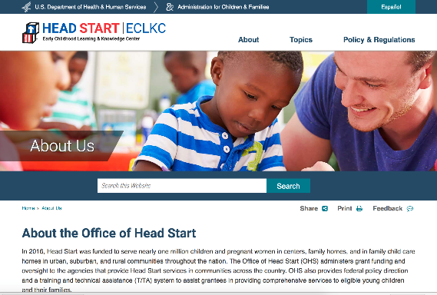
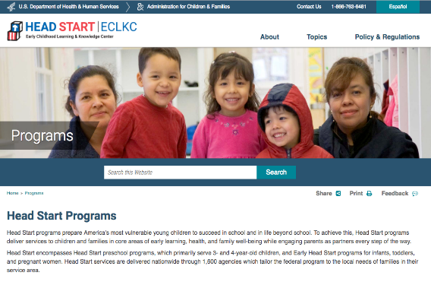
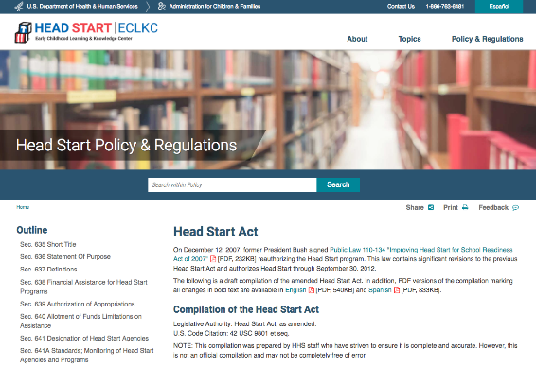
Related ECLKC Resources
About the Office of Head Start
https://eclkc.ohs.acf.hhs.gov/about-us/article/office-head-start-ohs
Head Start Programs
https://eclkc.ohs.acf.hhs.gov/programs/article/head-start-programs
Head Start Act
https://eclkc.ohs.acf.hhs.gov/policy/head-start-act
Notes:
Slide 30
Facilitator Notes:
Discuss additional resources with participants.
Say to Participants: “If you’d like to build your knowledge about Head Start, I want to call your attention to the resources on the
slide.
“The Early Childhood Learning and Knowledge Center, or ECLKC, also has several excellent resources on community assessment
and self-assessment. To find them, go to the ECLKC website and search for those terms.”

Slide 31


Contact PMFO
pmfo@ecetta.info
https://eclkc.ohs.acf.hhs.gov/ncpmfo
Call us: 888-874-5469
Notes:
Slide 31
Facilitator Notes:
Review the contact information on the slide with participants and invite them to reach out with questions or delve further into topics
discussed in this module.

